Slide 1

Cognitive Mid Atlantic CIO Forum
What will you do with Watson?
Nicole Bradley and Tom Mattox
IBM Watson Cognitive Solutions, Financial Services
https://www.youtube.com/watch?v=6SNs9kvRWSA

Slide 2
Cognitive business
ENHANCE EXPERTISE
Digital business +
Digital intelligence
GROW
KNOWLEDGE
FROM DATA
An organization that creates knowledge from data to expand virtually everyone’s expertise, continually learning and adapting to outthink the needs of the market
CHANGE MODELS OF ENGAGMENT
Notes:
COGNITIVE BUSINESS: DIGITAL BUSINESS + DIGITAL INTELLIGENCE
Our definition of a cognitive business is an organization that creates knowledge from data to expand virtually everyone’s expertise, continually learning and adapting to outthink the needs of the marketplace.
These three elements are the roots of what becomes possible for cognitive businesses.

Slide 3

1
Strategy: 2004 Cognitive Technology Research:
2011 Jeopardy; 2012 Incubator; 2014 Startup
2
Investment : per 2014 over $1B over the next several years, dedicating over 4000 professionals, and creating a $100M equity investment
3
Watson is not one product, it’s an Ecosystem of cognitive API’s

Slide 4
IBM Watson
The Waston that competed on Jeopardy! in 2011 comprised what
is now a single API—Q&A—built
on five underlying technologies.
Since then, Watson has grown to
a family of 28 APIs.
By the end of 2016, there will
be nearly 50 Watson APIs—
with more added every year.
Questions
&
Answers
Personality
Insights
Keyword Extraction
Image Link
Extraction
Decision
Optimization
Easy
Adaptation
Language
Detection
Relationship Extraction
Feed
Detection
Answer
Generation
Emotion
Analysis
Concept
Expansion
Dialog
Sentiment Analysis
Knowledge Graph
Knowledge Studio Service
^{Natural Language Processing}
^{Machine Learning}
^{Question Analysis}
^{Feature Engineering}
^{Ontology Analysis}
Visual
Recognition
Concept
Insights
Concept
Tagging
Usage
Insights
Decision
Support
Natural
Language
Classifier
Language
Translation
Message
Resonance
Risk
Stratification
Statistical Dialog
Text to
Speech
Retrieve
&
Rank
Taxonomy
Fusion Q&A
Criteria
Classification
Author
Extraction
Tone
Analyzer
Image
Tagging
Policy
Identification
Q&A
Qualification
Tradeoff
Analytics
Watson
News
Text
Extraction
Video
Augmentation
Knowledge
Canvas
Speech to
Text
Entity
Extraction
Face
Detection
Factoid
Pipeline
Case
Evaluation

Slide 5
Build toward outcomes and actions.
BUILD YOUR COGNITIVE BUSINESS STRATEGY
TAKE COGNITIVE ACTIONS
Create a
cognitive system.
IBM as your
team member.
Define the
desired outcomes
Assess your
data needs
Build cognitive
apps.
IBM as your
platform
Ready the organization
Give workflows
cognitive
capabilities.
IBM as your
provider
Enhance and expand
Assess infrastructure along the way
Notes:
BUILD TOWARD OUTCOMES AND ACTIONS.
When you’re putting together your strategy (left side), IBM can offer a cognitive value assessment to identify your gaps and build a roadmap for you.
The other thing you’ll do is decide what cognitive actions (right side) you will take first:
Use Watson APIs on Bluemix to start TODAY, building cognitive apps or customizing your business application
Give your workflows cognitive capabilities
Go for building a cognitive system from the ground up.

Slide 6
Watson is a cloud-based, open platform of expanding cognitive capabilities. With Watson, you can build cognition into digital labor applications, products and operations.
1. Build your own AI, securely
We have the only model that allows you to build your own AI vs contribute their data to a central knowledge graph. We have experience working with enterprises and organizations who need to keep their most critical information private and proprietary.
2. Access the most comprehensive AI platform in the market
Watson has deep sensory capabilities, in language, vision and speech. Watson can also interpret emotion, tone, and personality in multiple languages. Applications for Watson are far reaching. Watson is currently helping doctors cure cancer, and helping athletes use data to become faster and stronger.
3. Leverage the Rest of IBM
We are committed to getting you to the future first. With over 250,000 technical experts worldwide, IBM is uniquely positioned to provide a comprehensive portfolio in not only cognitive, but also security, design, research, Blockchain, and more.
An End-to End-Journey
Federal Income Tax Law
A Sample Journey
Smart Tax Lawyer
Q&A Support
Knowledge Complexity
R&D Analysis
Individual Tax Codes
Tax Transaction Analysis
Simple
Information Oriented
Work Complexity
Complex
Judgment Oriented

Slide 7
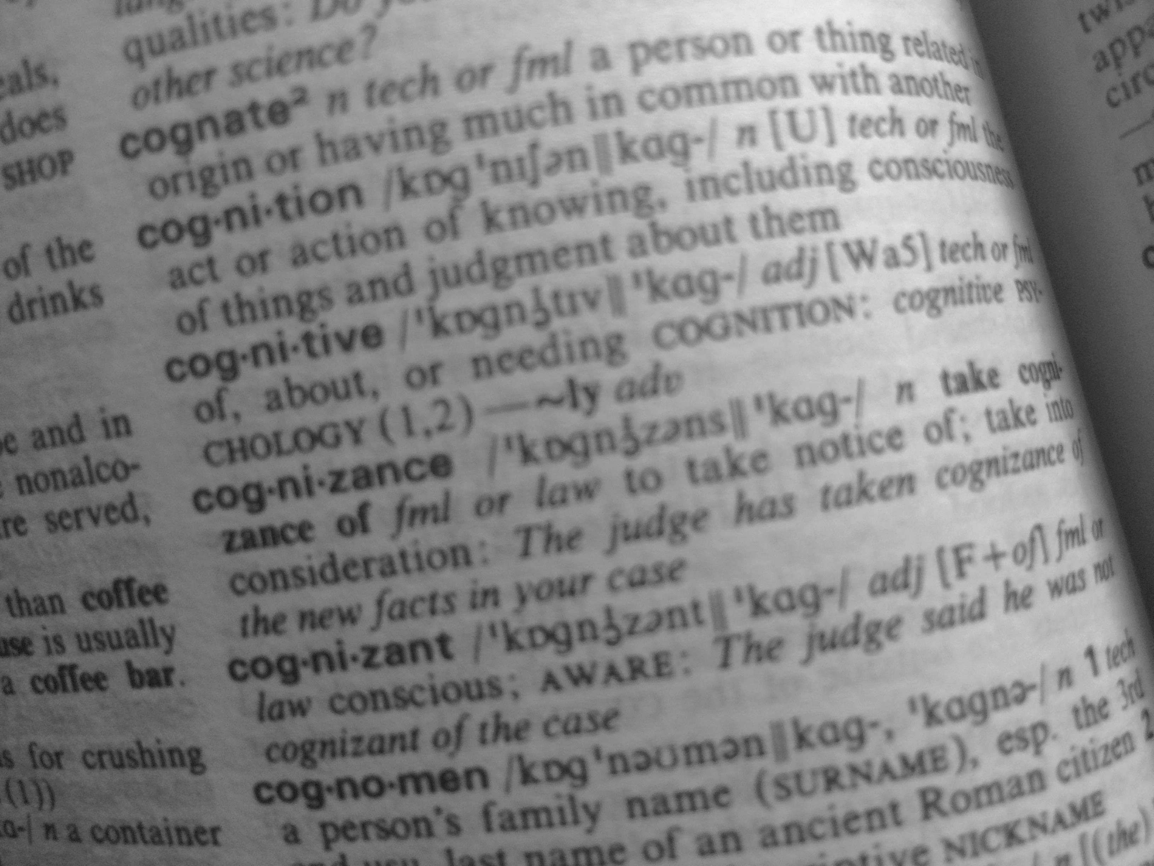
Language in Context
Learning From Experience
Obscene Amounts of Data
cognition |ˌkägˈniSHən| noun
the mental action or act of knowing,
including the context of things,
and judgement about them
Notes:
Enter Cognitive Technology
cognition |ˌkägˈniSHən| noun
the mental action or act of knowing,
including the context of things,
and judgement about them
LEARN means NO Q&A list !!!!

Slide 8

. Cognitive systems amplify human cognition.
UNDERSTAND
REASON
LEARN
INTERACT
Cognitive systems understand imagery, language and other unstructured data like humans do.
They can reason, grasp underlying concepts, form hypotheses, and infer and extract ideas.
With each data point, interaction and outcome, they develop and sharpen expertise, so they never stop learning.
With abilities to see,
talk and hear, cognitive systems interact with humans in a natural way.

Slide 9



Sensor Data
Internet of Things
New Data
Images
Tone Analyzer
Videos
Personality Insights
Social Media
News
External Data
Weather Data
Wellness Data
Geolocation, Telematics
Wikis, Blogs, ....
Account Information
Forecast Models
Intrnal Data
Treaty Data
Interaction History,
Notes, Correspondence
Perforamance History
Web Analysis

Slide 10
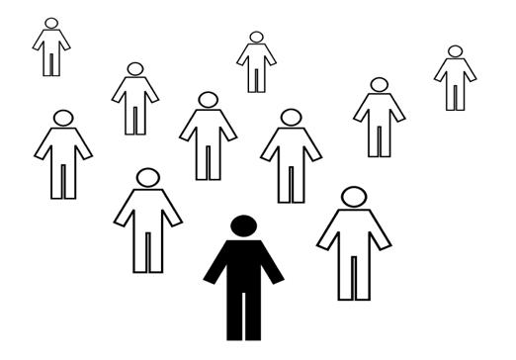
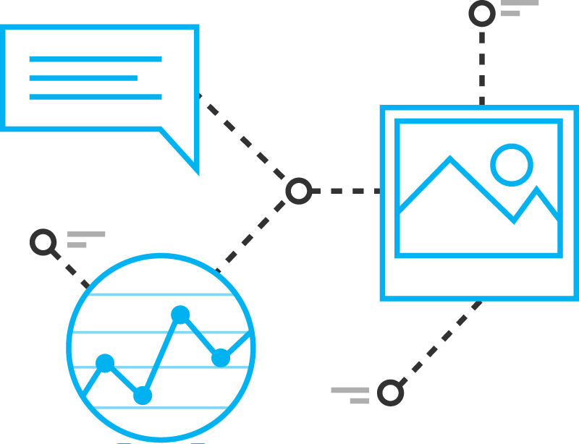

Foundations of Cognitive at IBM
Science
Simplicity
Scalability
Stewardship
We have the most sophisticated cognitive technology.
We have designed an open platform where leaders everywhere can innovate with cognitive.]
We bring IBM’s expertise in industries and professional domains to every cognitive endeavor.
We are the pioneers of cognitive, heavily committed tackling the world’s most complicated problems and educating both clients and future generations.
Watson is much more than artificial intelligence. It is a problem solving system that combines massive data processing power with reasoning and learning capabilities to surface insights and solutions on a scale that we never thought possible.
Accessible on the cloud through a number of APIs, Watson provides companies and organizations with the flexible building blocks and data connections to bring sophisticated new ideas to reality.
We not only create advanced technology like Watson; we help clients apply it within the context of an industry or profession to produce meaningful outcomes.
In addition to being the first company to implement cognitive solutions for clients, we are shaping the future for cognitive leaders by investing heavily in cognitive education for students.

Slide 11
IBM Watson
These APIs are underpinned by
50 technologies:
Anaphoric Co-referencing
Colloquialism Processing
Content Management -- Versioning
Convolutional Neural Networks
Curation
Deep Learning
Dialog Framing
Ellipses
Embedded Table Processing
Ensembles and Fusion
Entity Resolution
Factoid Answering
Feature Engineering
Feature Normalization
Focus and Spurious Phrase Resolution
HTML Page Analysis
Image Management
Information Retrieval
Knowledge (Property) Graphs
Knowledge Answering
Knowledge Extraction Annotators
Knowledge Validation and Extrapolation
Language Modeling
Latent Semantic Analysis
Learn To Rank
Linguistic Analysis
Logical Reasoning Analysis
Logistical Regression
Machine Learning
Multi-Dimensional Clustering
Multilingual training
n-Gram Analysis (word combinations and distance)
Ontology Analysis
Pareto Analysis
Passage Answering
PDF Conversion
Phoneme Aggregation
Question Analysis
Question-answering Reasoning Strategies
Recursive Neural Networks
Rules Processing
Scalable Search
Similarity Analytics
Statistical Language Parsing
Support Vector Machines
Syllable Analysis
Table Answering
Visual Analysis
Visual Rendering
Voice Synthesis

Slide 12



Transformed Engagement
Watson empowered interactive, personalized dialogues in natural language support sales and service
Digital Virtual Agent
Digital Virtual Agent Supporting questions across all platforms.
Significant improvements in measurable metrics like AHT, FCR and Customer Satisfaction.
Contact Center
Virtual agent to guide CSRs in resolving customer requests via a desktop application
Call deflection, increased customer satisfaction
Guided Experience
Virtual agent to guides applicants in completing complex forms and provides answers around complex topics
Improved accuracy of completion
Improved conversions

Slide 13




Applying Watson to engage with customers on prominent social channels will deflect calls from the call center and favorably impact NPS
Reduce Operating Cost | Improve Customer Satisfaction | Increase Opportunities To Sell | Reduce Customers At Risk
1
Quantitative KPIs
2
Qualitative Drivers
Increase Contact Deflection
Increase Customer Retention
Net Promoter Score (NPS)
Increased customer satisfaction
Customer engagement insights
Consistency of answers across channels
Increase Life time value

Slide 14
Watson Social CRM on a Page (Vision)
Symptoms
Today: Contact centers are managing more channels and channel management is getting more complex. Ineffective social efforts don’t change the metrics or contact volume.
A better approach is needed.
Poor customer experience
High Cost
High Customer Churn
High Agent turnover
Agent Training costs
Channel Complexity
Watson Social CRM can support multiple social media outlets in these Target Industries:
Telecommunications
Airlines
Financial Services
Media
Retail (high velocity, major chain)
Results
Tomorrow: Watson Social CRM will provide users with a consistent, unique and personal way of engaging with the organization via a variety of channels.
Contact Deflection
First Contact Resolution
Answer Consistency
Cross/up sell opportunities
Customer satisfaction
Net Promoter Score (NPS)

Slide 15
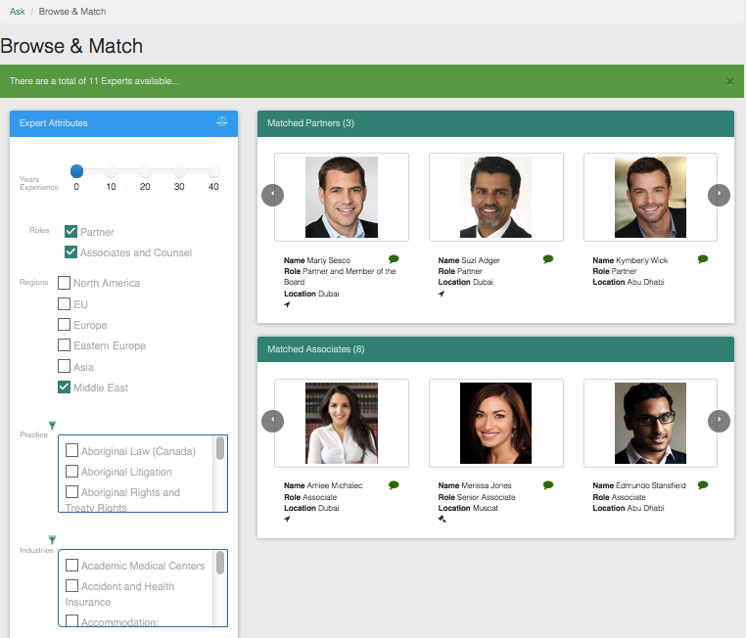
Leveraging Watson to locate expertise
Match expertise with relevant employee experience
Streamline a company’s internal discovery process for resource matching to projects
This pattern can be applied to any scenario where locating human expertise globally is essential to solving problems
15

Slide 16
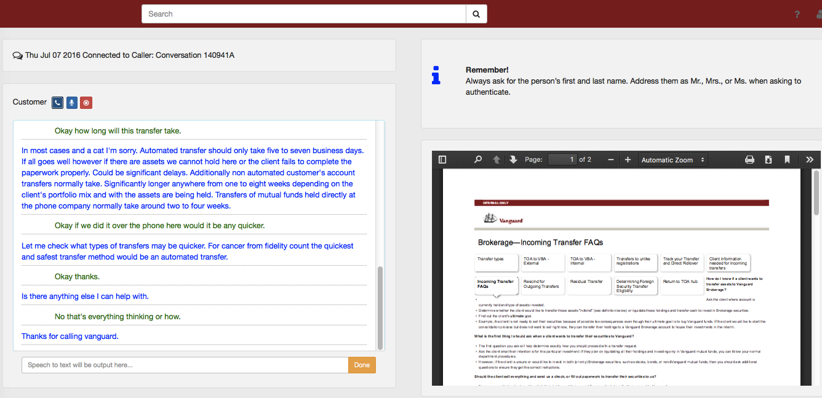
Leveraging Watson for Agent Assist
Listen into the conversation between the customer and agent, understand the intent of customer's and surface relevant information and actions for the agent
Enable agents to ask Watson for specific help when needed
16

Slide 17
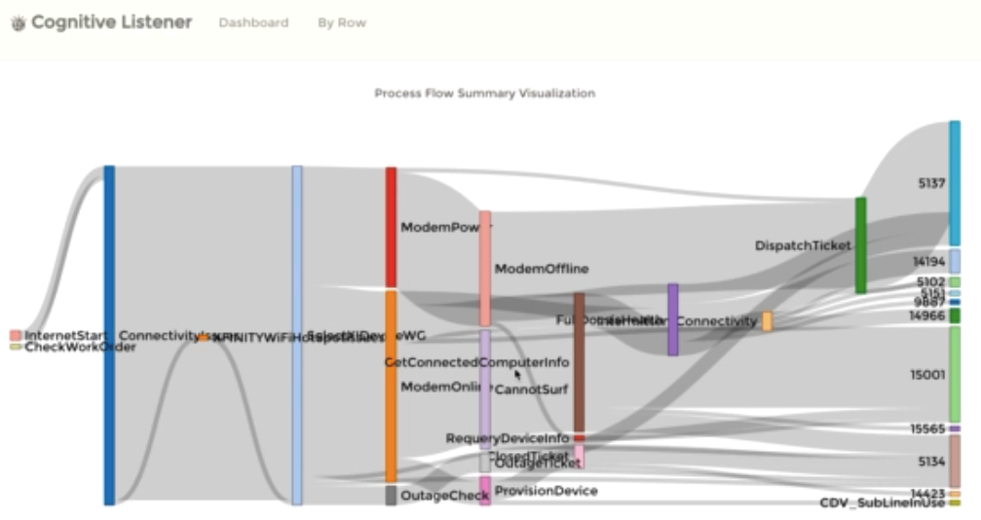
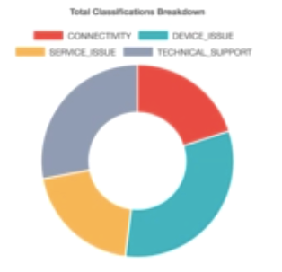
Watson drives deeper insights & analytics inside the contact center
Watson can assist an Operations Director in management of the contact center
Transcribe the calls and gain insights from them
Depict intent, extraction of entities and call workflow logic
Classify calls for the center based on an unstructured set of parameters
IBM Internal Use Only
17

Slide 18
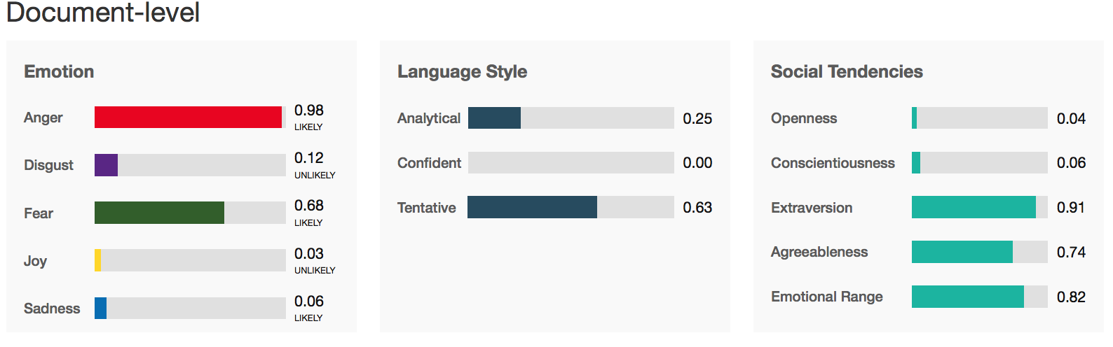
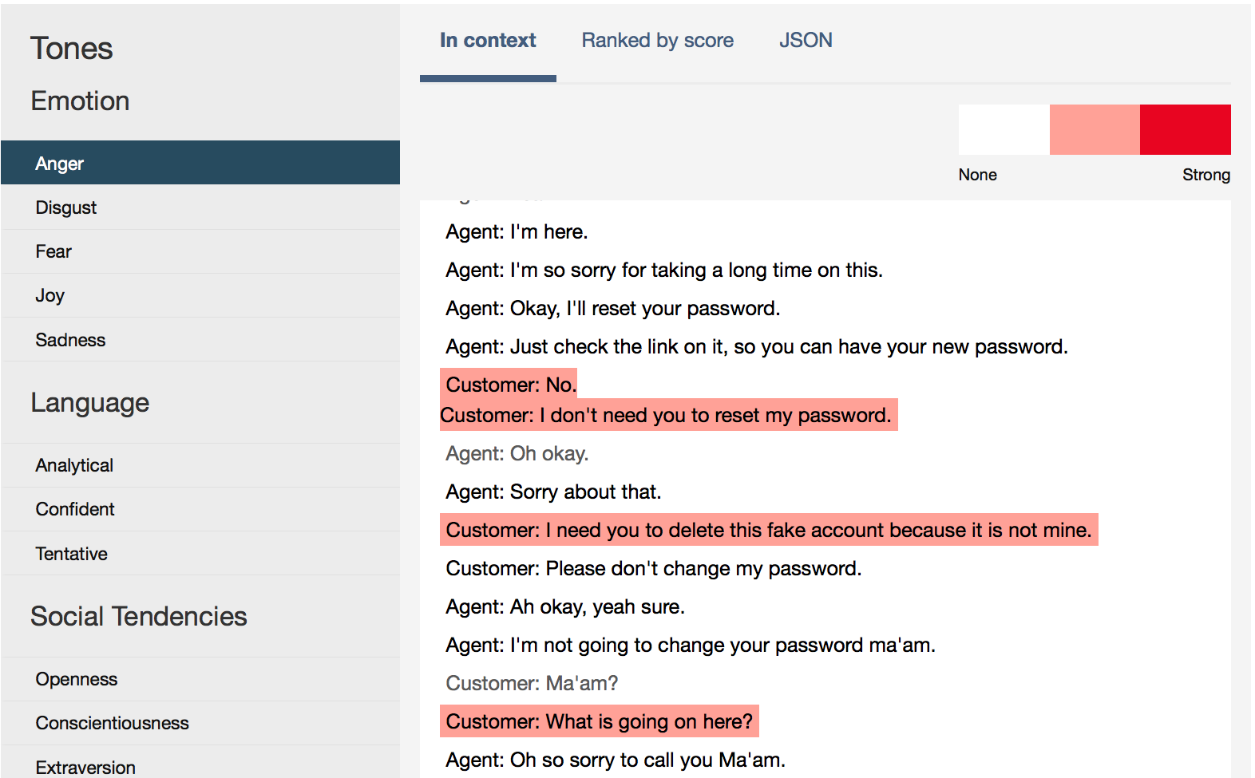
Tone Analyzer
Tone Analyzer understands and helps fine tune your message
Uses psycholinguistics, emotion analysis and language analysis to assess Tone
Notes:
Back-up slide if you don’t have online connection – otherwise hide
Emotional Tone
The emotion tones are derived from the patterns of using emotional words in people’s writing. We employ ensemble machine learning approaches in our model including matrix factorization, Support-vector-machine and other approaches. Our current approach extracts the emotional categories based on Plutchik’s model of emotions
Social Tone
Tone Analyzer derives openness, agreeableness, extroversion, emotional range and conscientiousness from the Big-5 model by mapping the words used with personality traits as proposed by Yarkoni. (Yarkoni, T. 2010)
Writing Style Tone
Uses natural language process and language parameters and metrics to detect the three writing tones.
- Analytical tone (causation, insight and exclusion);
- Tentative tone (inhibition, tentativeness and fillers);
- Confident tone (certainty)

Slide 19

What’s the cost of not being
a cognitive business?
Is someone else defining
your industry?
How much do you lose by not monetizing your data?
Will your customers leave for competitors that engage more personally with them?
Notes:
WHAT’S THE COST OF NOT BEING A COGNITIVE BUSINESS?
What will happen if you don’t become a cognitive business?
What are the consequences to your industry leadership? To your earning potential? To your competitive position?
If you can think of consequences, when do you think they might start happening? Have they already begun?

Slide 20
Thank you!

