Slide 1

Digital Transformation & the Workforce
Eusebio Scornavacca, PhD
Parsons Professor of Digital Innovation
Director, Center for Digital Communications, Commerce and Culture
John & Margaret Thompson Chair in MIS
Merrick School of Business
University of Baltimore
Maryland, USA

Slide 2



Development of a Digital Ecosystem
Key Technological Enablers
  Diffusion of the Internet
  Growth of wireless telecommunications
  Increased System Convergence & Fluidity
  Moore’s Law

Slide 3
Space
Work
Stationary
Home
Space
Time
Key disruptive aspects:
  Spatiality
  Temporality
  Interactivity
  Task support
Work
Networked
Internet Kiosk
Home
Time
Space
Work
Ubiquitous
Internet
Kiosk
Home
Time
= Physical Boundaries
= Tasks Supported by ICT
= Temporal and Spatial Continuum
= Virtual Organizational Boundaries
= ICT support not available
= ICT support available

Slide 4
So basically…
Advances in wireless connectivity, technology portability, data analytics made possible the emergence of a ubiquitous digital ecosystem that enables continuous support to individuals and enhances the affordances of objects.
Key technological characteristics:
  Connected
  Embeded
  Smart

Slide 5
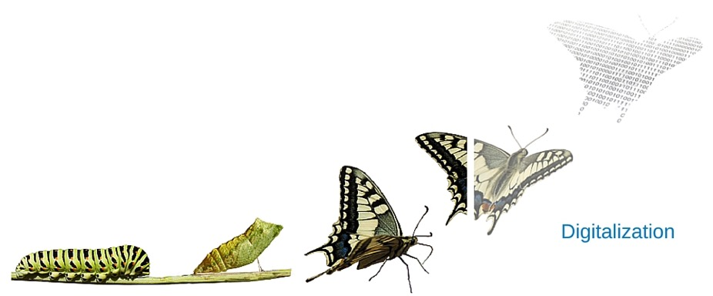

Key Digital Disruption Enablers
Digitalization & Decoupling
  function no longer constrained by form
Ubiquity & Embeddedness
  everywhere, everyone, in everything
Network Effect & Generativity
  combinatorial complexity drives extraordinary unanticipated innovation

Slide 6
Does it really change things in the workplace?

Slide 7





Context, Boundaries, Productivty

Slide 8




End-user Behavior & Social Norms
Digital Immigrant
Digital Native

Slide 9

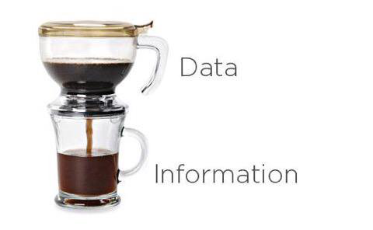
D.R.I.P.
Data Rich, Information Poor, Knowledge Miserable!

Slide 10



Digital Risk & Organizational Resilience
Security – Vulnerability
Digital Footprint
Resilience
Traceability
Privacy
Ethics

Slide 11
Is technological disruption of the workforce something new?

Slide 12
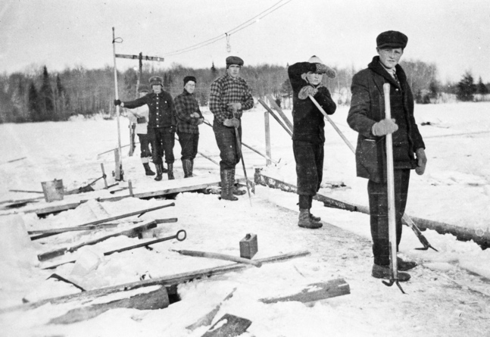
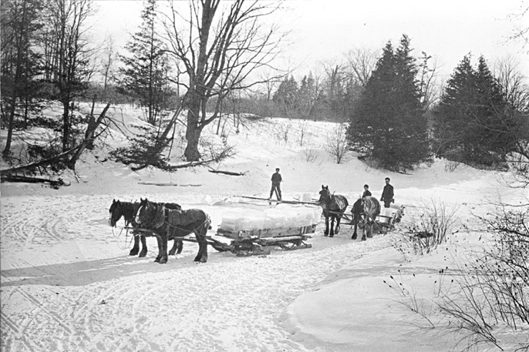
Not really…

Slide 13
4th Industrial Revolution
Fourth Industrial Revolution — Graphic by Christoph Roser

Slide 14
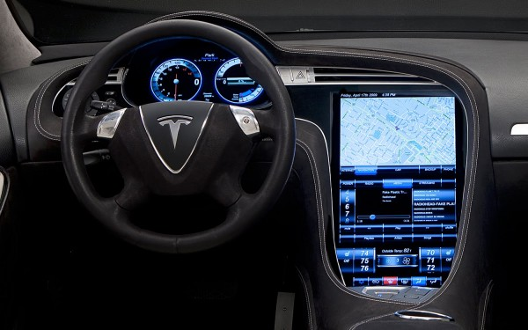
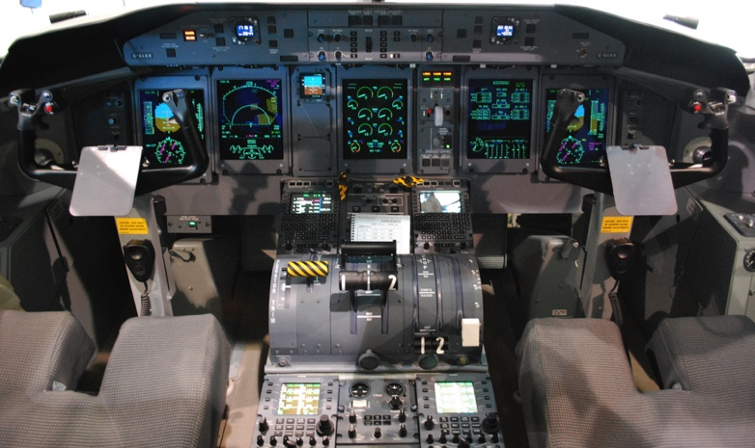

The diffusion of technologies result in to a series of changes the portfolio of skills we need to survive in society.
- Incremental technological dependence occurs when we substitute a skill for an affordance provided by this fluid digital ecosystem.
- The Automation-Augmentation Paradox
Technological Dependence &
Shifting Skills

Slide 15
What about Digital Transformation?

Slide 16

Digital Transformation
“Digital” is not all about technology
    Thinking digitally is different than thinking we are “Digital” (tech savvy).
Digital Transformation is about Transforming Organizations through the use of Digital Technologies, Business Models and Strategy to Improve Performance and, above all, Create Value to stakeholders.

Slide 17

Digital Transformation – Do or Die
The Forth Industrial Revolution is based on Digital Disruption and is dramatically changing industries and the skillset needed for a successful workforce.
The real question is: how long until you are in the crosses of the Digital Revolution??
In order to thrive (not only survive) in the Digital Economy companies must develop a Holistic Digital Transformation Strategy (including workforce)

Slide 18
The 4 “Sins” of Digital Strategies
1. Focus on disruptors rather than disruption
  The focus should be on the disruptions occurring in your industry, not exclusively on the disruptors.
2. Technology-focused, siloed digital strategy
  Too much attention on ‘digitalization’ of silos as the ultimate goal instead of looking holistically at the organization. The main goal should be value creation and enhancing performance.
3. Digital disruption is not the only source of disruption
  While digital disruption is extremely relevant, this does not mean we can overlook more traditional forms of disruption.
4. Fail to focus on change management
  Focus on change management is fundamental for successful digital strategies.

Slide 19
Key Challenges
Based on a global survey of more than 4,300 managers, executives, and analysts, MIT Sloan Management Review and Deloitte’s

Slide 20
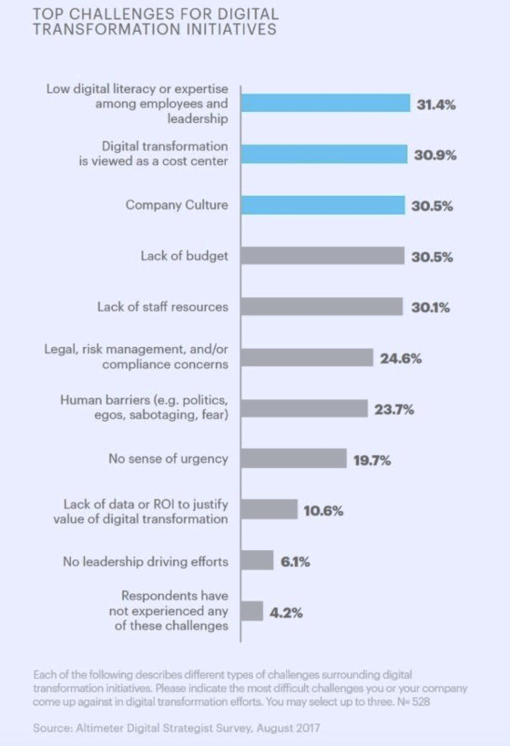
Top Challenges
We must to develop key organizational capabilities and individual competences in order to future-proofing businesses and workforce.

Slide 21
Organizational Capabilities and Individual Skills

Slide 22
Future-proofing Businesses:
Organizational Capabilities
 | Capability | Explanation
1. | User Engagement | Engaging users’ in value co-creation and combining seamlessly the physical and digital experiences.
2. | Hyper Awareness | Capability to understand and identify emerging patters that will affect the organization.
3. | Anticipatory Decision Making | Analyze information that comes through hyperawareness and predict trends as well new areas of impact.
4. | Operational Agility | Resources in the organization have to be flexible.
5. | Constant Innovation | Innovation is promoted by the leveraging of new technologies affordances.
6. | Creative Business Model | Reconfiguring value delivery models by using technology to connect products, services and information in order to gain competitive advantage.

Slide 23
Redefining the skillset

Slide 24
Digital Workplace
Based on a global survey of more than 4,300 managers, executives, and analysts, MIT Sloan Management Review and Deloitte’s

Slide 26
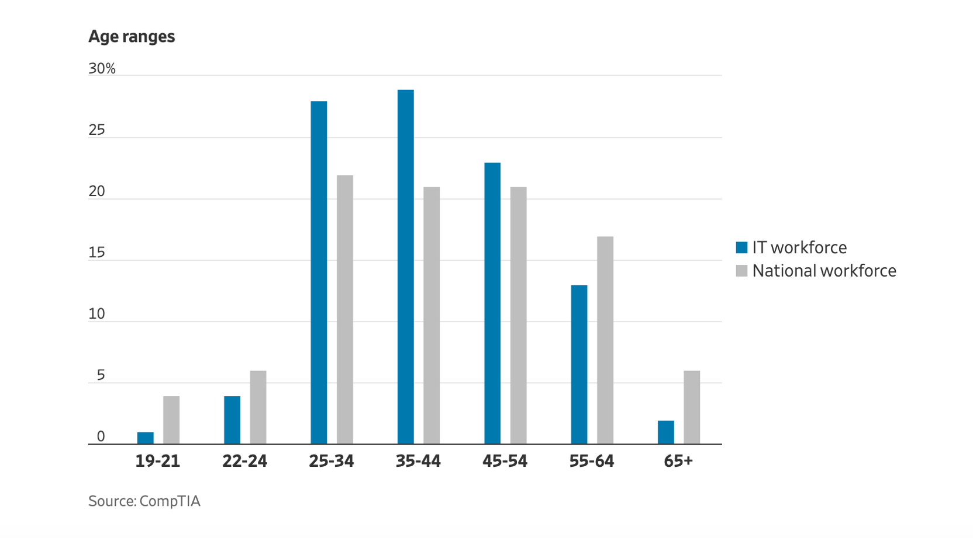
IT Jobs for the Ages
Information technology jobs skew young, with workers aged 22 to 44 accounting for 61% of the IT sector workforce in 2019.

Slide 27
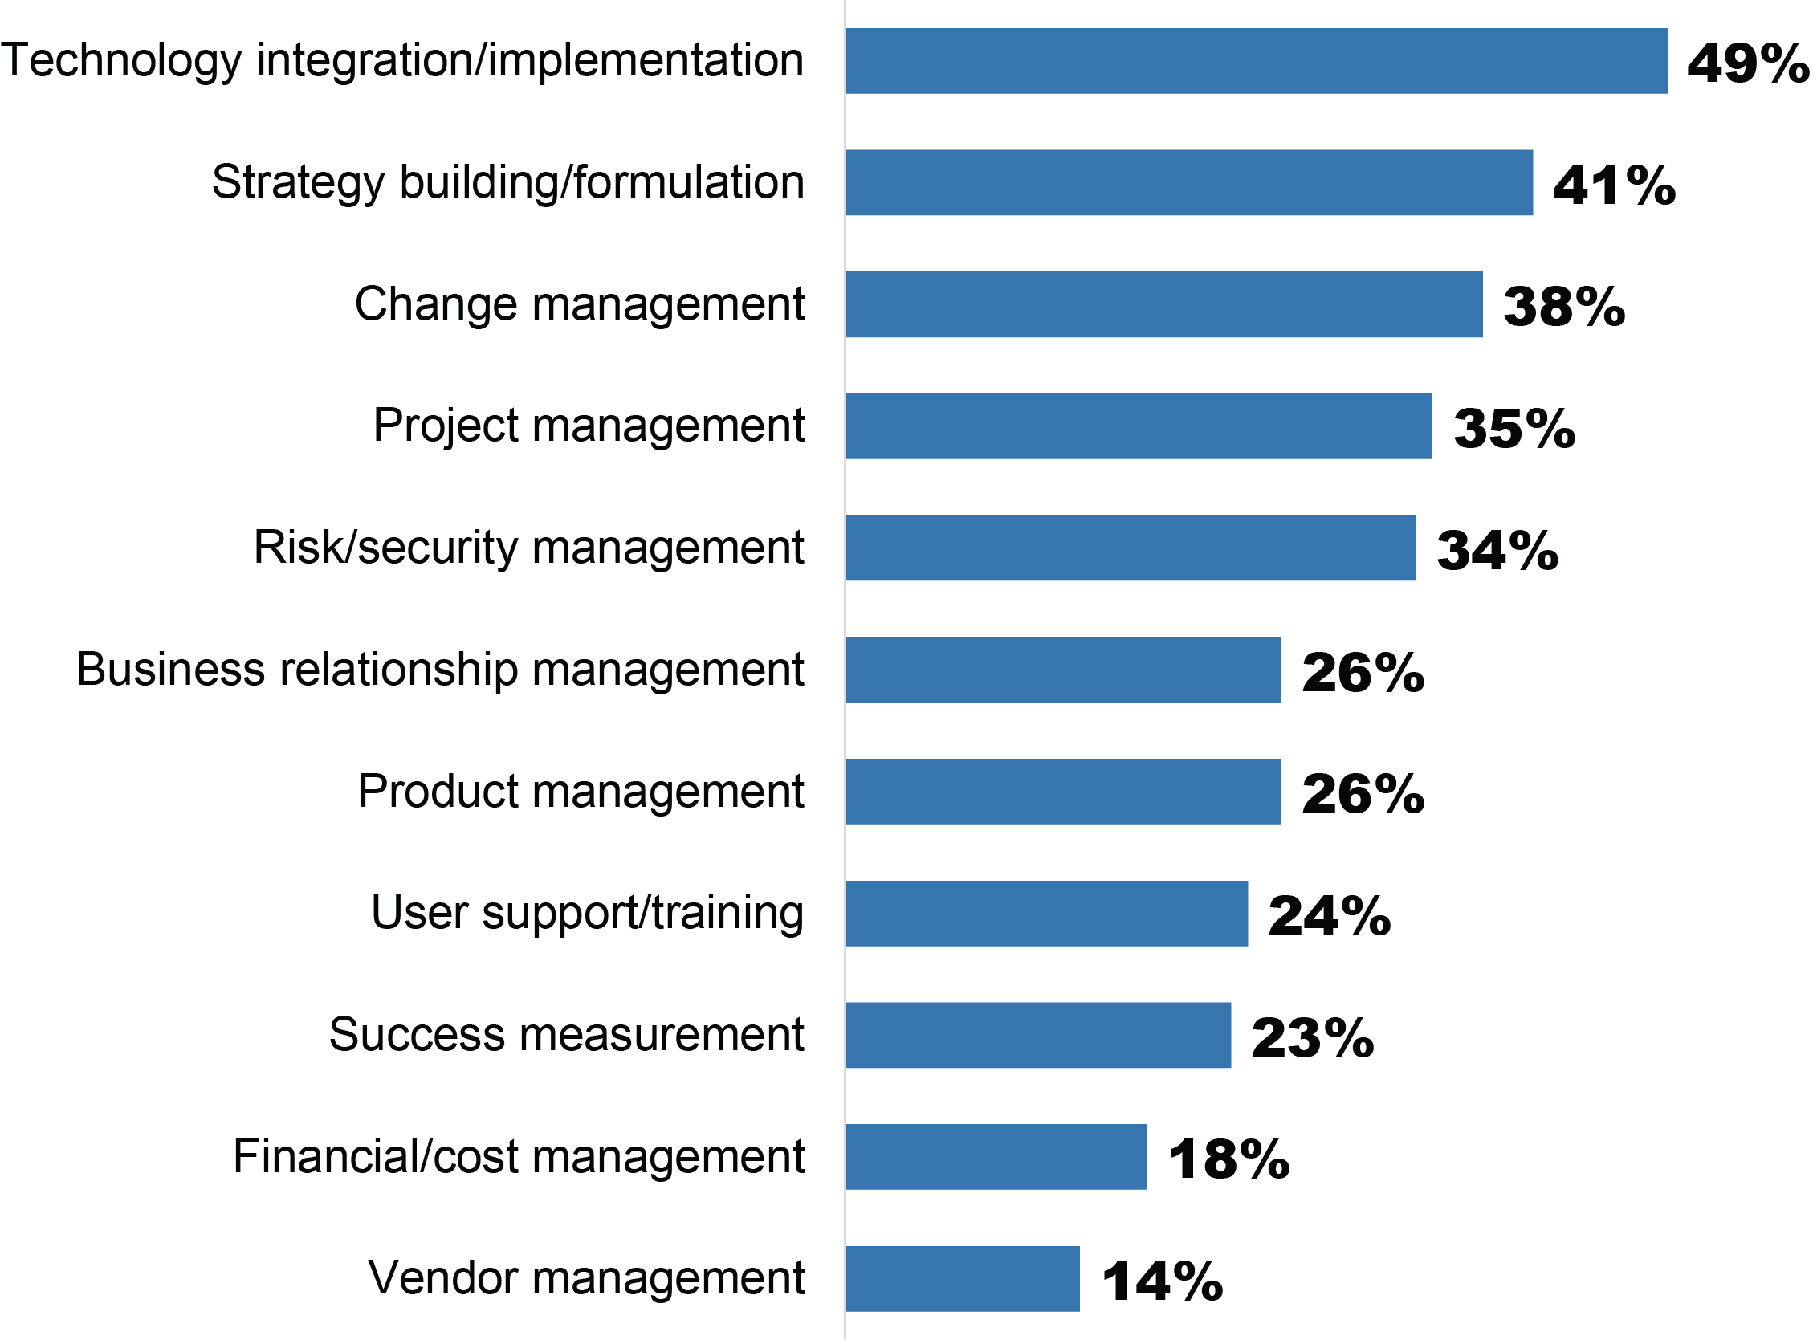
Skills needed to Support Digital Initiatives
IDG - THE 2020 STATE OF THE CIO

Slide 29
Future-proofing the Workforce:
Individual Competences
 | Competence area | Examples of Domains
1. | User Experience | User experience design Logic and creativity combination Interface Design
2. | Data Analytics | Data leverage (algorithms) Business analysis Big data analytics
3. | Emerging Technologies | Mobile and HTML5 Blockchain Cloud IoT
4. | Cyber Risk | Risk management Network security Cyber security management Cyber Leadership
 | Competence area | Examples of Domains
5. | Digital Communications & Content | Social media Content management Social networks Digital Entertainment Digital Design
6. | Business Soft Skills | Change management Innovation Entrepreneurship Business modeling Critical thinking Collaboration Leadership
7. | Digital Civility | Intellectual Property Ethics Cyber Law Privacy Management Digital Citizenship

Slide 30
The need for workforce development
Based on a global survey of more than 4,300 managers, executives, and analysts, MIT Sloan Management Review and Deloitte’s

Slide 31
Keep going….
Based on a global survey of more than 4,300 managers, executives, and analysts, MIT Sloan Management Review and Deloitte’s

Slide 32
Case: developing the
MS in Cybersecurity Management

Slide 33
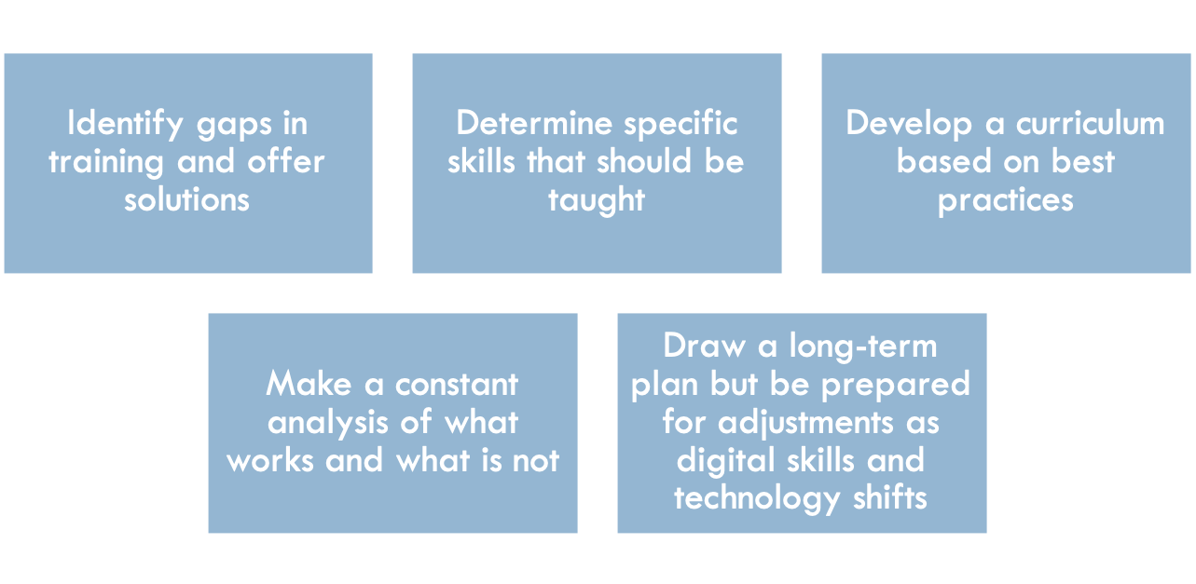
Process

Slide 34
Areas of Competency
The program requires 30 credits of coursework in five areas of competency:
Business Fundamentals
Decision-making and Analytics
Ethics and Law
Information Security Management
Leadership and Human Behavior

Slide 35
Beyond disciplinary boundaries…
 | Leadership & Human Behavior | Decision Making / Analytics | Business Fundamentals | Ethics / Law | Information Security Mgmt
Foundation (3) |  | Opre 505+506 Stats I+II
Core (19.5) | Mgmt 605 (1.5) Leading with Integrity | Opre 605 (1.5) Business Analytics | Acct 505 (1.5) Accounting Essentials | FSCS601 (3) Legal Issues in High Tech Crime | Inss 605 (3) IT for Bus Transformation
 | Appl 603 (3) Learning & Cognition |  |  |  | Inss 703 (3) Principles of Info. Sec Mgmt
 | OPM 615 (3) Innovation & Project Mgmt
Electives (7.5) | Mgmt 615 (3) Managing in a Dynamic Env. Mgmt 730 (3) Leadership, Learning & Change | Inss 611 (1.5) Data Science Toolkit I Inss 612 (1.5) Data Science Toolkit II | Acct 601 (3) Forensic Acct Principles | Acct 604 (3) Litigation Support Acct 701 (3) Accounting Ethics
 | Appl 641 (3) Organizational Psychology Appl 642 (3) Motivation, Satisf. & L’ship |  | Inss 621 (1.5) Digital Innovation Inss 622 (1.5) Digital Transformation
Capstone (3) | INSS 753 (3) Info Sec & Bus Continuity

Slide 36
Future-proofing the workforce

Slide 37
Tackle The Widening Skills Gap
A systemic holistic approach is necessary
  Look for nontraditional applicants.
  Incentivize employees to continue their education.
  Interact with educators regularly.
  Address the knowledge gaps by upskilling your team.
  Advocate for policy changes.

Slide 38
Invest in People
Integrate People and Strategy
Demonstrate to Employees They Are Valued
Invest In Workforce Development
Develop a Disruption-Ready Culture
Create a Workplace Experience that Matches what Employees Look for:
    Meaningful
    Personalized
    User-friendly
    Digital.

Slide 39
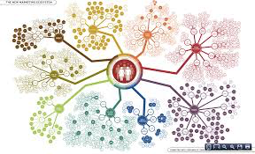
Final remarks
Digital Disruption is revolutionary.
Digital Business Transformation Strategy must be holistic and foster the development of key organizational capabilities as well as individual competences.
Skill shortage is an ecosystem issue
Don’t wait until is too late - start future-proofing your workforce now!

Slide 40
Digital Transformation & the Workforce
Eusebio Scornavacca, PhD
Parsons Professor of Digital Innovation
Director, Center for Digital Communications, Commerce and Culture
John & Margaret Thompson Chair in MIS
Merrick School of Business
University of Baltimore
Maryland, USA

