Slide 1


Effective Strategies for Today’s Workforce
Franklin Reed
Director of Inclusion and Diversity

Slide 2

Well networked
We’re part of the Allegis Group family, a $12B+ enterprise

Slide 3



Sourcing Strategy
Data –Driven Hiring Goals
Hiring Strategy

Slide 4
Scope of the Labor Market
The IT unemployment rate has been consistently low for the last decade,
meaning IT talent is more and more difficult to find.
¹
4.7 million
IT workers
UNEMPLOYMENT RATE: Q1’19
3.8% for all occupations
2.1% for IT talent
160
million
workers
TEMPORARY WORKERS
10%
of the current total workforce
20%
IT Workforce
Overall Workforce
of the IT workforce

Slide 5
Annual Unemployment Trends
Over the last decade the IT unemployment rate is roughly half the overall unemployment rate in the U.S. and
since 2010, the IT talent market has continued to tighten, meaning IT talent is more and more difficult to find.

Slide 6


SOURCING STRATEGY

Slide 7
Diversity Sourcing Strategy
Diverse IT Organizations
Veterans & Disabilities Networks
Technology Boot Camps
Specialized & Targeted Searches
Diverse IT Associations
Local Diversity Focus Events
QUALIFIED DIVERSE IT TALENT

Slide 8

Partnerships
Engage and attract underrepresented groups through strategic partnerships and collaborations.

Slide 9







In good company
Collaborating with diverse IT organizations and associations, corporate talent sources, and technology boot camps brings you a brilliant workforce.

Slide 10












Hand-in-hand
To gain access to diverse pools, established partnerships with national and local organizations that engage veterans and overlay that into your sourcing strategy.
We’ve received numerous awards for our work with veterans.

Slide 11

DATA DRIVEN HIRING GOALS

Slide 12
Gender of IT Workers in the U.S.
Occupation Gender Breakdown (2019)
Occupation Total | % of Occupation
3,523,432 | 74.3%
1,218,569 | 25.7%
Notes:
Source: Economic Modeling Specialists International (EMSI)

Slide 13
Ratio of Female IT Workers by Occupation
Across tech roles, women represent an average of 25.7% of the workforce.
Occupation | Total Employed | Women | Men | % Female within Occupation
Technical Writers | 51,930 | 28,132 | 23,798 | 54.2%
Computer Operators | 51,252 | 22,973 | 28,279 | 44.8%
Database Administrators | 118,291 | 43,542 | 74,749 | 36.8%
Computer Systems Analysts | 595,312 | 207,076 | 388,236 | 34.8%
Web Developers | 131,703 | 41,246 | 90,457 | 31.3%
Computer and Information Systems Managers | 378,331 | 108,068 | 270,263 | 28.6%
Computer Network Support Specialists | 205,716 | 55,755 | 149,961 | 27.1%
Computer User Support Specialists | 691,779 | 184,597 | 507,182 | 26.7%
Computer Occupations, All Other | 337,866 | 85,494 | 252,372 | 25.3%
Information Security Analysts | 110,899 | 25,213 | 85,686 | 22.7%
Computer Programmers | 253,527 | 57,250 | 196,277 | 22.6%
Software Developers, Applications | 862,739 | 176,178 | 686,561 | 20.4%
Software Developers, Systems Software | 402,211 | 81,890 | 320,321 | 20.4%
Network and Computer Systems Administrators | 389,576 | 76,725 | 312,851 | 19.7%
Computer Network Architects | 161,137 | 24,428 | 136,709 | 15.2%
Grand Total | 4,742,001 | 1,218,569 | 3,523,432 | 25.7%
Women represent an above-average portion of the workforce in these roles
Notes:
Source: Economic Modeling Specialists International (EMSI)

Slide 14

HIRING GOALS

Slide 15



Partnership, the active ingredient
Transformation never plays solo
Helping you achieve your goals is our purpose. We’re skilled listeners committed
to a partnership with you.
We work on your terms and in your best interest- adding real value to what you do and how your do it.
The best results for intentional diversity efforts require…
The Right Role
A Diversity Champion (Hiring Manager)
A Timetable

Slide 16
Attrition for Women in Tech
According to the National Center for Women & Information Technology, it is suggested that female attrition in tech
can be largely attributed to workplace conditions, limited access to key roles and feeling stalled in one’s career⁴.
The quit rate among women is more than twice as high as it is among men.
Notes:
Source:
4.) The National Center for Women & Information Technology (NCWIT)
https://www.ncwit.org/sites/default/files/resources/womenintech_facts_fullreport_05132016.pdf
“Evidence suggests that workplace conditions, a lack of access to key creative roles, and a sense of feeling stalled in one’s career are some of the most significant factors contributing to female attrition from the tech field.“

Slide 17
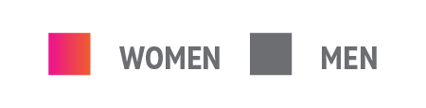
FOSTERING TALENT
developing TALENT
retaining TALENT
34%
don’t have a positive/respectful work environment
55%
aren’t satisfied with
the number of females
in senior or executive leadership roles
76%
aren’t satisfied
with the mentorship programs
30%
don’t believe their manager treats them fairly
44%
aren’t satisfied with the opportunity to work on engaging projects

Slide 18
are thinking about switching careers in the next 1-3 years
35%

Slide 19

Upskilling and Talent
Kim Sneeder
Managing Director, CareerCircle

Slide 20

Global Technology Labor Deficit

Slide 21

Upskilling and Building Talent Pipelines
There will be a talent shortage of 85.2M people by 2030 according to Korn Ferry.
There is a call to action to find solutions to combat the pending skills gap statistic versus falling victim to it.
Putting organizations back in control using a proactive vs. reactive approach to talent acquisition by aligning available talent pools with in-demand skills training.
CareerCircle strives to:
  Help solve the skills gap problem
  Create newly qualified and prepared professionals
  Know what positions are in-demand
  Provide access to new career opportunities

Slide 22
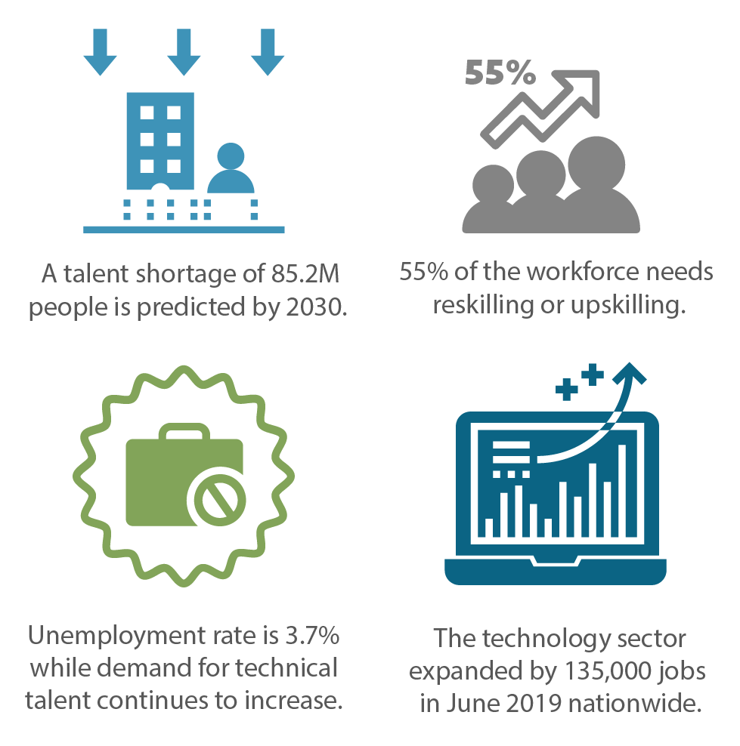
Consideration 1
Does your current talent supply support the demand for new capabilities and technologies?

Slide 23
Consideration 2
Are your corporate learning and development programs keeping up with the demand for new skills?

Slide 24
Consideration 3
What project is at risk and what are the skills missing on your current team?

Slide 25
Consideration 4
What is your plan to address the pace of technology change and impact it has on your business?

Slide 26


Slide 27




Keys to Building Talent Pipelines
FEEDER SKILLSETS
Identify individuals with transferable skills who are interested in upskilling
UPSKILL
Train individuals on the latest skills in partnership with top e-learning providers
PLACE
Multiple options from apprenticeships to internships to address the gap between education & application
SUPPORT
Provide organizations with newly upskilled talent pipelines to address current and future needs
1.
2.
3.
4.

Slide 28


Final Thoughts
Building Talent Pipelines to Optimize Full Revenue Potential

Slide 29
THANK YOU!

