Slide 1
New and Emerging Privacy Laws
Kathryn Fox, Privacy Officer
Cystic Fibrosis Foundation

Slide 2
California
California Privacy Rights Act
In effect January 2023, lookback to January 2022
Sensitive personal information definition added
Added sharing to sale provisions
Correction and limitation of use rights added. Deletion given more rules.
Change in opt-ins for minors.
4 new rights: correction, limit use and disclosure of sensitive personal information, access to information about automated decision-making logic and right to opt out.
Retention period transparency, data minimization, purpose limitation
California Privacy Protection Agency
Define cross-context behavioral advertising, profiling, and dark patterns
New exemptions: emergencies, research, employees.

Slide 3
Virginia
Consumer Data Privacy Act
Passed in early 2021, effective date January 2023
Scope:
Any controller who conducts business in VA or produce products/services targeting VA residents and:
Control or process personal data of over 100k residents
Control or process personal data of 25k residences and derive at least 50% gross annual revenue from sale
Sale does not include non-monetary consideration
Business obligations:
Collection and use limited to what is necessary
Sensitive data may only be processed with consent
Administrative, technical, and physical data security
Data protection assessments
Privacy policy transparency
30-day cure period before Attorney General enforces
Notably, does not mention dark patterns

Slide 4
Colorado
Colorado Privacy Act
Passed mid-2021, effective date July 2023
Scope:
Any controller that does business in CO or produces/delivers products or services targeting CO residents and
Controls or processes personal data of 100k residents yearly
Derives revenue or receives discount on goods or services from sale of personal data and processes/controls data of 25k consumers
Sale includes non-monetary consideration
Controller obligations:
Transparency (privacy notice)
Purpose specification (data minimization)
Care (security precautions)
Non-discrimination
Data protection assessments
No private right of action
60-day cure period, right to cure ceases January 2025

Slide 5
Proposed/ Introduced
Washington Privacy Act
Template for other acts that have passed
No private right of action
Not applicable to non-profits or institutes of higher education until 2026
New York Privacy Act
Fiduciary duty of controllers
Ohio
More comprehensive requirements for privacy notice as well as ways to submit a data subject request
NIST Privacy Framework affirmative defense

Slide 6
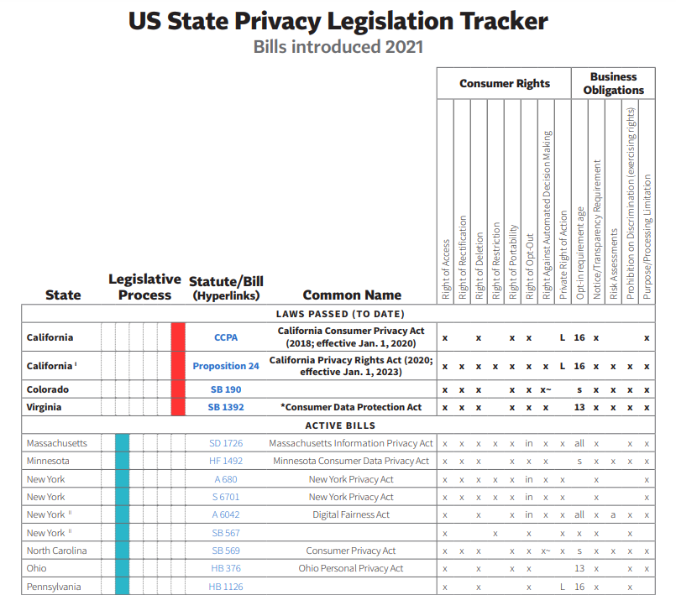
IAPP tools
*International Association of Privacy Professionals, 9/16/2021, iapp.org/resources/article/us-state-privacy-legislation-tracker

Slide 7
Federal proposed
There were approximately 24 unique laws that have been proposed in Congress, as of the end of August.
COVID-19, large tech regulation driving need
Some are comprehensive, some narrow to one topic, like COVID-19 health data privacy or prohibiting vaccine passports or mandates or even developing privacy technology or contact tracing
Laws to change children’s privacy
“Plain English” requirements for privacy policies, service agreements
One establishes new agency to regulate high-risk processing

Slide 8
Trends
Large focus on data subject rights and technical tools to implement them
Specifically, number of different ways to request and conspicuousness of ways to request
Most laws defining children as under 13, but that is not universal
Private right of action debate
Profiling and cross-context behavioral advertising
Dark patterns and transparency
Focus on prohibiting businesses from using data contrary to what consumers think they will do

