Slide 1
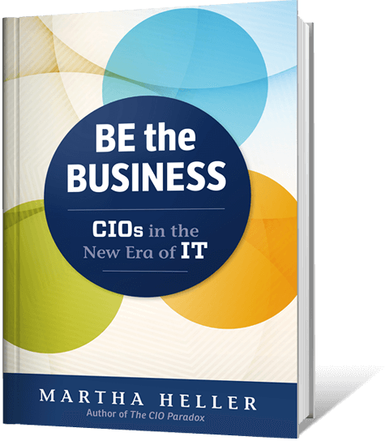
Top Skills for Today’s CIOs
By Martha Heller | CEO
@marthaheller

Slide 2
Digital Leadership
What is digital?
Digitization:
Automation (S/4HANA)
Customer Engagement
Transformation:
Platform Business Model
Lexmark & Alorica
Chief Digital Officer

Slide 3
IT Business Partnership
Scale of 1-10
Embedded IT
Training and Culture
Ask the right questions
Driving the enterprise solution
Product/Capabilities Management
Aligns to value streams
Customer acquisition
Hire to retire

Slide 4
Team Leadership
From IT to Engineering
Data Scientists
Product Managers
IT/OT
AI?

Slide 5
Data & Analytics
The Reality
Data Democratization
Education
Use cases
GenAI impact

Slide 6
Transformation
Traditional
Architecture
Digital
Organizational
From delivery to design and governance
COO, CDO, P&L leader
Notes:
managing the whole process from creating a vision through development then delivery, monitoring and then refinement.

Slide 7
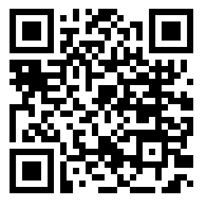
Discussion
hellersearch.com
@marthaheller

