Slide 1
Digital Transformation: A Focus on Cybersecurity/AI Education and Research
Towson University
Sidd Kaza, January 18, 2024

Slide 2
Digital Transformation
Key Highlights
Doctoral level research programs at TU
Cyber4All Center and the focus on cybersecurity education and research
Significant work in AI and Cybersecurity by faculty members
What does Digital Transformation mean to future of Cyber education
Towson as a Techhub
Notes:
TU is a regional workforce powerhouse. Which is a known.
Go through program numbers, each being transformed by tech and now AI.
Today I will highlight some aspects of TU that you may not have heard of - research, innovation in education with a focus on tech.

Slide 3
Notes:
TU is a regional workforce powerhouse. Which is a known.
Go through program numbers, each being transformed by tech and now AI.
Today I will highlight some aspects of TU that you may not have heard of - research, innovation in education with a focus on tech.

Slide 4
Doctoral Programs
Ph.D. in Information Technology
Ph.D. in Instructional Technology
Ph.D. in Occupational Science
Research on cybersecurity, artificial intelligence, human computer interaction, data science.
Research on innovative pedagogy, AI in Teaching, Virtual Reality and Immersive Learning.
Cutting-edge techniques to help individuals navigate the world. Including some innovative work on devices.
Ph.D. in Autism Studies
OTDs in Occupational Therapy
AuD in Audiology
Multidisciplinary research in autism across three colleges in the university. Technology is transforming how individuals on spectrum thrive.
Focused on producing practising OTs with the skills to incorporate technology to improve patient outcomes.
Research on devices to augment hearing in noisy environments, enhancing sounds, transcription.

Slide 5
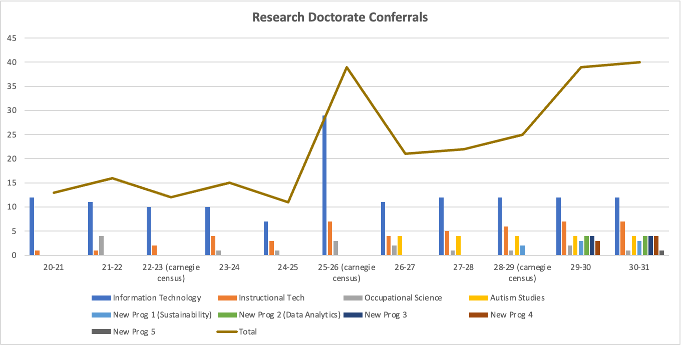
PhD Programs - they define the future
Many programs are applied and interdisciplinary in nature and will be influenced by technology, using it to solve problems.
There is a need to focus on technology-driven curriculum and research infrastructure to support the growth strategy.

Slide 6
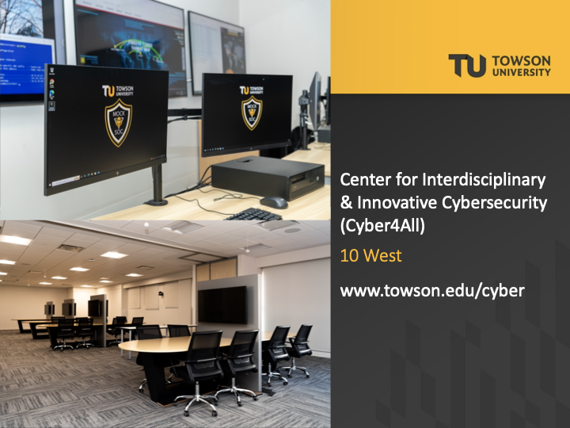
Mantra:
Cybersecurity is everyone’s business
Notes:
Not just a technical problem
Every major has to play - it is a human problem

Slide 7
Mantra:
Think like the adversary
Notes:
Diverse teams innovate faster
Diverse teams bring different research methodologies
Diverse teams are culturally sensitive

Slide 8
Towson University's approach to Cybersecurity Education
Integrated cybersecurity across the curriculum - an introduction to cyber course for all computing majors
Hands-on training in state-of-the-art cyber exercise labs - our first cyber defense lab was built in 2001
Expert faculty with both research and industry experience
Emphasis on real-world simulations and case studies - designated by the NSA as a Center of Excellence in Cyber Operations
Notes:
NSA CO (1 of 21)

Slide 9
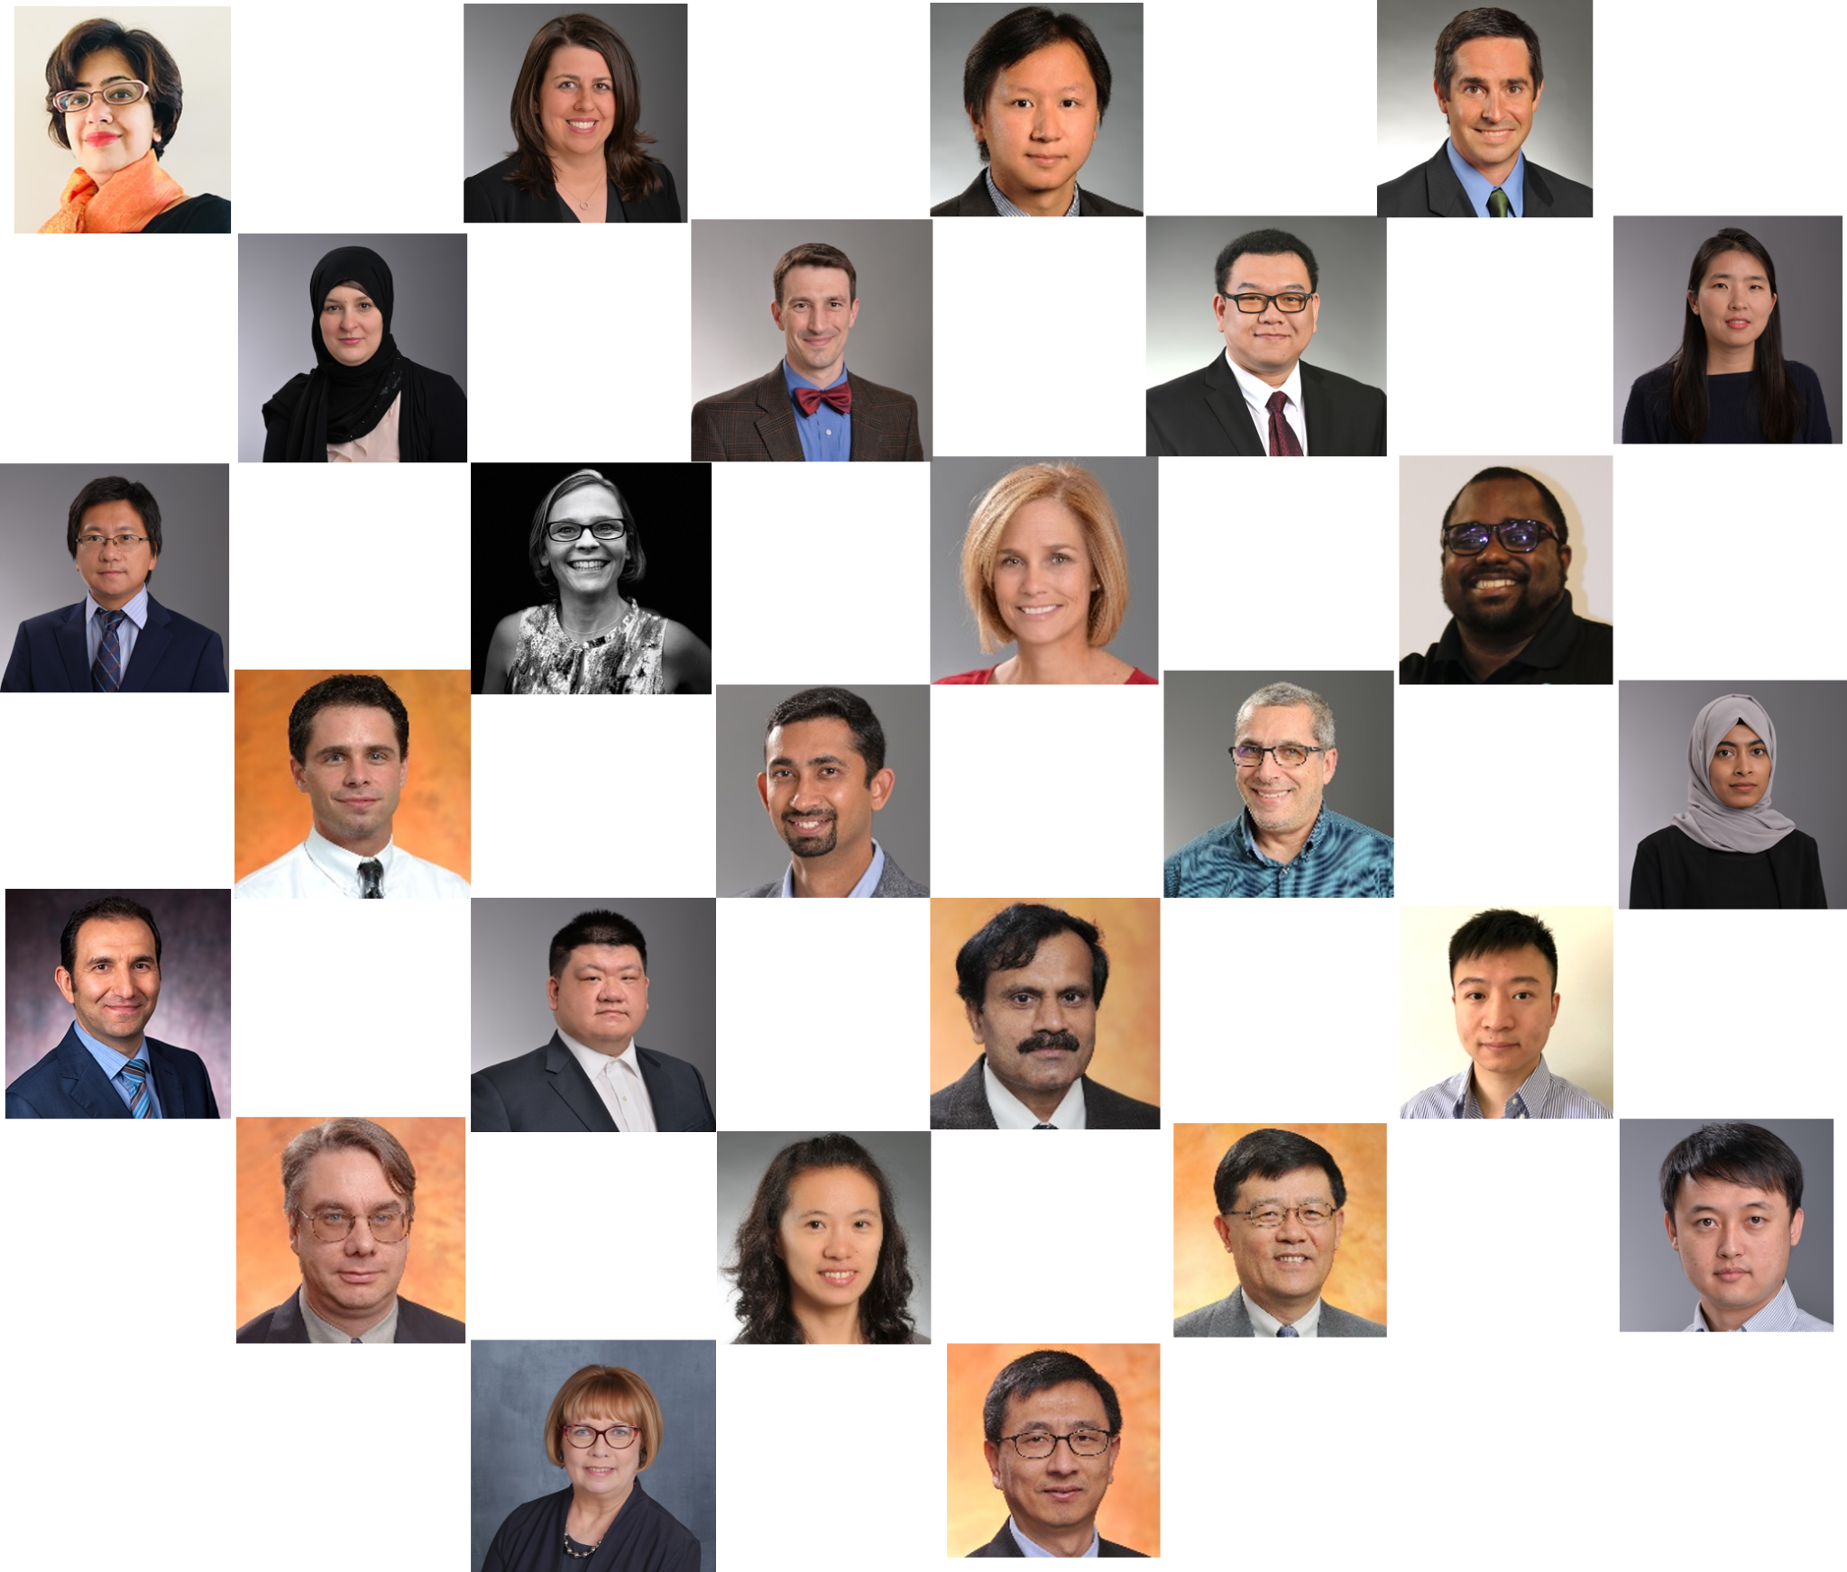
Faculty Involvement in AI and Cybersecurity
Overview
40+ faculty members across five colleges
$6 million+ in research funding in 22-23.
Cybersecurity is a particularly strong suit, with numerous faculty engaged in research cyber-physical systems (Power Grids and IoT devices), secure software development and forensics, encryption techniques, securing elections, and threat analysis.
In the realm of AI our faculty demonstrate expertise in areas such as deep and machine learning, data analytics, geospatial data, and large language models.

Slide 10
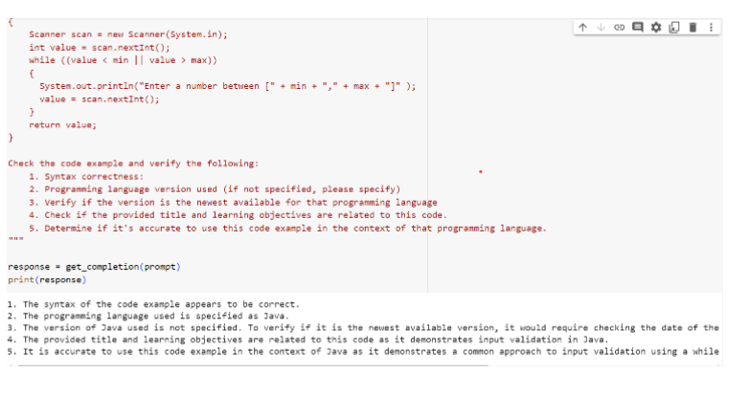
Transforming how we build and maintain curriculum
Exploration of LLM Models
Exploring various prompting techniques and LLM models
Using AI to maintain curriculum relevance
https://www.clark.center/collections/secinj
Notes:
This slide shows a research project that is using AI to maintain curriculum relevance and explores various prompting techniques and LLM models.

Slide 11
Impact of Digital Transformation on Students
1
2
3
Enhanced curriculum in cybersecurity, providing more comprehensive and practical knowledge.
Increased opportunities for real-world experience and internships in the field of cybersecurity.
Higher graduate placement rates and career advancement in cybersecurity roles.

Slide 12
Future Directions for Cybersecurity Education
Specialization in Cybersecurity and AI
Experiential Learning in Real-World Scenarios
Developing a specialized curriculum that integrates cybersecurity and artificial intelligence knowledge.
Creating opportunities for students to apply their skills in simulated and actual cybersecurity situations.
Cross-Disciplinary Programs
Outreach and Collaboration
Introducing cybersecurity elements into non-technical programs and vice versa to promote a holistic understanding.
Establishing partnerships with organizations to share best practices cybersecurity, and provide students in real-world job experience.

Slide 13
Future Directions for Cybersecurity Research
AI and Cybersecurity
Further integration of artificial intelligence and machine learning in cybersecurity protocols and defense mechanisms.
Cyber-Physical Systems Security
Enhancing security measures for interconnected systems in healthcare, transportation, and manufacturing.
Privacy and Intellectual Property
Developing advanced encryption and data protection techniques to safeguard user privacy and intellectual information.
Cybersecurity in Emerging Technologies
Addressing security challenges in quantum computing, IoT, and blockchain technologies.

Slide 14
CLARK
SECURING THE
NATION THROUGH EDUCATION
http://www.clark.center

Slide 15
Cybersecurity Faculty and Teacher Shortage
www.clark.center
572,392
90
14
Job openings in the U.S. requesting cybersecurity-related skills in 2023
Cybersecurity Ph.D. graduates from US institutions in 2021
Cybersecurity Ph.D. graduates joined the tenure-track faculty ranks at universities
(Cyber Seek)
(PhDs in Cybersecurity, Taulbee Survey)
(PhDs in Cybersecurity, Taulbee Survey)
Notes:
https://www.varonis.com/blog/cybersecurity-statistics
PhD in Cybersecurity, Taulbee Survey
Need to find the number of PhDs that stay in academia versus go into industry
There are 1,053,468 employees working in cybersecurity in the U.S. as of February 2022. (Cyber Seek)
Also as of February 2022, there are nearly 600,000 job openings in the cybersecurity industry, meaning only 68 percent of open jobs are filled. (Cyber Seek)
59 percent of cybersecurity professionals feel the demands of their job limit them from keeping up with cybersecurity skills. (ISSA & ESG)
More than half of cybersecurity professionals believe that a minimum of three years in the industry is required for proficiency. (ISSA & ESG)
70 percent of cybersecurity professionals claim their organization is impacted by the cybersecurity skills shortage. (ISSA & ESG)
There was a 350 percent growth in open cybersecurity positions from 2013 to 2021. (Cybercrime Magazine)
Link to the ISSA and ESG Report: https://www.esg-global.com/hubfs/ESG-ISSA-Research-Report-Life-of-Cybersecurity-Professionals-Jul-2021.pdf
https://www.csis.org/analysis/cybersecurity-workforce-gap
A recent CSIS survey of IT decision makers across eight countries found that 82 percent of employers report a shortage of cybersecurity skills, and 71 percent believe this talent gap causes direct and measurable damage to their organizations
By 2022, the global cybersecurity workforce shortage has been projected to reach upwards of 1.8 million unfilled positions
According to the recently published Report to the President on Supporting the Growth and Sustainment of the Nation’s Cybersecurity Workforce, authored by the U.S. Department of Commerce and Department of Homeland Security, “employers increasingly are concerned about the relevance of cybersecurity-related education programs in meeting the needs of their organizations.”9 In 2016, a CSIS survey of IT employers found that only 23 percent thought education programs were fully preparing students to enter the cybersecurity industry,10 and in 2018, professional association ISACA found that 61 percent of organizations believe that fewer than half of all applicants for open cybersecurity positions are actually qualified for the job.11

Slide 16
Evolution in Core Cybersecurity Knowledge
www.clark.center
1960s
1970s
1980s
1990s-Current
Physically Secure Cyber Assets
Networks need to be secured as well
Cyber Attacks can be launched against key infrastructure
Cyber Attacks can be launched against anything or anyone that is connected to the internet. Including supply chain attacks through humans (no internet needed).

Slide 17
https://www.clark.center

Slide 18
CLARK’S STORY
STUDENT-LED
2018
2019
2021
2022
2023
In the past 7 years, over 70 students, comprising of undergraduate, graduate, and doctoral students from Towson University, have collaborated on building CLARK and shaping it into the platform it is today.
Version 1 is released
684 learning objects and 174 users
CLARK grows to 3855 users
1000th learning object is released
CLARK reaches 30,000 downloads
Total Objects By Year
Total Downloads By Year
1,494
47,635
OPEN-SOURCE
932
646
In Creative Commons, all material on CLARK is freely accessible for educators and students at any time. Open-source material enables educators to customize the content to meet the specific needs of their students.
594
545
19,115
12,273
47
8,560
1,178
2,660
2018
2019
2020
2021
2022
2023
2018
2019
2020
2021
2022
2023

Slide 19
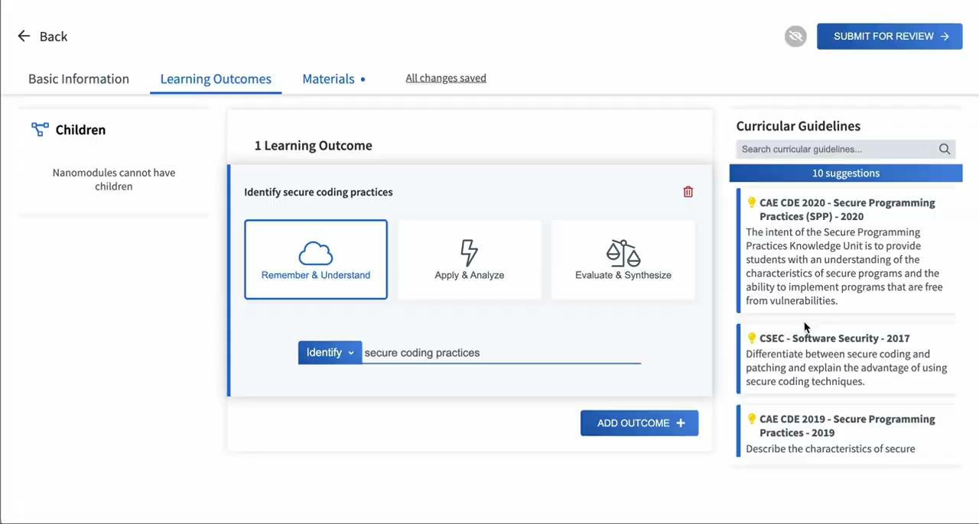
Mapping

Slide 20
Towson University Supports Cybersecurity/AI and other companies
Towson University connects cybersecurity startups with academic experts for mentorship and guidance.
Towson University provides incubation space and resources for cybersecurity startups.
University collaborations can provide companies with access to specialized cybersecurity laboratories and equipment.
The university collaborates on funding support and assistance with grant applications for cybersecurity startup initiatives.

Slide 21
Partnerships and Collaborations
University Partnerships
Industry Collaborations
Government Connections
Towson University has established strategic partnerships with other universities to collaborate on joint research projects and cybersecurity initiatives.
Towson University's cybersecurity program has ties to industry leaders, fostering collaborations for internships, research, and job placements.
Towson University's cybersecurity work is supported by government agencies, providing funding, resources, and real-world data for research and education.

Slide 22
Questions?
Key Takeaways
Next Steps
Towson University has made significant strides in digital transformation, with a focus on cybersecurity education and research.
SecurEd, a successful startup, has emerged from the university, showcasing the practical impact of the work.
Faculty members have demonstrated expertise in AI and cybersecurity, contributing to both education and research.
Continue to advance cybersecurity education and research through innovative programs and partnerships.
Support the growth of more startups in the cybersecurity sector, building on the success of SecurEd.
Further develop AI capabilities to enhance cybersecurity measures and defenses.
Notes:
This first version of this presentation was generated by AI (Plus AddOn for Google Slides).
The prompt provided was.. describe prompt. TU brand colors were provided.

