Slide 1
Data in Action
Stella Tomasi, PhD
Business Analytics & Technology Management Department

Slide 2
Data, Data, Data!!!
“In a world of more data, the companies with more data-literate people are the ones that are going to win.”
Miro Kazakoof, Senior Lecturer at MIT Sloan
“Data is meaningless unless it helps make decisions that have measurable impact. Generating value is a matter of connecting data to insights to action in a fast, repeatable way.”
Meyer et al. 2013, Forbes

Slide 3
From Data to Action
Profitable
Action
Knowledge
Useful
Information
Educational
Data
Interesting

Slide 4
Action Drives Data
Profitable
Action
Knowledge
Significant
Information
Relevant
Data
Essential

Slide 5
5 Types of Data Analytics
Descriptive analytics
What happened?
Analyze historical data to identify patterns
Slice and dice the data
Diagnostic analytics
Why did this happen?
Explain why the trends happen
Predictive analytics
What might happen in the future?
forecasting
machine learning, AI and statistical models
clustering, time-series, regression

Slide 6
5 Types of Data Analytics (continued)
Prescriptive analytics
What should we do next?
Predictions
Machine learning, simulation, optimization
Reduce risk by analyzing credit risk or loan default
Predict peak demand cycles for energy utilities
Identify optimal routes for new delivery
Cognitive analytics
Applies human like intelligence to tasks
AI, deep learning, machine learning and NLP (natural language processing)

Slide 7
Benefits of data analytics
Report conducted by MicroStrategy in 2020
500 global companies with $100 million in annual revenue

Slide 8
Case #1: Perdue Farms
Transporting products is significant part of total logistic costs
Additional costs incurred when trucks are held by customers
Multiple deliveries
Lack of staff
Inefficient warehouse systems
Lost of wages for drivers
Reduces on-time performance to subsequent customers

Slide 9
Case #1 – Data Analytics
“Drop trailers”
But which customers receive the “drop trailers”?
Data was merged from multiple systems
Transportation Management System
Financial Reporting System
Delivery Performance Scorecard

Slide 10
Data in Action – Decision-making & Financial Performance
Identified which customers receive “drop trailers”
Identify customers with highest held time
Overall cost of occurrences
Which states would benefit most from “drop trailer”
Which drivers had the lowest on-time performance
Able to predict when a late arrival is more likely to happen

Slide 11
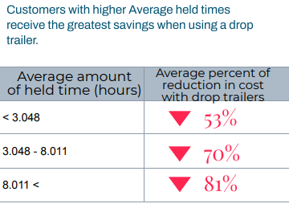
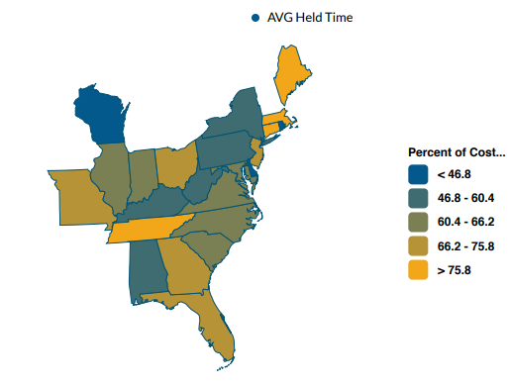
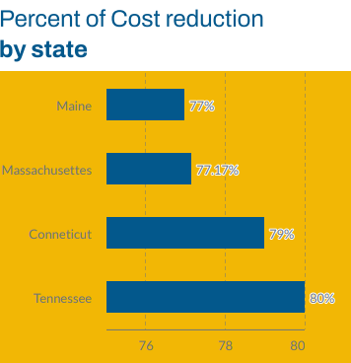
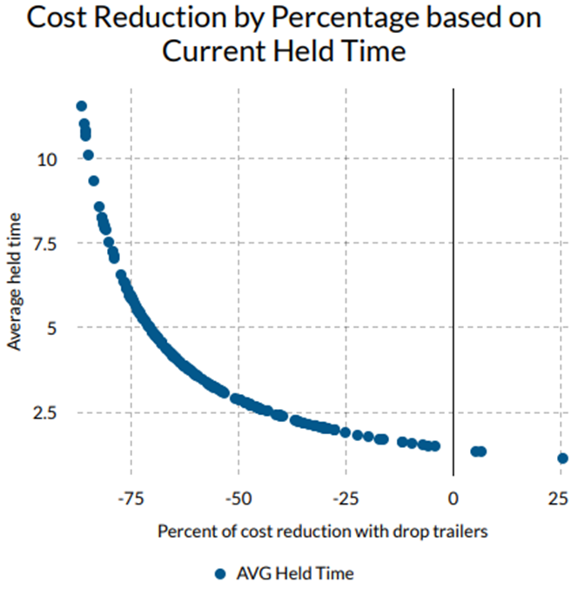

Slide 12
Case #2 – Baltimore NFL Ravens
on-field and off-field data analytics teams
Use data to generate more revenue
Merchandise data
Provided from one source
Provided over multiple years
Various locations around the world
Analyze data to find insights

Slide 13
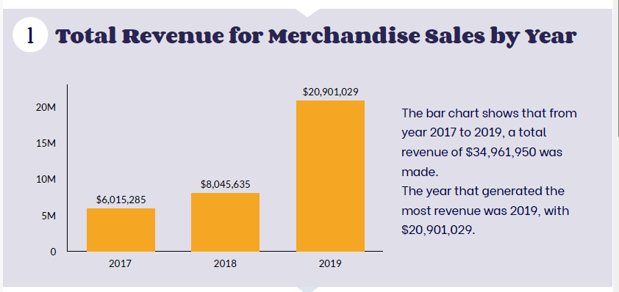
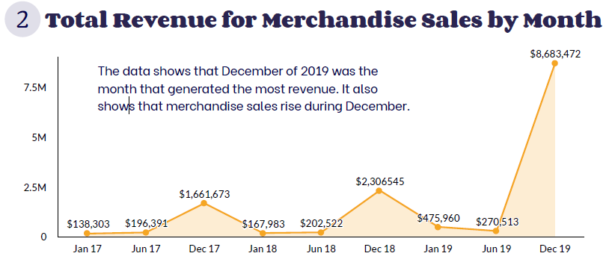
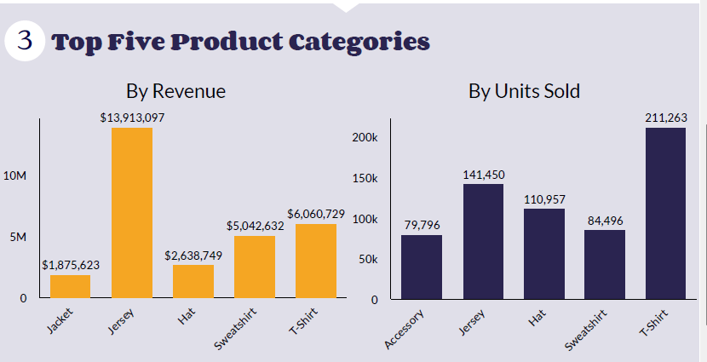
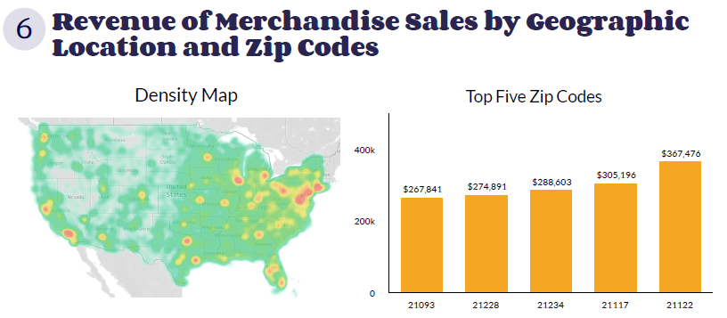

Slide 14
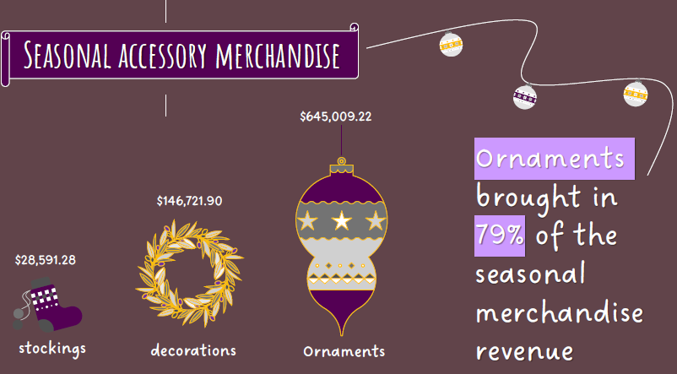
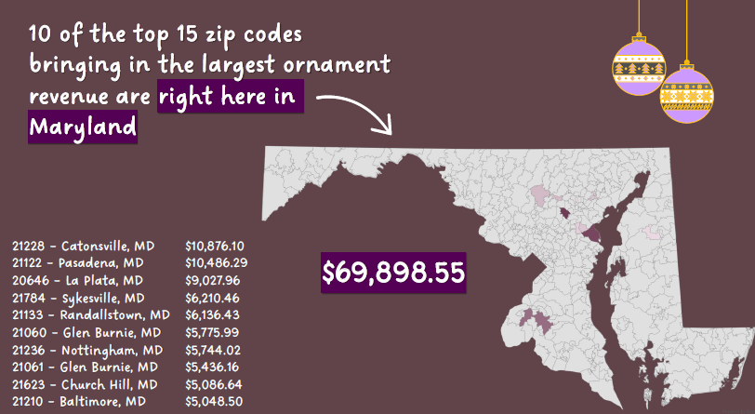
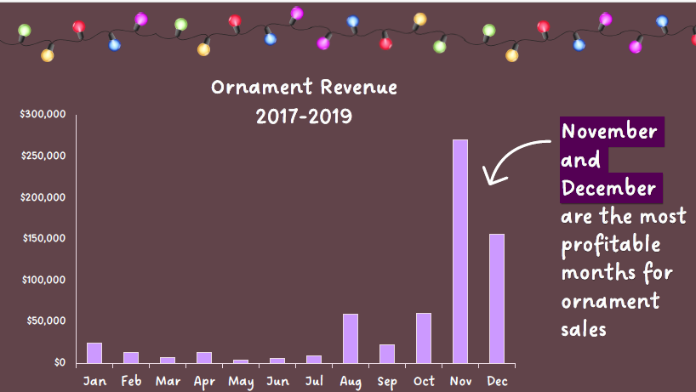

Slide 15
Case #3 – SC&H Group
Maximize profitability of company
Measure how employees are utilized across practices performance
currently, employees were working across sectors
Opportunity to move employees to support sectors
Which employees were overworked
Data collected through one application

Slide 16
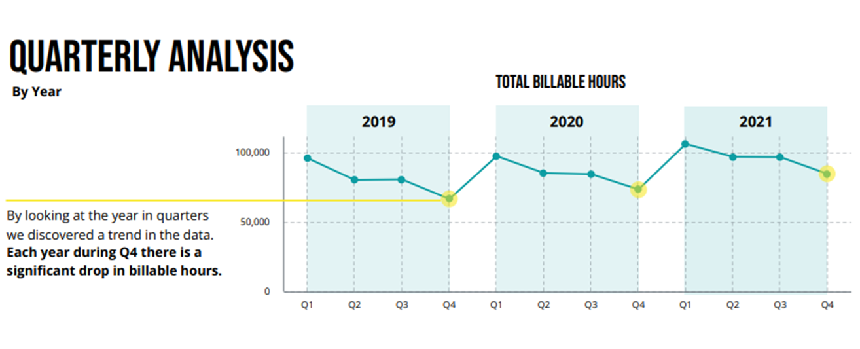
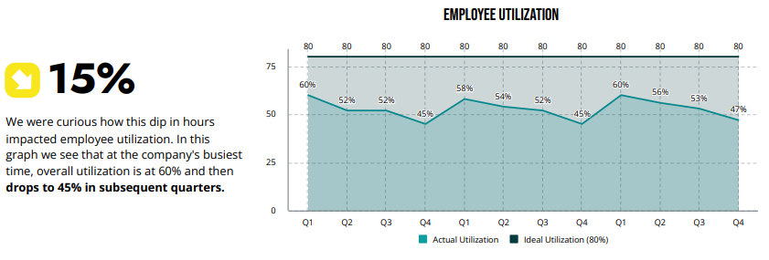
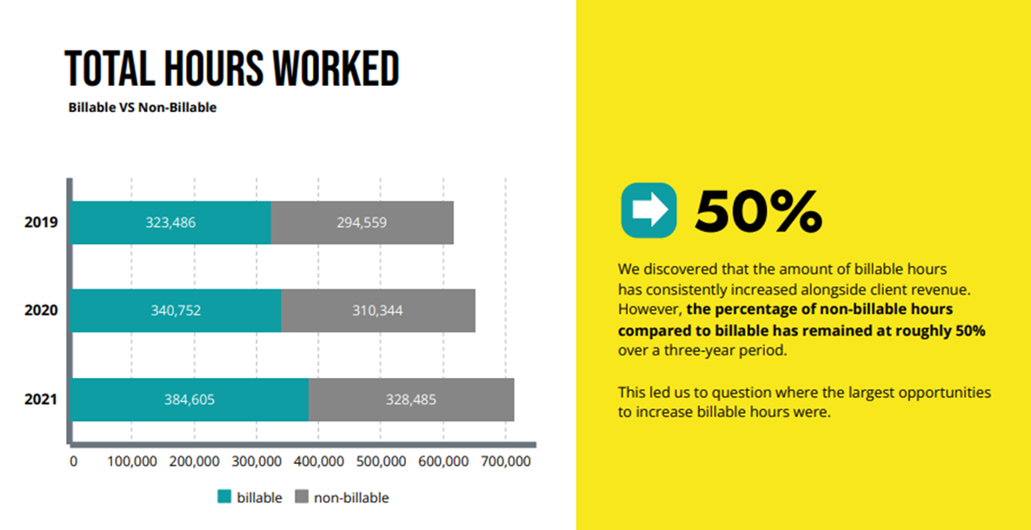
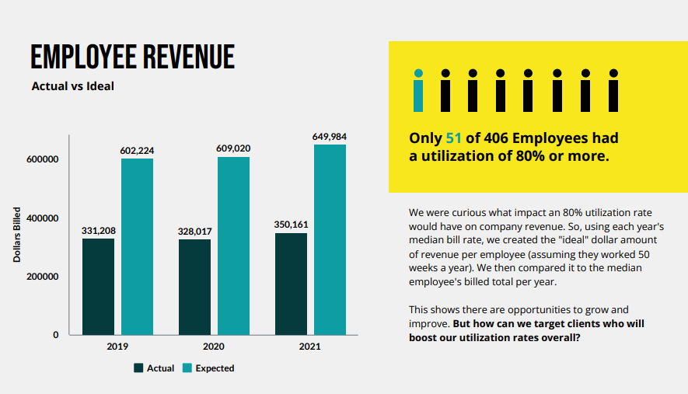

Slide 17
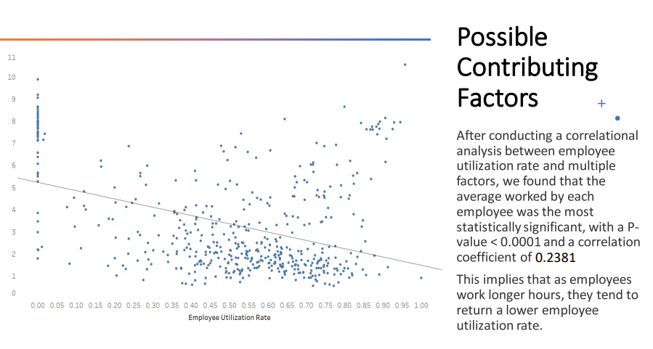
Case #3 – Diagnosing the problem

Slide 18
Case #4 – TU Alumni Office
Wanted to understand their customer base
Identify which type of customer engages more with TU
Provide recommendations on how to engage more customers
Survey was conducted in 2020
2,773 participants responded
Requested valuable insight to develop engagement initiatives
Engaged alumni will give back to TU

Slide 19
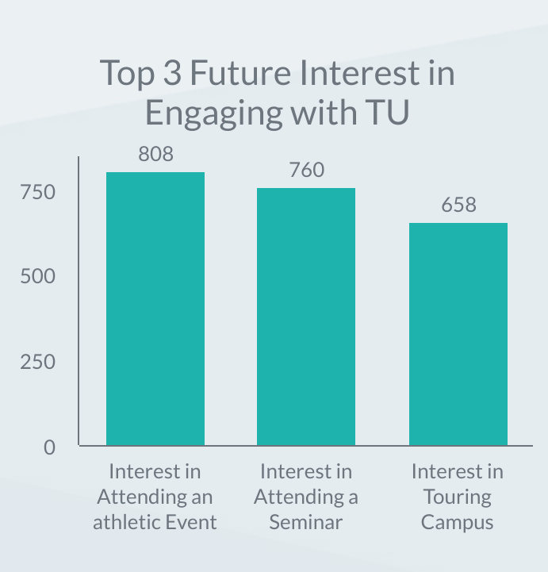
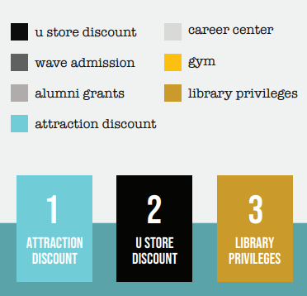

Slide 20
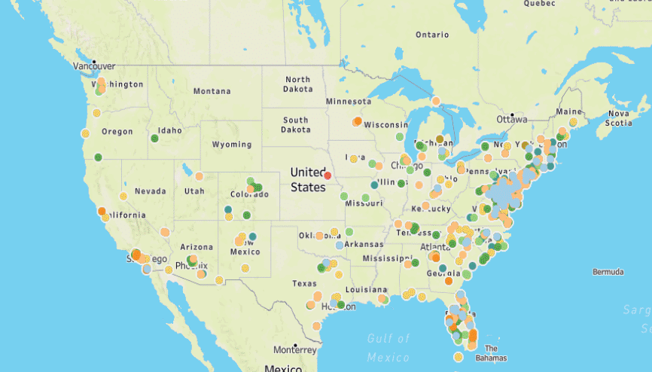
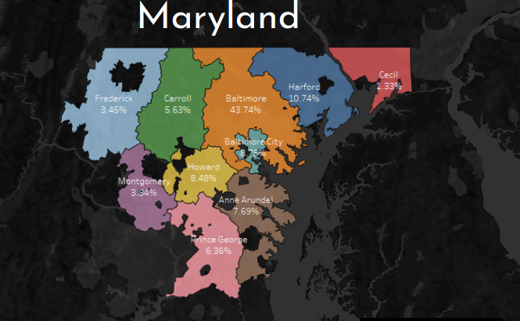

Slide 21
Benefits of data analytics for case studies
Perdue Farms
effective decision-making & financial performance
Ravens
identify new products & financial performance
SCH Group
improved productivity & financial performance
TU Alumni
improve customer experiences & financial performance

Slide 22
Challenges to using Analytics
Data privacy & security concerns
Access to data is limited across the organization
Organization lacks the talent to make best use of data

Slide 23
Missing Value
Incomplete data
Poor quality data
Incomplete data analysis
Good data is collected but not used effectively
very common
very damaging

Slide 24
Data-driven actions
Identify business objectives
Survey business teams for key sources of data
Collect and prepare data
Explore data
Visualization using charts, graphs and maps
Use clustering, trendlines, regression
Develop and share insights
What are you learning from the exploring the data?
Storytelling
Action – act on insights to be profitable

Slide 25
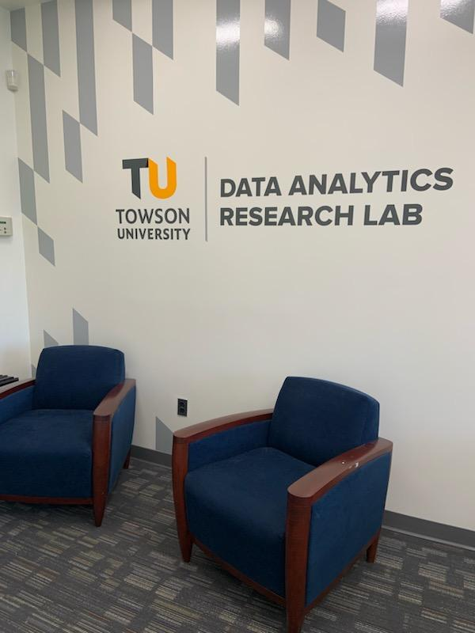
Data Analytics Research Lab
Equipped with high-powered computers with the latest analytical software
DARL provides students, faculty and industry partners with a shared space
Supports data analytics, conducting research and participating in experiential learning projects

Slide 26
Data Analytics Competition at TU
Data Analytics Competition is on April 26th
Round 1 – online from March 1st – April 9th
10 finalists move to final live competition
Elite Sponsor: DAP Global, Inc.
Premier Sponsor: Bolton Group

Slide 27
Thank you!

