Slide 1
Cybersecurity Risk Landscape: the good, the Bad and the ugly
CISO Panel Discussion

Slide 2
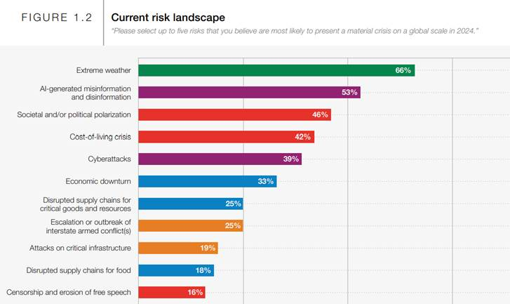
World Economic Forum - The Global Risks Report 2024
Leading insights on the evolving global risks landscape from 1,490 experts across academia, business, government, the international community and civil society.
Responses for the GRPS 2023-2024 were collected from 4 September to 9 October 2023.
“Global risk” is defined as the possibility of the occurrence of an event or condition which, if it occurs, would negatively impact a significant proportion of global GDP, population or natural resources
https://www3.weforum.org/docs/WEF_The_Global_Risks_Report_2024.pdf

Slide 3
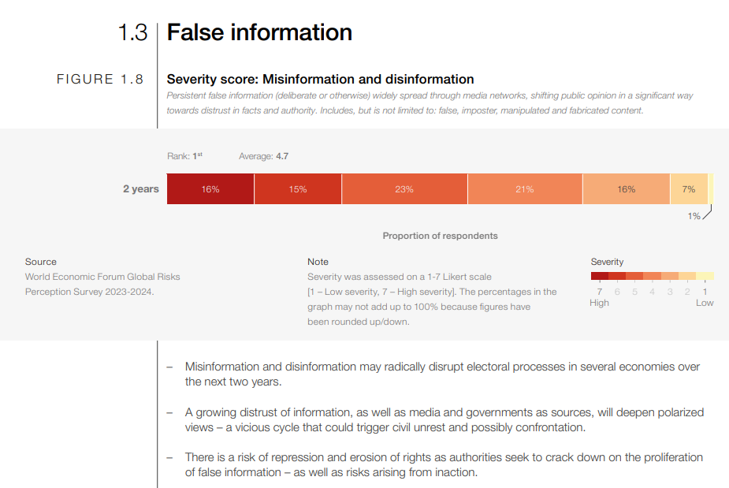
AI Generated misinformation and Disinformation
https://www3.weforum.org/docs/WEF_The_Global_Risks_Report_2024.pdf

Slide 4
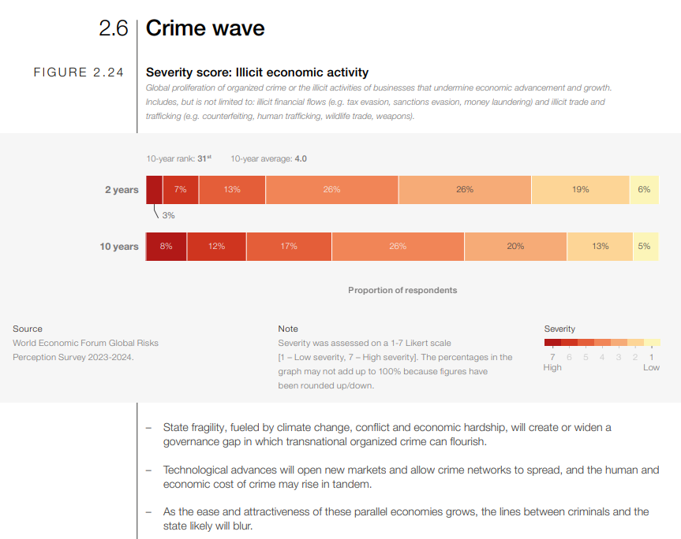
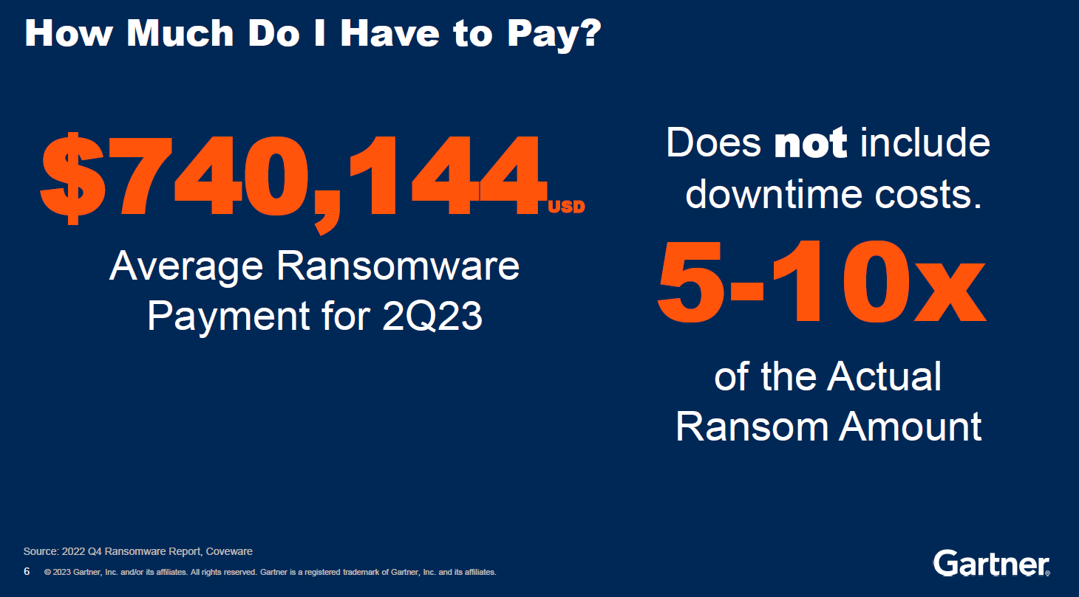
CyberAttacks
Why ransomware? It’s profitable.
https://www3.weforum.org/docs/WEF_The_Global_Risks_Report_2024.pdf

Slide 5
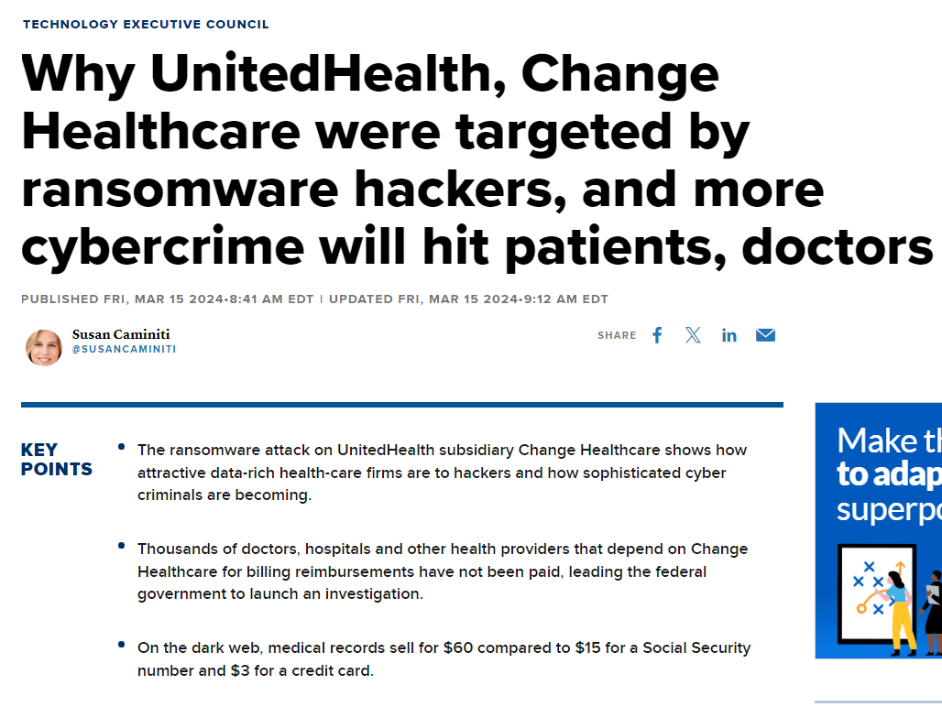
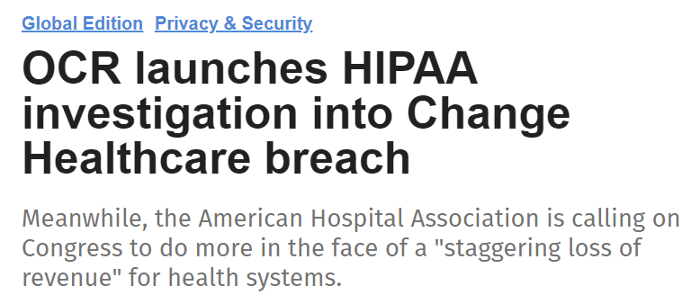
Attacks on Critical Infrastructure Exhibit A – Change Healthcare Data Breach

Slide 6
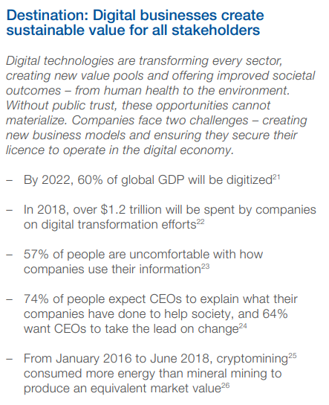
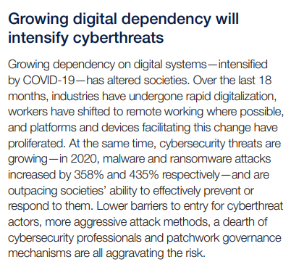
Increased Dependency on Digital Technology is increasing exponentially
World Economic Forum –
Our Shared Digital Future Report 2018
World Economic Forum –
The Global Risks Report 2022

Slide 7
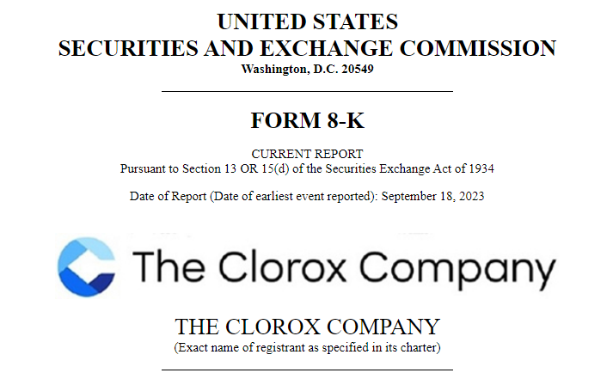
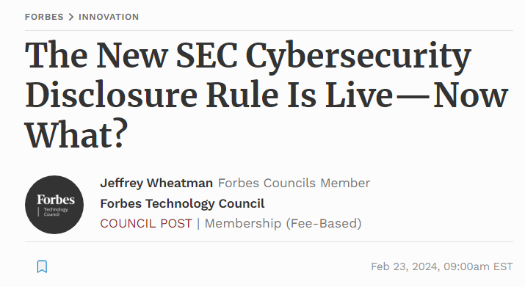
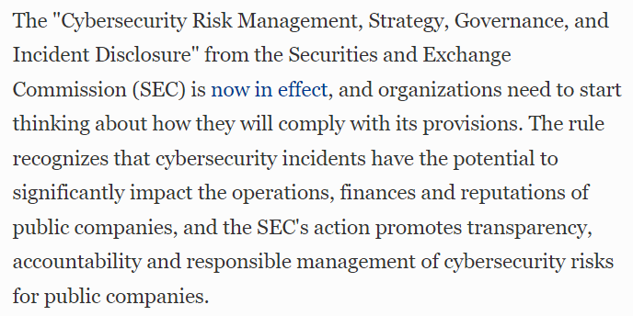
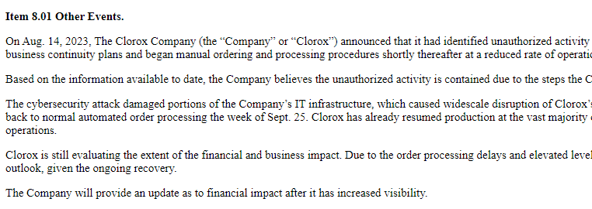
New SEC Cybersecurity disclosure Rule
Sep 12, MGM Resorts International
Oct 10, 23andMe
Nov 29, Okta
Dec 15, V.F. Corporation
Feb 21, UnitedHealth Group

Slide 8
What can we do to protect Against?

Slide 9
Cybersecurity Governance

Slide 10
Increased Cyber Expertise
Qualified Technology Experts (QTEs) are boardroom-ready technology executives with the skills, competencies, and experiences to be high-performing contributors in the corporate boardroom.
Digital Director's Network Masterclass

Slide 11
Quantifying Systemic Risk

