Slide 1
Ransomware – State of the Union
GuidePoint Digital Forensics & Incident Response
Mid Atlantic CIO Forum - March 2024
Notes:
Stephen Brzozowski, Managing Security Consultant for GuidePoint Security, will use their recent report to guide us on ransomware trends and directions. From GuidePoint Security’s Digital Forensics and Incident Response (DFIR) team, Stephen will share insights into the current state and observed trends of ransomware attacks. He will share the perspective of the counterintuitive world of cyber extortion as well as a peek behind the scenes of Ransomware Negotiations.

Slide 2
About Ransomware

Slide 3
Ransomware
Ransomware is a form of cybercrime designed to extort payment – a ransom – from victims through extortive tactics. While ransomware has traditionally referenced the malware used to perform these operations, we have increasingly observed ransomware operations in which no encrypting malware is used.
“Traditional” Ransomware
“Double Extortion” Ransomware
“Multiple Extortion” Ransomware
“Exfil Only” Ransomware
Two forms: Insular & Ransomware-as-a-Service (RaaS)

Slide 4
Initial Access Brokers
Source: Qualys
Notes:
Initial access may be gained directly or indirectly through IABs
Several methods:
Phishing
Compromised Creds
Vulnerabilities
The earlier an intrusion is caught, the easier to mitigate/remediate

Slide 5
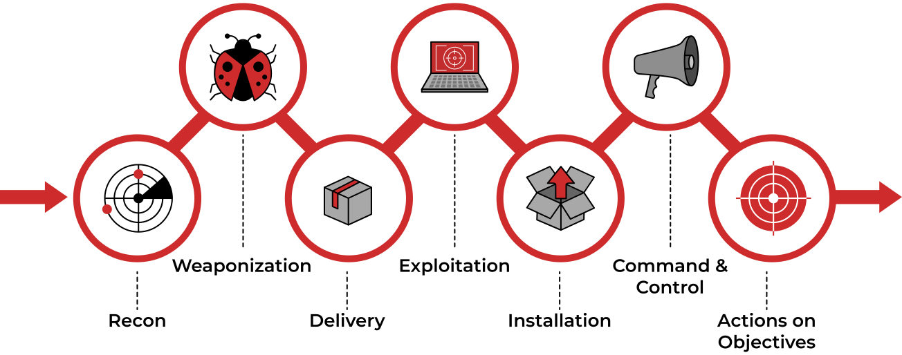
Post-Access
Source: KELA Cyber Threat Intelligence
Source: Lockheed Martin

Slide 6
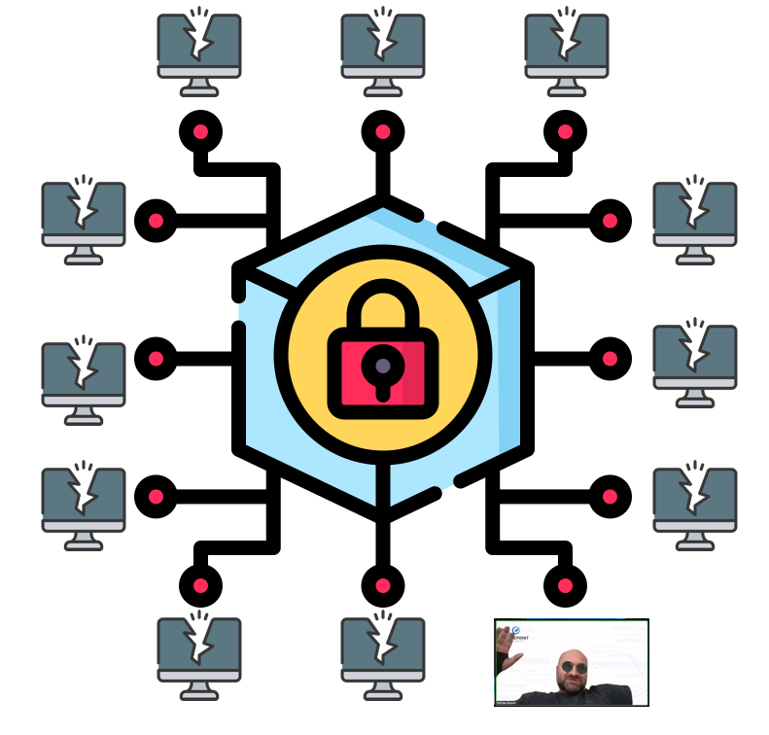
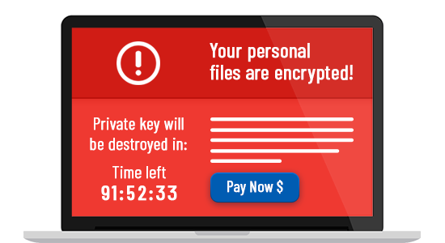
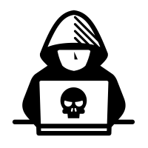
Typical Intrusion Timeline
Day 0
Days 0 - 7
Days 7 - 10
Ransomware
Nation-state
Days 10 -
Attack Vectors
Perimeter breach
Phishing
Drive-by
Third-party
Veni, Vidi, Vici
Cred harvesting
Recon
Lateral movement
Persistence
Data Theft
Staging
Exfiltration
Documents
Databases
Data Destruction
Backups
Virtual infrastructure
Servers
Workstations
Network Shares
Persist & Steal
Update malware
Cred harvesting
Data theft
Read E-mail

Slide 7
Ransomware Impacts
Ransomware Impacts
Brand
Financial
Technology
Legal/ Regulatory
Privacy
Business Operations
Downtime ranging from days to months
Severely degraded technology and business operations
Ransomware response is not just a technical response
Legal and regulatory requirements for disclosure and response
Privacy considerations associated with data
Reputational damage and future business relationships
Legal fallout, including class-action suits

Slide 8
Ransomware Response Roles
Incident Response
Role: IR Service Provider
Responsibilities:
Response Methodology
Containment
Incident Investigation
Forensics
TA Threat Intelligence
Threat Monitoring
Root Cause Analysis
Remediation Strategy
TA Communications
Role: Negotiation
Responsibilities:
Initial Contact with TA
Data Collection from TA
File Tree, Ransom Demand, etc.)
Payment Negotiation
Cyber Insurance
Roles: Insurance Carrier, Claims Adjuster
Responsibilities:
Determine what’s covered
Pay the bills
External Counsel
Role: Legal Counsel
Responsibilities:
Receive facts from IR & TA Communication
Counsel Client
Preserve Privilege
Assess Legal Risk
Recovery / Restoration
Role: IT Assistance
Responsibilities: Assist customer with hand-on keyboard recovery
FBI / CISA
Role: Law Enforcement
Duties:
Big Picture Investigation
Threat Intelligence
Decryption Tool (if available)
More…
MDR / MSS
Payment Brokerage
Data Mining / Review
Public Relations
Breach Management Services
Post-Breach Engineering Services

Slide 9
Trends

Slide 10
Rate of Publicly Posted Ransomware Victims - 2023
Slow start to the year, building into Q2 and Q3 with spikes correlating to mass exploitation campaigns
Estimated global impact of $1 Billion in 2023
Average ransom payment estimates vary, $750K-$1.54 Million
Correlation between active groups and daily posts
Overwhelming majority of victims attributed to the largest, most entrenched groups (85%)
“Holiday Breaks” in summer and winter – carries over into new years and orthodox Christmas
Notes:
2022: 1846 posts from 44 groups
Observed Trends: MSPs Targeted, Rebranding, Encrypting ESX, Legitimate Tool Usage (RMMs), Coercive Tactics, Mass Exploitation, Vulnerability Exploitation vs Social Engineering

Slide 11
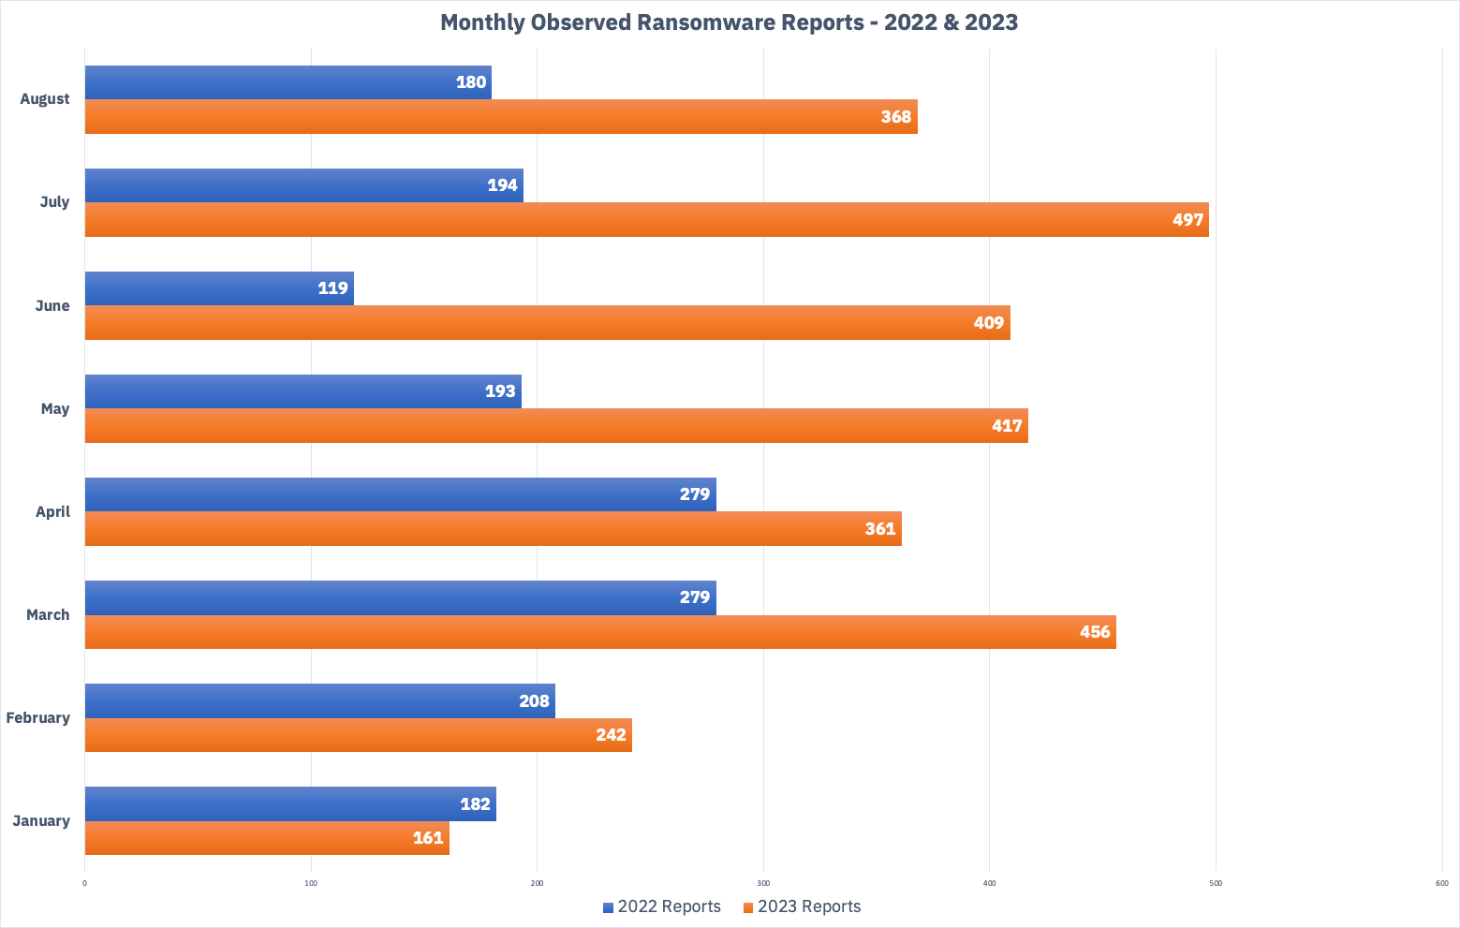
Ransomware Attacks Over Time

Slide 12
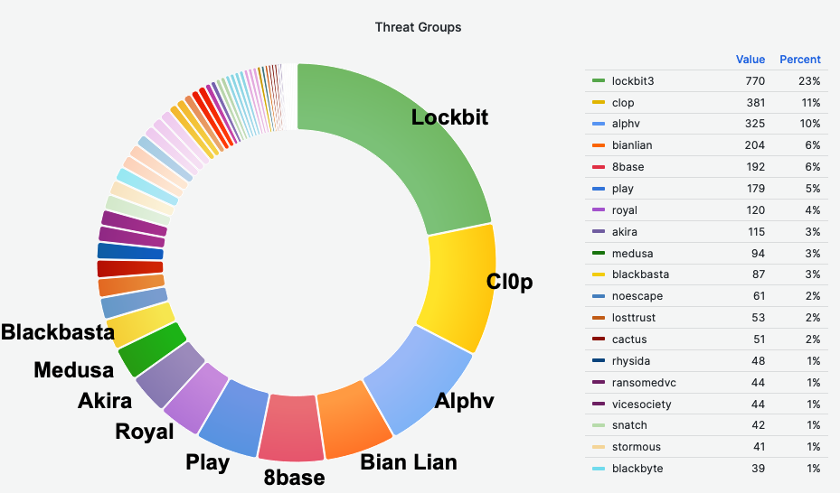
Threat Groups (2023)

Slide 13
Recent Trends
Law Enforcement Take downs – LockBit & AlphV – Resumed operations within days. AlphV ceased operations again and blamed Law Enforcement (exit scheme)
A la carte payment options offered up front - LockBit
File Trees may no longer be free - LockBit & Others requiring some payment or only providing partial tree
New Discount Rules - LockBit disallows affiliates from accepting less than 50% payment
New Coercive Tactics – Multi-extortion?
Threat to report to SEC – ALPHV
Social Media Campaign – LockBit name and shame on twitter
Stock Short Selling – “Darkside” threatening to release information to unscrupulous traders
Continued Trends
Virtualization Infrastructure continues to be targeted for encryption
Continued use of RMM for remote access

Slide 14
Case Studies

Slide 15
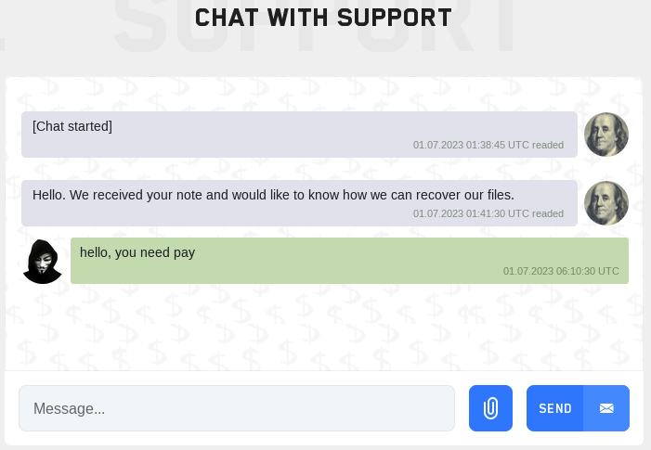
Ransomware Case Study: LockBit
LockBit is the most prolific ransomware group operating today, and has been operating since 2019 (originally dubbed “ABCD”)
Over 2,000 victims publicly posted (non-paying) in last two years, assessed to have extorted at least $120 Million
Global attacks, mostly North America and Western Europe
Responsible for ~25% of observed attacks against the financial services industry in 2023, more than any other group
Access typically via phishing-delivered dropper malware, or through public facing infrastructure vulnerabilities (VPN, MFTs, etc.)
Maintains “resilient and redundant” infrastructure
Instituted new restrictions on ransom negotiation “discounts” in October 2023

Slide 16
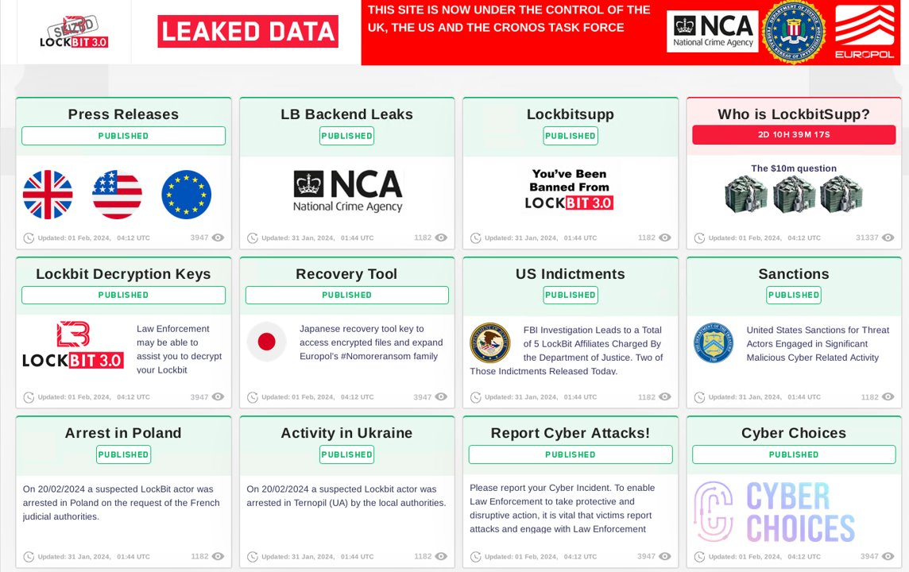
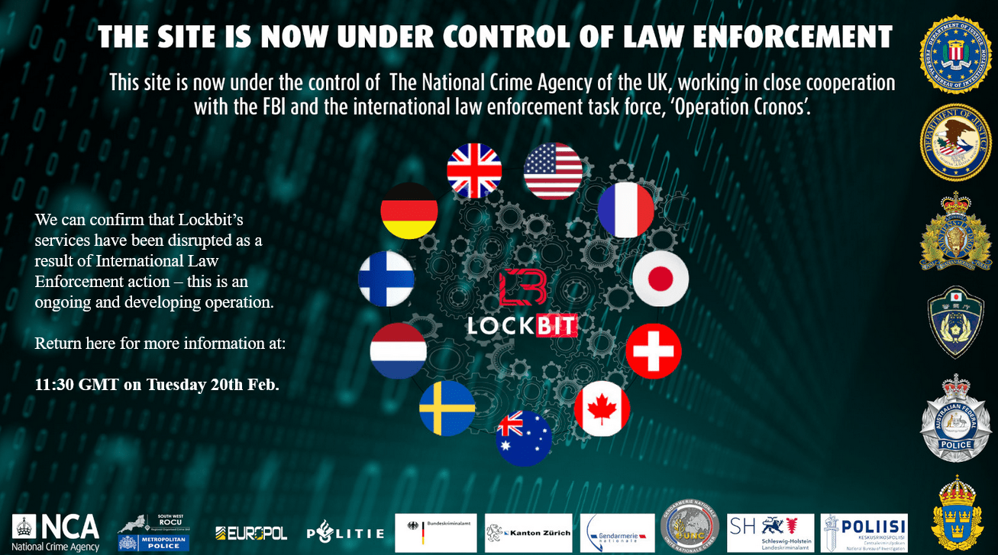
Ransomware Case Study: LockBit
Multinational LE Operation, “Operation Cronos” disrupted infrastructure and led to arrests in February 2024:
Data leak site seized
Source code seized
Two arrests with three additional warrants issued
> 200 Crypto wallets frozen
Sanctions against two Russian nationals
Admin claims initial access was via PHP CVE-2023-3824
LE discovered data retained from paying victims
Free decryptors being offered to victims
As of 2/24/2024, new LockBit infrastructure partially operational

Slide 17
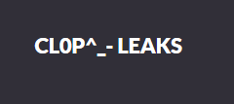
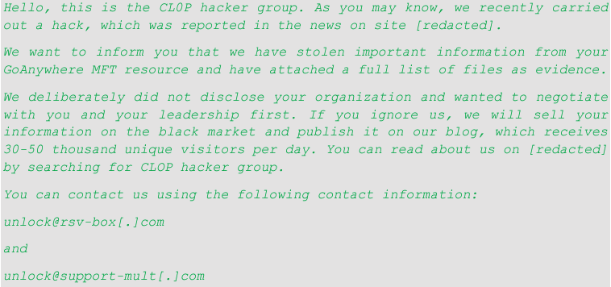
Ransomware Case Study: Cl0p
One of the most impactful data extortion groups in 2023, driven by mass-exploitation of enterprise software vulnerabilities
Operating since 2019, moved from double-extortion to data extortion circa late-2022
MOVEit MFT campaign alone impacted 2,600+ organizations and up to 77.2 million people
Global attacks, mostly global north
Responsible for ~21% of observed attacks against the financial services industry in 2023, the second most impactful group
Access typically via zero-day vulnerability in public-facing enterprise software; mostly Managed File Transfer (MFT) applications

Slide 18
Royal
Sector: Technology Services
Encrypted Systems: 50+
Servers
Minimal Workstation Impact
VMWare ESXI Servers (Virtualization Platform)
Initial access via FW vulnerability
Nearly all servers encrypted via ESX encryption
Client access environment was compromised
TeamViewer
Recovered from backups
Ransom Payment: $300k

Slide 19
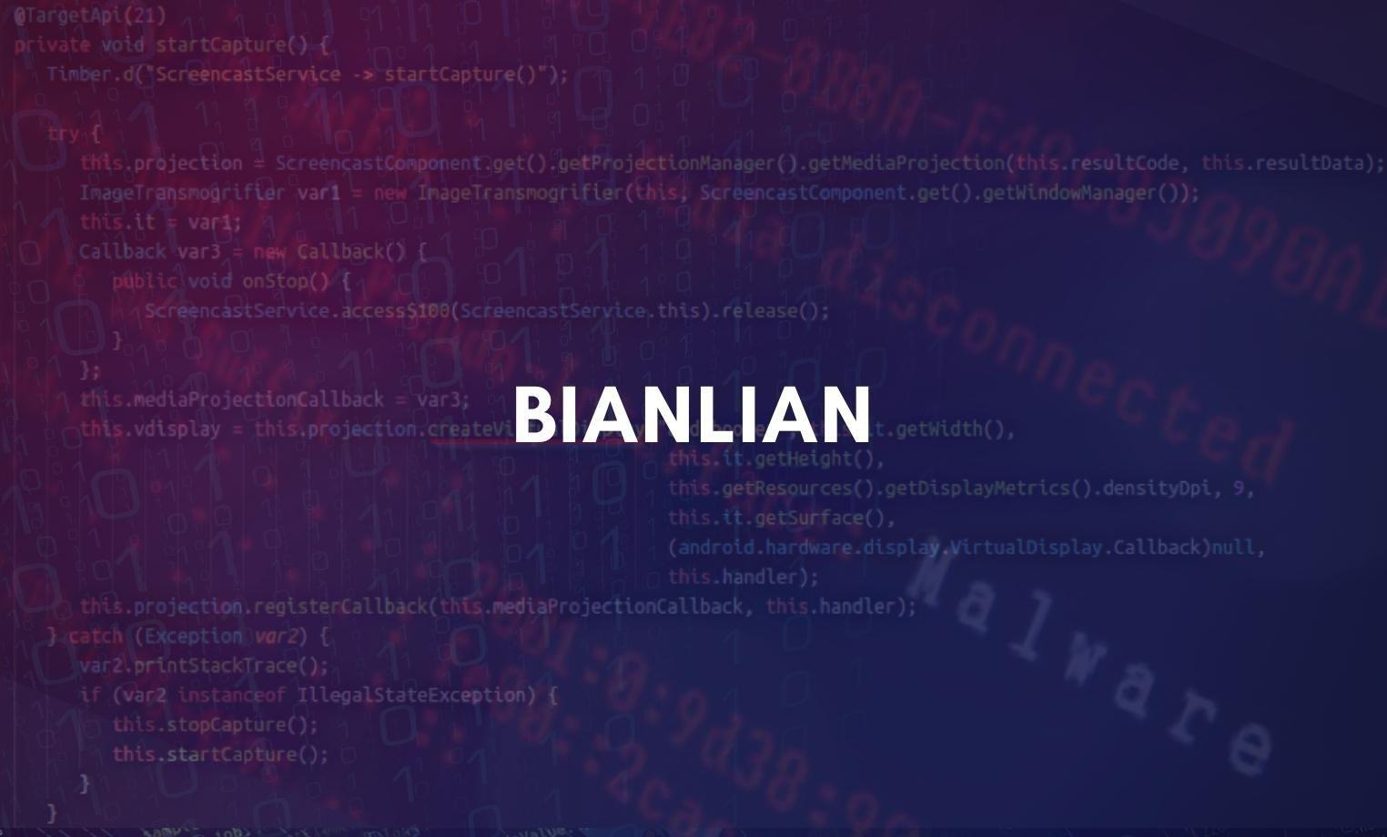
BianLian
Sector: Manufacturing
Manufacturing
Initial access via compromised 3rd party
Authenticated to single factor VPN
Zero Encrypted Systems
Multiple backdoors left by TA
Atera / Splashtop
Cobalt Strike
Others
Data Exfiltration Occurred
Ransom Payment: $1.5M

Slide 20
Unknown
Sector: Logistics
Initial access: Exposed Legacy Servers (RDP)
Client identified unusual account usage
Contacted DFIR, made decision to take internet offline
Zero Encrypted systems
Backdoors left by TA
Atera / Splashtop
Cloudflared Tunnel
Data Exfiltration Occurred
Ransom Payment: Zero
Attacker claimed they “decided” not to encrypt
Data posted to breached.to anonymously

Slide 21
What to do?

Slide 22
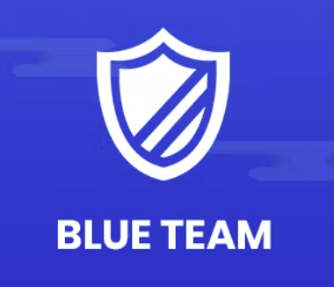
The Upsides Despite the Doom and Gloom
Focusing on cyber security fundamentals mitigates many exploitation scenarios commonly used by ransomware threat groups
Threat intelligence teams bridge the gap between emerging attacker trends and detection/prevention capabilities
Having knowledge of assets, applications, and emerging vulnerabilities helps to keep your attack surface as resilient and protected as possible
Having a plan for ransomware that covers administrative and technical response measures ensures you’re prepared to respond if necessary

Slide 23
Insights from the Field
Focus Areas
At least have the Basics
Includes People, Process, and Technology
Most Impactful Areas and Solutions
Multi-Factor Authentication (Remote and Privileged Access)
Patching / Vulnerability Management
Vetted / Immutable Backup Solution
Endpoint Detection and Response (EDR)
Privileged Account Management (PAM)
Centralized Logging (SIEM)
Updated Incident Response Plan
Threat-specific Playbooks (Ransomware, BEC)
Periodic IR Tabletop Exercises (Technical, Executive)
User Awareness Training/Testing
Proactive Preparation is Critical!

Slide 24
GPS DFIR Philosophy
Prevent
Continuously strive to improve and test your network defenses
Detect
When prevention fails, detect as quickly as possible
Prevention is a worthy goal, but early detection can prevent a “successful” compromise from becoming a “data-theft” or ”data-destruction” compromise.

Slide 25
Questions?
Thank You
The GuidePoint Security DFIR & Threat Intelligence Practices
IR@guidepointsecurity.com
GRIT@guidepointsecurity.com
Notes:
Questions:
Should we ban ransom/extortion payments?

