Slide 1
Technology M&A Services
Diligence + Post-Close + Day 2 Optimize

Slide 2





Why is M&A Technical Due Diligence (TDD) Important?
Technical due diligence (TDD) in mergers and acquisitions (M&A) is a critical component that serves multiple purposes. It provides a comprehensive evaluation of a company's technology infrastructure, systems, and intellectual property (buy-side or sell-side). This process is crucial for several reasons:
Risk Mitigation
Integration Planning
Future-proofing
TDD helps identify any potential technical risks that may not be apparent on the surface. This includes assessing the scalability, security, and stability of the technology in question.
TDD offers insights into how well the target company's technology can be integrated with the acquirer's systems. This is essential for planning post-merger integration and avoiding costly disruptions.
The due diligence process also looks at the future trajectory of the company's technology. It assesses whether the technology is future-proof and capable of meeting long-term business objectives.
Valuation Accuracy
Strategic Alignment
1
By understanding the technical strengths and weaknesses of a company, acquirers can more accurately determine its value. This ensures that the investment is sound and that the price paid is fair.
3
It ensures that the target company's technology is aligned with the strategic goals of the acquiring company. This alignment is key to realizing the expected benefits of the M&A.
5
2
4
In essence, TDD is more than just a checkbox. It's often thought of that way but shouldn’t be; it's an investigation that informs the buyer or seller about technical health, helping either to make informed, value-driven decisions and position themselves for a successful deal.

Slide 3
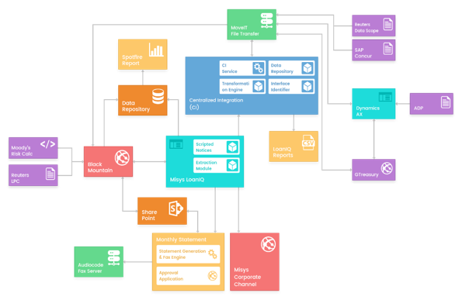
CASE STUDY: Lack of Detailed Diligence in Major Divestuture
CHALLENGE (Case Study)
Antares Capital was divested by GE Capital, to the Canadian Pension Plan (CPPIB). A Transitions Services Agreement (TSA) was signed and from an IT perspective, required the migration of 30+ legacy systems and processes (carve out) but it needed to be completed in 14 months or there were severe penalties in place. Antares Capital had office space, but no internet, a handful of employees and contractors, completely starting from scratch.
SCOPE OF WORK
30+ legacy systems and mountains of technical debt needed to be divested into a net new enterprise platform (carve out)
$120B in syndicated loans (Antares capital portfolio)
14-month timeline, $1M per month penalty for delay
OUR ROLE & OUTCOMES
Designed Solution Architecture for 6 new enterprise applications (CRM, SL, GL, Payments, EDWH, Reporting)
Full on-prem to Cloud migration and enablement
Developed full Integration architecture to move data throughout new enterprise landscape
Tested and reconciled all source to target data migration using 1Rivet proprietary tools/accelerators
Facilitated all senior stakeholder meetings with GE, CPPIB and Antares leadership
Led Implementation Command Center through a successful Go-Live and Post-Production Support
*More Client Success Stories later in presentation

Slide 4

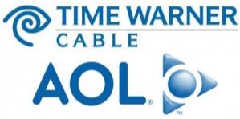

More M&A Famously Gone Wrong
Deal valued at $165 billion in 2000
Often cited as one of the most significant failures in M&A history.
Due Diligence was rushed and conventional. It did not take into consideration oversights including both technical and managerial issues that needed to be addressed.
Loss was estimated to be up to $99B.
Deal valued at $29.7 billion in 2005
DD did not raise the incompatibility of the merging companies' cultures, market-focus and systems. iDEN and CDMA - were not compatible.
Resulted in writing down $29.7 billion of the $36 billion that Sprint had paid for Nextel.
TDD is critical in identifying risks and ensuring that the acquiring company fully understands the technological capabilities and liabilities of the target company. Proper TDD can help prevent costly mistakes and support the strategic objectives of the M&A transaction.
Notes:
One notable example of a merger and acquisition (M&A) that faced significant challenges due to inadequate technical due diligence (TDD) was the AOL-Time Warner merger in 2000. This deal, valued at $165 billion, is often cited as one of the most significant failures in M&A history. The merger aimed to create a powerhouse by combining traditional media content with internet service delivery. However, the lack of thorough TDD contributed to a failure to recognize the rapid technological changes and the incompatibility of the merging companies' systems and cultures. This oversight led to significant integration problems, ultimately resulting in a massive loss in value.
Soon after the idea appeared, the two so-called equals Sprint Corporation and Nextel Communications decided to merge into Sprint Nextel Corporation. It might have been perfect. However, due diligence failed to correctly estimate the so-many challenges the new corporation would have had to face, especially market and culture-related, and even technical ones. Firstly, the two networks - iDEN and CDMA - were not compatible, and the series of attempts to ameliorate this particular situation were not too successful. Secondly, Nextel, as a wireless service provider had some conservative approaches, while Sprint, as a telecommunications company, was more customer oriented. Nonetheless, some sources reported certain issues Sprint had with customer service, affecting the sound reputation of Nextel’s representatives. Thirdly, with these and other challenges in mind, it is no surprise that Nextel’s management started to leave the company one by one. This due diligence failure resulted in writing down $29.7 billion of $36 billion that Split had paid for Nextel.

Slide 5









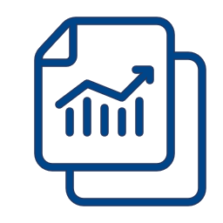

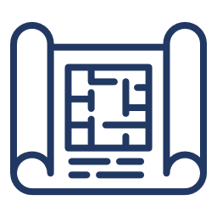

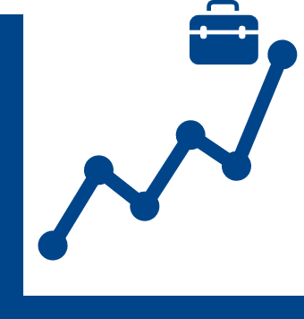

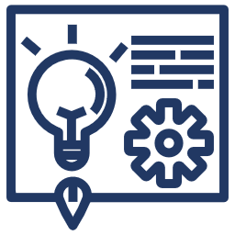

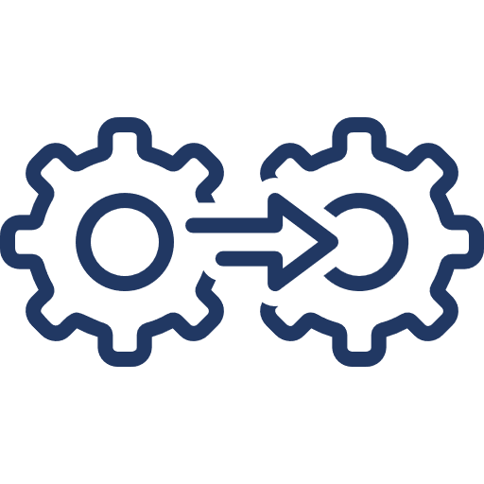
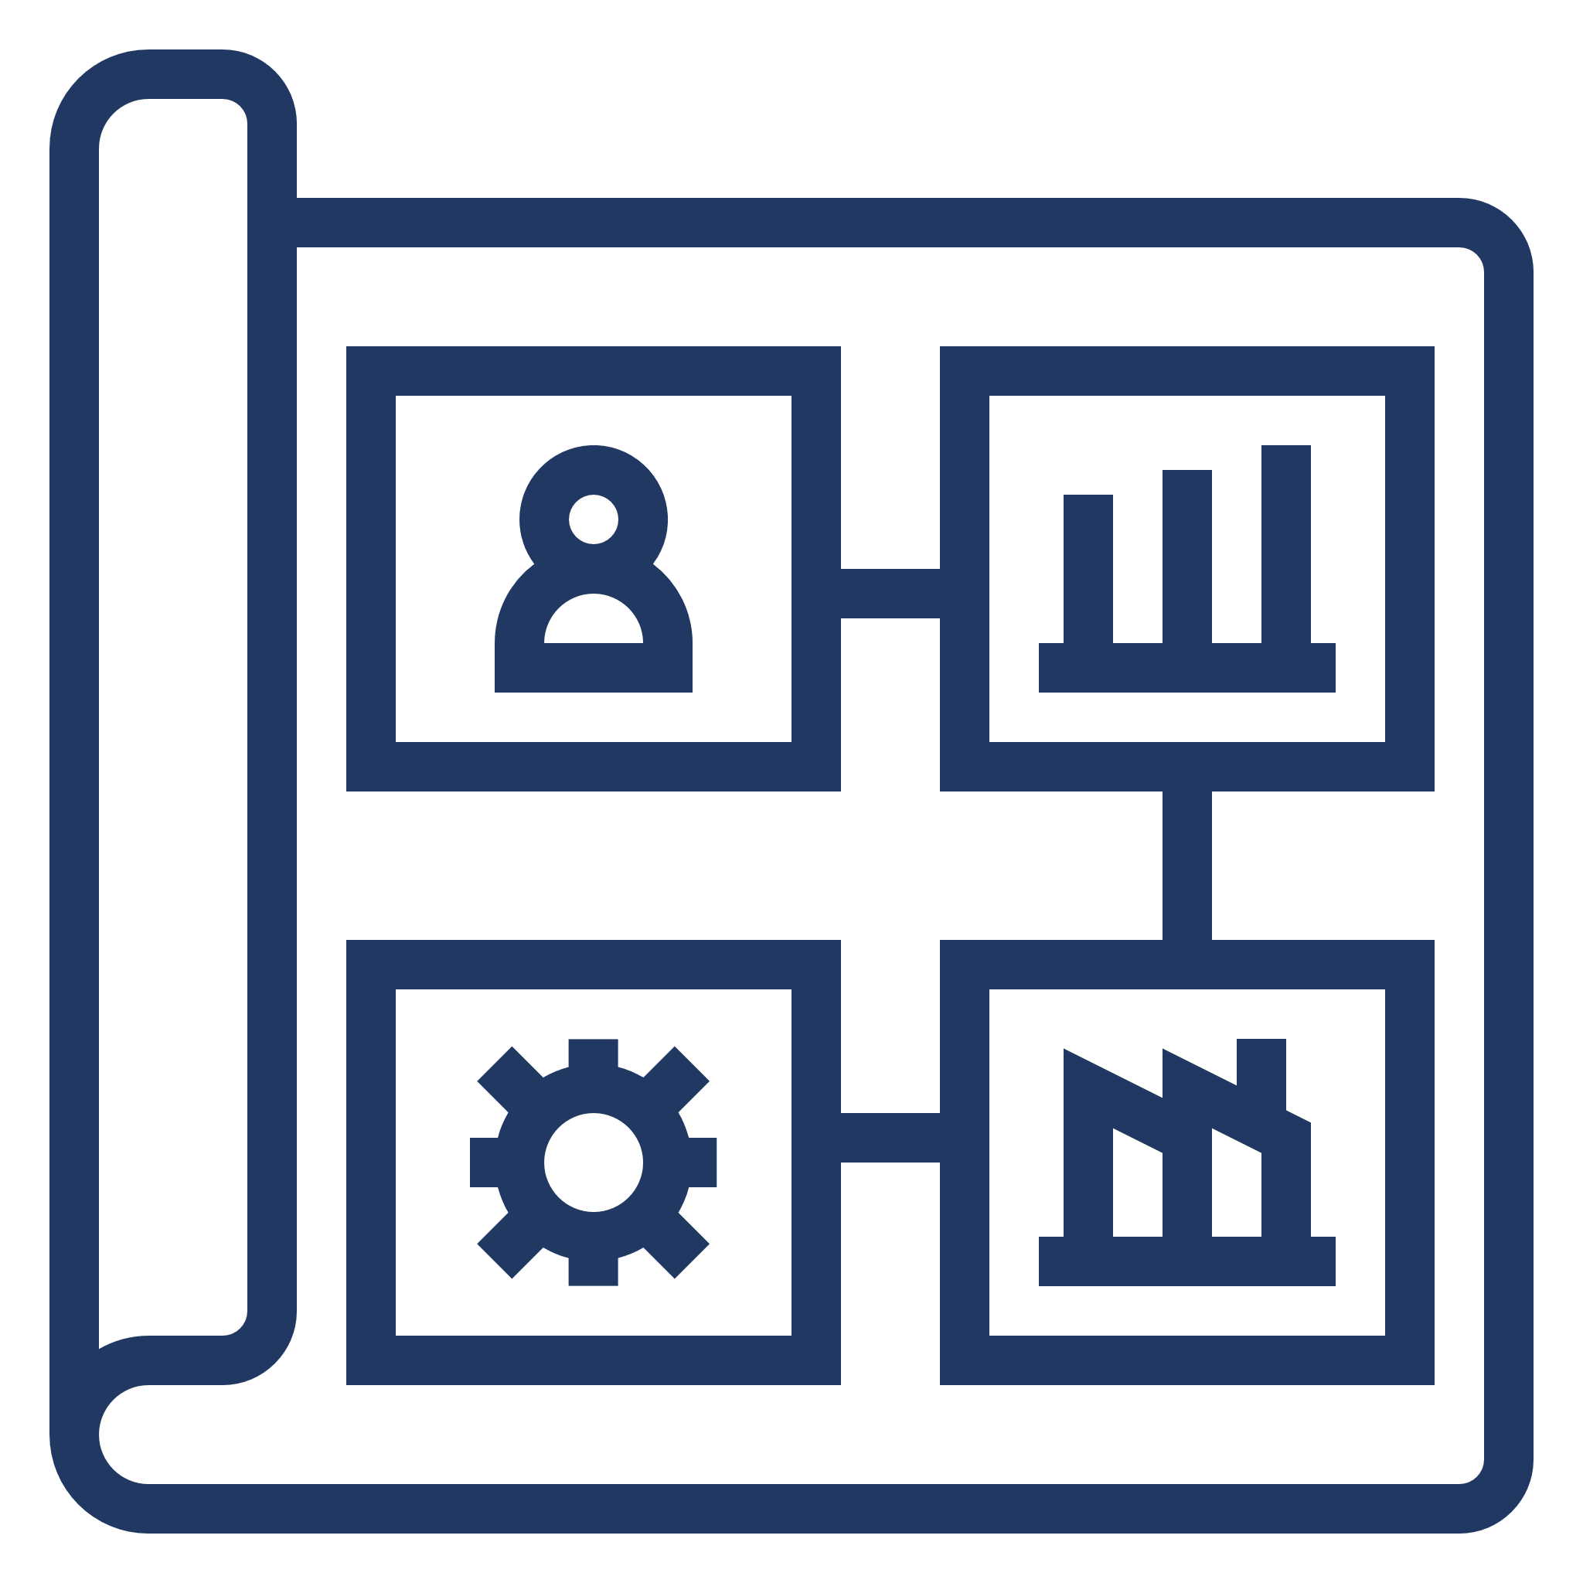


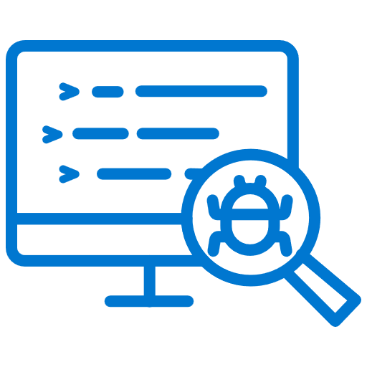

CSF #1: Selecting the Right Partner(s) … Start to Finish or Surgical Needs?
We go beyond just Due Diligence. We are Start-to-Finish M&A Partners pre- and post-close. Our proprietary, best-practice accelerators give us a unique advantage to decrease timelines, reduce risk and prove to you, your board, auditors, and regulators that we got it right.
Technology Due Diligence
IT Operational Maturity Assessment
Risk Identification, Red Flag Report & Remediations
Cost, Investment, Opportunities Roadmap
Initiation
Execution
Go-Live
Charter/Scope
Business Case
Governance & Comms
Integrated Program Plan / RAID Logs
EPMO & Team Status Reporting
Command Center Setup
& Execution (runbooks)
Organizational Readiness
Solution Architecture /Blueprints
Project Kick-Off
& Alignment
Board/Executive Presentations
TSA Financial Tracking
Data Reconciliation & Controls Balancing
Real-Time Updates / Executive Dashboard
Vendor/Product Integration Mapping
Business Processes & RACI
Full SDLC Template Library
Mock Conversion Strategy
Rapid Issue / Defect Management
Ongoing Production Support
Notes:
Our deep experiences led us to creating a repeatable, better, faster, quicker, best practice-based proprietary toolset to ensure we are successful and can prove we got It right

Slide 6
CSF #2: Structuring the Implementation Team for Success!
Combined Board of Directors
MEMBER READINESS
ORGANIZATIONAL
READINESS
Executive Leadership
GOVERNANCE, LEGAL &
REGULATORY
BUSINESS READINESS
SYSTEMS READINESS
Merger Steering
Committee
A key foundation for success is the formation of governance and communication mechanisms, early on
All business areas need to be at the table, working collectively towards the common goal
Openness, frequent engagement, active participation, and clear accountability
Future State Org Structure
Transitional Org Structure
Employee Support
Member Transition Support
Communication Planning & Member Relations
Work Stream Owners
Oversight – Internal Audit, Regulatory Compliance,
Risk Management
Support Staff – Administrative & External Consultants
Board Governance
Legal & Regulatory Filings
Merger Application & Approvals
Accounting Issues & Processes
Investments Funding & COs
Capital & Balance Sheet Restructure
Risk Analysis, Mitigation & ERM Processes
Other Business Processes
System Integrations
Data Selection & Migration
Reporting

Slide 7





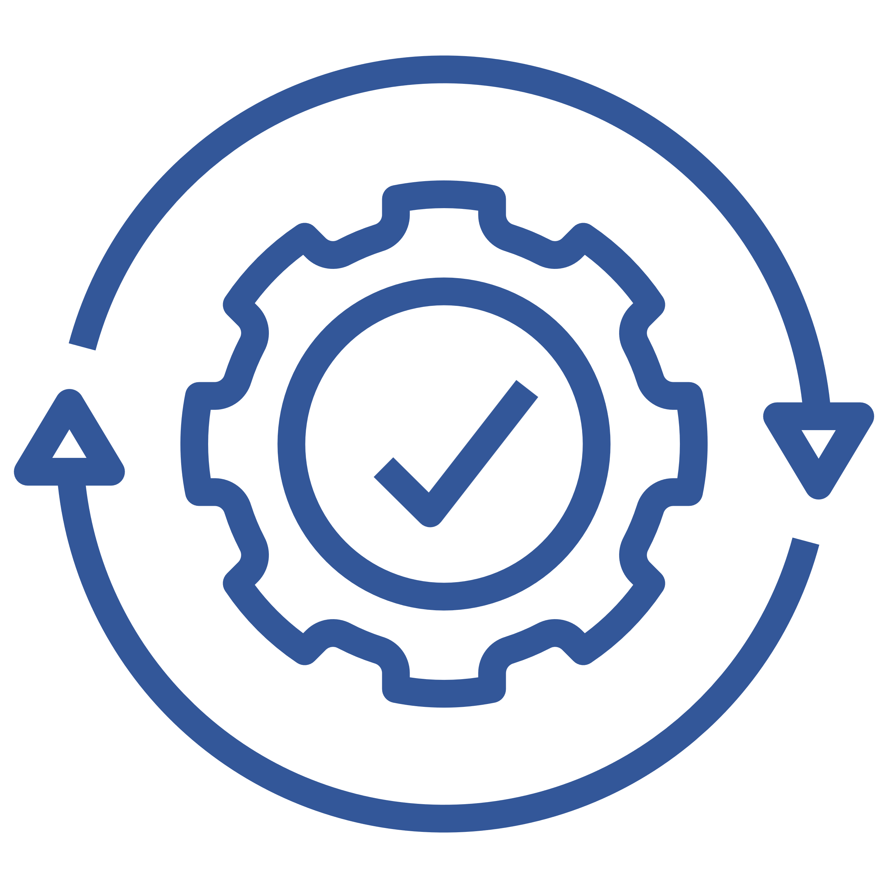









CSF #3: Roadmap Value Opportunities Post-Close and Post-Integration
1R Strength
Company + 1R Support
Post Close
Go live
Post Integration
01
02
03
Integration Phase, to realize value of the merger or acquisition and setup growth engine
Surgical Coordination
Maximize future value and reduce cost
SYSTEMS READINESS
Company A + B
Solution Blueprint
Application Consolidation
Data Conversion
Updated Integration(s)
Data Warehouse
Reporting
Data Archive
Parallel & Performance Testing
Command Centre Planning
(Runbooks)
Modernization – AI/ ML
Company A
Optimized Solution / Integration
ORGANIZATIONAL & BUSINESS READINESS
Robotics / Automation Processing
Legal/ Regulatory
Balance Sheet Consolidation
Member / Customer Communications
Functional Mapping
Command Centre Execution
Future State Org Structure
Business Testing
Training & Enablement
Internal & HR Communications
Remove technical debt
Growth Engine begins
AUDIT & COMPLIANCE
Company B
Reconciliation
Validation
Full Audit Trail
Proof of Success
Contingency Planning
Regulatory updates
PROGRAM MANAGEMENT
Stakeholder Alignment
Estimation & Planning
Status Reporting
Risk Management
Defect Management
Communications
Incident Management
Production Support
Notes:
TaskiePro - Track thousands of tasks and hundreds of people while managing a project or repetitive events. Instantly interpret the tactical status of in-flight projects and events, all in one app
1DataServices - Give your business teams X-Ray vision to research, validate and correct data discrepancies across all your enterprise systems - prevent critical issues before they occur

Slide 8

OUR TEAM, EXPERIENCE, & ACCELERATORS IN DETAIL

Slide 9
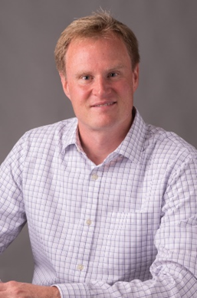
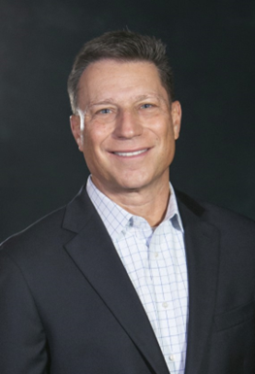
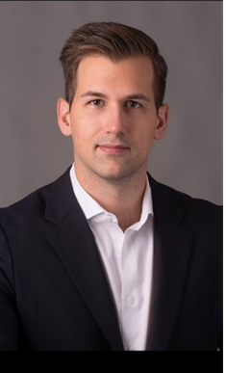
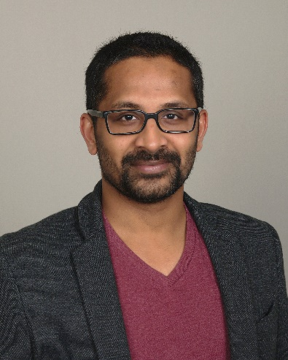
OUR TEAM
Eric Middleton has over 25 years of experience delivering complex systems and business integration programs. In depth knowledge of program management, marketing and technology consulting experience. A hands-on team player expertly skilled at all phases of the SDLC, building long term customers, implementing large scale technology programs, digital marketing strategies, business intelligence, content management systems, data conversion and archive architecture and solutions. Eric has delivered mission critical merger integrations initiatives for Fortune 500 clients.
Mike Wolk has over 30 years of experience in serving clients globally in financial services and energy trading. Leveraging his experience in IT and Financial Operations, Mike is a hands-on program and project leader with 1Rivet’s team of technology specialists. Mike’s career includes 15 years with Accenture, where as part of the business strategy practice defined pre-deal technology integration programs and delivered IT synergy savings for client M&A transactions. Mike also led several enterprise IT implementations for Fortune 500 clients. Mike also led multiple Trading & Risk Management implementations while with SunGard Consulting.
Derek Swank has over 15 years of Program Management and M&A delivery experience. He is used to leading from strategy through implementation of large-scale, complex, transformative programs typically touching all front, middle and back-office facets of an organization. Derek thrives as a leader and point of accountability, and has guided major organizations like CPPIB, GE Capital, Antares Capital, FHLB, ARI Fleet and TD Bank through successful mergers, acquisitions, divestitures and carve-outs. His hands on approach gives him detailed insight from the bottom up to give BoDs, senior executives and stakeholders the transparency they need to confidently navigate through intricate complexity and risk.
Krishna Nair has over 19 years experience working at the intersection of audience and technology, Krishna has led large-scale integrations of systems and data, managed content across omni-channel platforms and worked with some of the best-known brands including Nike, Western Union, Verizon, Sprint, ADT and Harvard University. His global leadership experience driving technology excellence grew from his love of design and development challenges. He still likes to jump in and write code when challenges arise. Before joining 1Rivet, Krishna was a senior technology manager at SapientNitro and a senior technology delivery manager at Fannie Mae. At 1Rivet, Krishna is Chief Technology Officer.

Slide 10


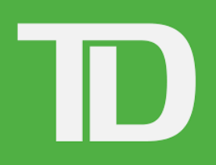

OUR EXPERIENCE
Every merger, acquisition, or divestiture is unique and requires specific expertise. 1Rivet’s IT Integration experience with complex transactions provides the right Due Diligence input. We get ‘our hands dirty’ during due diligence, strategy, implementation, go-live, and support.
TD BANK (FIRST HORIZON) - KEY WORKSTREAM LEAD ROLES
24+ month timeline to integrate First Horizon (~$90B AUM) - ongoing
1Rivet staffed into key Workstream Lead positions for Host Core, Distributed Core Data, Wealth & Archive / Decommission
Leverage accelerators, toolkits and expertise from Commerce Bank / TD BankNorth migration
Able to parlay TD technology system knowledge, line of business familiarity & recency experience into Cowen integration
ANTARES CAPITAL (GE Capital & CPPIB) – DIVESTITURE & SYSTEMS INTEGRATION
Migrated all front, middle and back-office processes and data from 30+ legacy GE Capital systems, $120B in syndicated financing deals, on-time in 14 months.
Executive status updates with joint board, Canadian Pension Plan, GE Capital and Antares stakeholders (took over EPMO from Deloitte).
Program Management of all application vendors to install, configure, train employees on 4 new cloud-based applications (CRM, SubLedger, GL, Payments).
Responsible for all Solution & Integration Architecture, data migration, ETL conversion, interfaces, new enterprise data warehouse, reporting migration to PowerBI.
TD BANK (SOUTH FINANCIAL GROUP – TSFG and FDIC ACQUISITION) – ACQUISITION
18+ month timeline to merge to complete the data conversion and data archival. This included both Carolina First Bank and Mercantile Bank.
This program also included data conversion and data archival for FDIC based acquisition of First Federal Bank of North Florida, AmericanFirst Bank, and Riverside National Bank of Florida
Command center and mock conversion planning, management and execution using proprietary toolkit to prove 100% accuracy to bank and auditors.
FEDERAL HOME LOAN BANK – MERGER (SEA & DSM)
Strategy, planning and execution of the first and only successful merger between FHLBs ($30B in assets).
Migrated all business data and processes, on time, in less than 7 months - high visibility with auditors, federal regulators.
Leveraged proprietary tools/accelerators to prove that all customers, accounts, complex derivatives data was moved with 100% success on GoLive weekend.

Slide 11

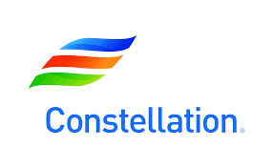

OUR EXPERIENCE
Client Success Stories continued…
ARIEL INVESTMENTS – TRANSFORMATION INITIATIVES
Trading Platform Migration (2020-2022) – Program management of a complex conversion to ‘best-in-class’ trading platform (Charles River)
Client Investor Reporting (2022)– Migration and automation (dynamic data feeds) of client monthly, quarterly, year-end client services reporting
CRM Replacement (2023) – Program management, configuration and data migration of a legacy CRM system into Dynamics CRM.
TD BANK (Commerce & BankNorth) – ACQUISITION & MERGE
Distributed Systems Data Conversion – Strategy, full SDLC implementation to convert all structure and unstructured data from distributed systems.
Command center and mock conversion planning, management and execution using proprietary toolkit to prove 100% accuracy to bank and auditors.
Analyzed around 10TB of data and archived required data based on retention policies
Implemented e-discovery solution for archived data to handle legal holds and data destruction based on retention policies.
CONSTELLATION – MULTPLE GLOBAL ACQUISITIONS
IT Due Diligence and Trading & Risk Management system migrations. Delivered Trading & Risk Management application data conversions and business process consolidation.
Designed and built custom P&L application to incorporate multiple trading business units and support the CFO’s organization for financial reporting. Built interfaces to the corporate ERP system.
Led data conversion, testing and go-live efforts on multiple mission critical projects.
BROADRIDGE FINANCIAL – UNDISCLOSED
Newly hired CTO Asset Management is a ‘change agent’ with specific expertise in large, complex, transformative projects
1Rivet has partnered with this CTO across multiple initiatives in the past and has been approached for assistance in 2023

Slide 12


OUR PROVEN, ACCELERATOR-DRIVEN APPROACH
Extract & Transform
Accurately pull legacy data & transform to target
Test the end-to-end automation processes
Enrichment – identifying and correcting bad data
Resolving automation errors
Pull the right data every time
Validation
Continue to Test and
Validate data
Bank to Bank Reconciliation
Ensure data is accurate
Testing of converted data
Comfortable with old data in new systems
Checklist
Document All Tasks both business and technology
Capture all needed tasks and owners
Determine timings and dependencies
Readiness criteria met
Contingency planning
Repeat
Practice, Practice
.. and learn from mistakes
Practice all tasks and timings over and over
Each mock improves on the previous (lessons learned)
Know our expected results
Assess and mitigate Risks for go-live
1Rivet Proprietary Accelerators
Notes:
Data-and-results driven framework to guarantee your source data matches your target data before golive and the audit tool that proves you got it right to your board, shareholders, any and all sorts of audit, compliance, regulators.

Slide 13
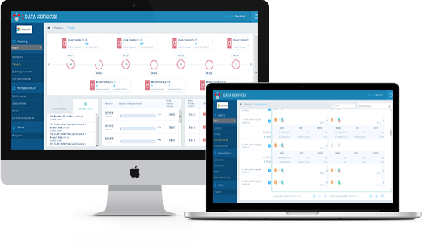
1DATASERVICES
Overview
1Dataservices is a web application designed to compare large scale of data and track database migration for business organization
1DataServices validates data before it impacts core and downstream systems
Say goodbye to manual data reconciliation and hello to business and IT users interacting within the framework to research
Data
Reconciliation
Accountability
Data Migration
Webservices
CORE FEATURES
1DataServices saves time and money by running programs during parallel testing, mergers, system conversions, migrations and divestitures
1DataServices gives users an X-ray vision into data discrepancies and variances between and across systems. It creates an automatic system history and audit trail to show compliance, accounting and that financial colleagues’ data transferred properly with nothing left behind
1DataServices avails automatic data migration functionality. It directly eliminates incorporation of data migration team
1DataServices allow user to gathered data from different data sources in the form of end-points with allowing users to perform various operations(Insert, Update, Delete) on it.
Notes:
1DataServices - Give your business teams X-Ray vision to research, validate and correct data discrepancies across all your enterprise systems - prevent critical issues before they occur

Slide 14
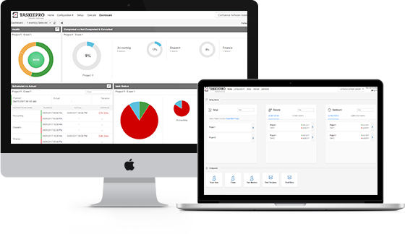
TASKIEPRO
Overview
A web application to track thousands of tasks and hundreds of people while managing a project or repetitive events
Instantly interpret the tactical status of in-flight projects and events
Provides status reporting, and is fully auditable
Task Management
Project Tracking
Audits
CORE FEATURES
TaskiePro provides a central location for all tasks, overcoming the problem of tracking project status manually. It handles repeatable tasks and also links dependable tasks. Project Manager can check status of all the tasks by using this excellent tool.
Any team member can log in to see which tasks are in progress, completed or not started. TaskiePro provides status of every project and event from a single screen
TaskiePro creates an auditable log showing when each task starts and finishes. In future audits, the log files shows what got done, who did the task and when.
Notes:
TaskiePro - Track thousands of tasks and hundreds of people while managing a project or repetitive events. Instantly interpret the tactical status of in-flight projects and events, all in one app

Slide 15
CLOUD ENABLEMENT
Overview
We analyse your IT ecosystem and score it based on your priorities (IT vision, Risk, and Time) to help you make decision. It prioritizes activities that can be handled during Day 1 without impacting timeline and provides a roadmap for post-integration.
Our focus during Day 1 is to maximize your investment and minimize the implementation timeline.
Reduce Risk
Accelerate Implementation
Modernize Integrations
Azure Partnership
CORE BENEFITS
Reduces Infrastructure & application security risk by building or using industry compliant ready to use cloud services.
Reduce time to execute by building IaaS container -based environments. Our dedicated Infrastructure team can setup any environment with minimum notice.
Our cloud expertise can help in accelerated cloud adoption and modernize your ecosystem without impacting your integration timeline.
We are Microsoft/Azure Partner in multiple solution areas. With 25+ Azure implementations, we have very detailed knowledge on Azure capabilities.

Slide 16
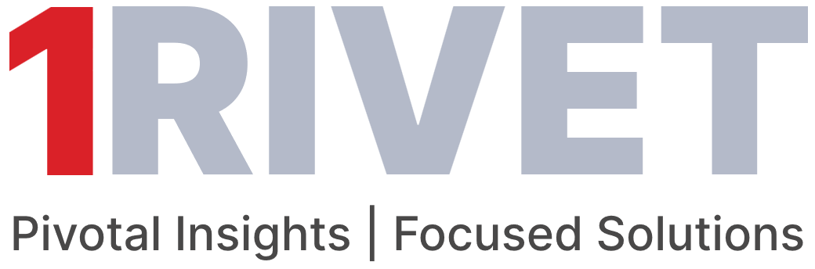
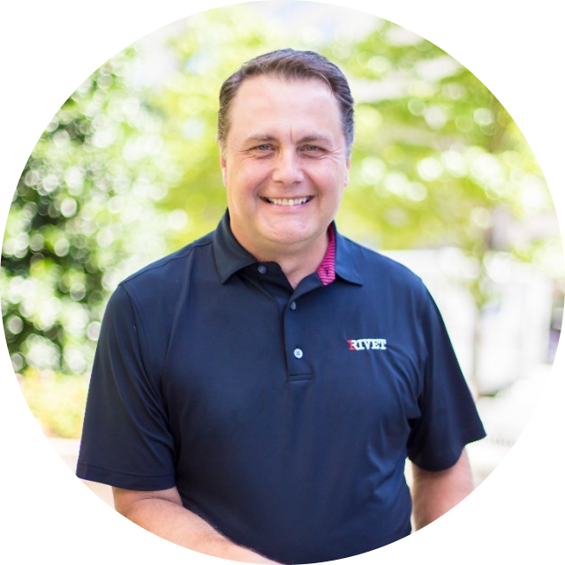
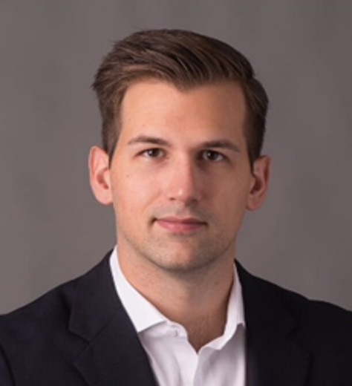

CONTACTS
Mike Rolfes
Derek Swank
443.985.0449
609.920.3846
mike.rolfes@1rivet.com
derek.swank@1rivet.com

Slide 17
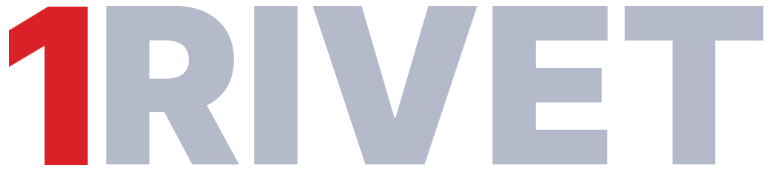



On time, On budget & On point
Global talent without the price tag
Driving projects for your success
THANK YOU!

Slide 18



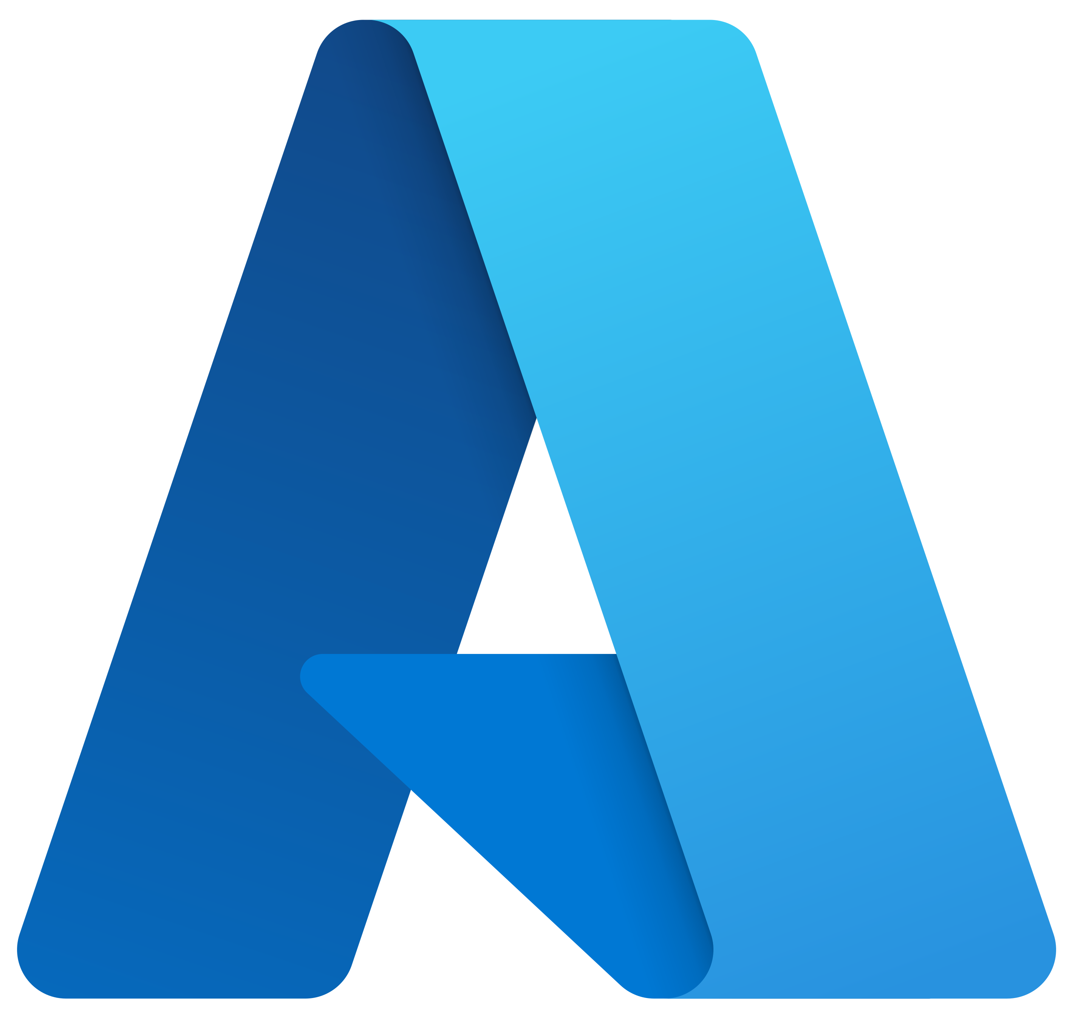






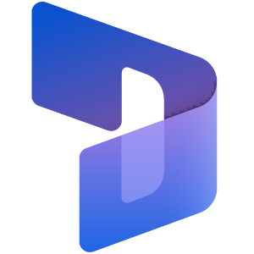







OUR M&A LIFECYCLE SERVICES
INTRODUCTION
FOCUS AREAS
We are a Global IT consulting company, providing value-driven M&A services to clients worldwide
Technology Due Diligence (Rapid)
Data Conversion, Validation & Recon
Rapid 2–3 week assessment, identifying major risks or “red flags” that might put the deal in jeopardy
15
Technology Due Diligence (Comprehensive)
Custom Application & Integration Development
A deep-dive into all systems and applications to identify risk and create a roadmap of value-driven opportunities
Years in Business
HIGHLIGHTS
375+
Employees (US/India)
AI, RPA & Machine Learning
Post-Close Implementation
150+
End-to-End “hands on keyboards” solution, integration, development, testing, reconciliation, and support teams
Certified Professionals
Microsoft
Dynamics 365
Technology Modernization
Optimization and Growth initiatives to accelerate value leveraging AI, ML, RPA, automation, or cloud migration
Mike Rolfes (EVP Sales)
PROPRIETARY ACCELERATORS
mike.rolfes@1rivet.com
Battle-tested tools and methodologies to hit the ground running, no matter where you are in the implementation roadmap
443-985-0449
M&A ‘IN-A-BOX’
Eric Middleton (CEO)
Track thousands of tasks across hundreds of people and instantly interpret the tactical status of your project go-live or repeatable event
eric.middleton@1rivet.com
TEAM MEMBERS
X-Ray vision to compare and reconcile large sets of data being migrated or transformed, highlighting discrepancies across systems
Derek Swank(CDO)
derek.swank@1rivet.com
Krishna Nair (CTO)
Why 1Rivet ?
krishna.nair@1rivet.com
We deliver Value, on Time, & on Budget !

