Slide 1
Introduction
Avaap Data Analytics Services
AI Domains and Areas of Opportunity
Predictive Models
Generative AI for Free Text Field Analysis
Software Product AI Features
Office Worker Operational Efficiencies
Demo

Slide 2
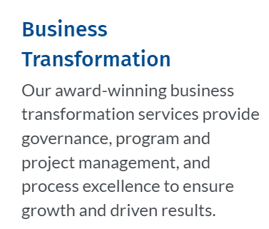
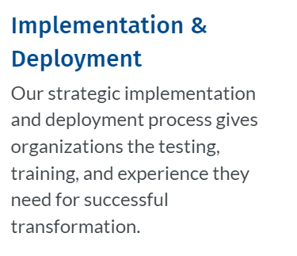
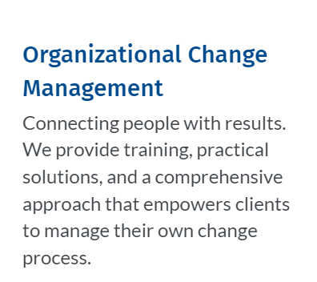
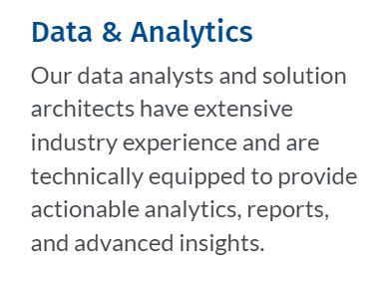
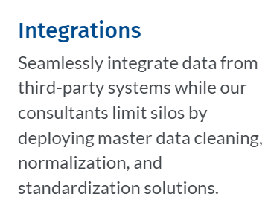
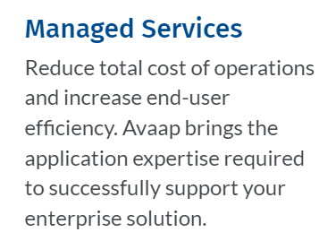
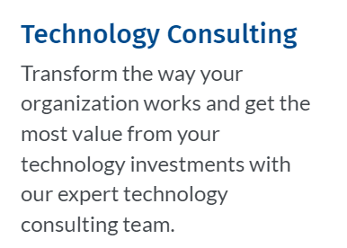
THE ELEMENTS OF A GREAT BUSINESS
It’s more than just a name – we fully believe in harnessing our values and maintaining the positive culture we built since our inception in 2006. We’re focused on addressing critical business gaps across various industries and treat every customer like it’s our first, approaching each of their needs with an unwavering attention to detail and meeting the ultimate goal of accelerated growth.
REPRESENTATIVE SOLUTION PARTNERS
Notes:
Since early 2000’s, Avaap has been helping organizations transform their operations and meet business goals
We continue to experience tremendous growth and are fortunate to have 200+ customers across healthcare, nonprofit, education, and government
More than 400 exceptional business and technical consultants, data strategists and change management professionals have chosen to build their career at Avaap, offering our clients the most experienced pool of certified consultants in the industries we serve
Avaap has won 100+ industry awards for its partnerships, services, innovation, culture and growth
Avaap’s mission is to successfully partner with our customers in their pursuit of digital transformation, delivering outcomes-based services to support their business goals.
Avaap’s service offerings help ensure client and project expectations are exceeded. This starts with:

Slide 3
Our Services
From Selection to Support
FULL LIFE CYCLE SERVICES
Organizational Transformation Services
SYSTEM SELECTION | ORGANIZATIONAL READINESS | PROJECT MANAGEMENT | PROGRAM GOVERNANCE | CHANGE MANAGEMENT | BUSINESS ANALYSIS | PROCESS DESIGN | STRATEGY & ROADMAPS | QUICK START ENABLEMENT | SOLUTION IMPLEMENTATION | COE DEVELOPMENT | DIGITAL TRANSFORMATION | CLOUD DEPLOYMENT | MANAGED SERVICES | CLOUD ADVISORY SERVICES | INTEGRATION | EMERGING TECHNOLOGY
IMPROVE PERFORMANCE & MANAGE DISRUPTION
Data and Analytics
MAKE INFORMED DECISIONS
Workday Services
And beyond…
DEPLOY WITH CONFIDENCE
CROSS-INDUSTRY SUCCESS STORIES
Notes:
BUSINESS TRANSFORMATION: Our business transformation experts help lay the foundation for success by eliminating many of the front end "gotchas" that come up when you go blindly into an implementation. Avaap offers a full suite of advisory services including system selection, process excellence, and organizational change management.
DATA ANALYTICS: Our data analytics team help organizations get the most value from their data in real time and set leadership up to make decisions faster and with more confidence.
CHANGE MANAGEMENT: Avaap's market-leading change management practice is powered by research, data, and proven practices personalized for your business. Our OCM experts help organizations connect people with results.
WORKDAY: Avaap is one of the fastest growing Workday service partners. Our consultants can help your organization get the most value from your Workday investments, from implementation, through go-live and training, to optimization and application managed services.

Slide 4
Avaap Data Analytics
Service Offerings
Data
Platform (Warehouse, Data Lake)
Center of Excellence Development
Data Management Strategy & Roadmaps
Managed Services
Data Engineering and Data Analytics
AI & ML
BETTER INSIGHTS● FASTER TIME TO VALUE● INCREASED ADOPTION

Slide 5
Avaap Data Analytics
Partnerships
Team Partnerships
Solution Partnerships
BETTER INSIGHTS● FASTER TIME TO VALUE● INCREASED ADOPTION

Slide 6
AI Domains and Areas of Opportunity
AI Predictive Models (Today’s Avaap Demo)
We’re deeply skilled in predictive AI models
Avaap differentiators
Combining desperate datasets
Robust visualization-based front ends
Use Cases:
Fraudulent transactions
Call center wait times
Health outcomes
Credit default risk
Success Story: Avaap saved the State of Ohio over $1 Billion in unemployment insurance fraud by using AI models to detect fraudulent unemployment insurance claims.
Generative AI Insights from Free Text Fields
Free-text data is often unusable and “locked-up” within relational DBs.
Avaap can help make sense of the data using Generative AI and LLMs.
Snowflake and Mistal AI LLM.
Software Partner AI Features
Our software partners are productizing and delivering AI as features within their software.
Avaap’s delivery teams have experience implementing these AI capabilities through our existing implementation services.
Examples:
Workday supports AI in recruiting, talent management, and employee experience. AI is used to screen resumes to identify candidates that match job descriptions.
Tableau provides Generative AI capabilities through Tableau Pulse.
Snowflake is delivering Generative AI interfaces to Snowflake data through Mistral AI LLMs.
Office Worker Operational Efficiencies through AI Upskilling (OCM and Training)
Avaap is helping organizations deliver change management and training to office workers to increase daily task productivity with AI tools like Microsoft Copilot.
This is about people/process (training and governance) and less about implementing technology.

Slide 7
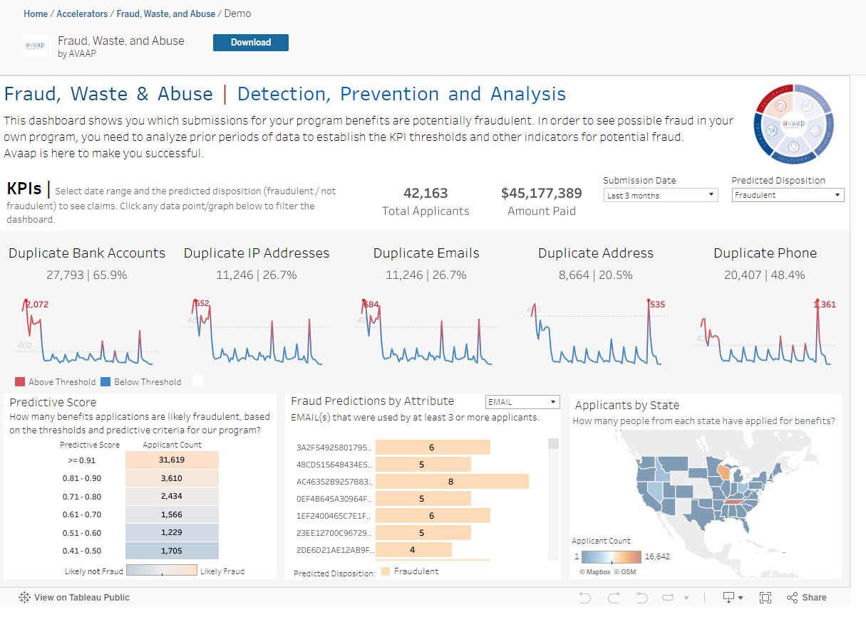
DEMO
Avaap – AI Predictive Modeling in the domain of Fraud, Waste and Abuse

Slide 8
Thank you
Together we will solve any project challenge while driving your organization to a better state.

