Slide 1
Converge Technology Solutions
Services-Led, Software-Enabled IT & Cloud Solutions Provider

Slide 2
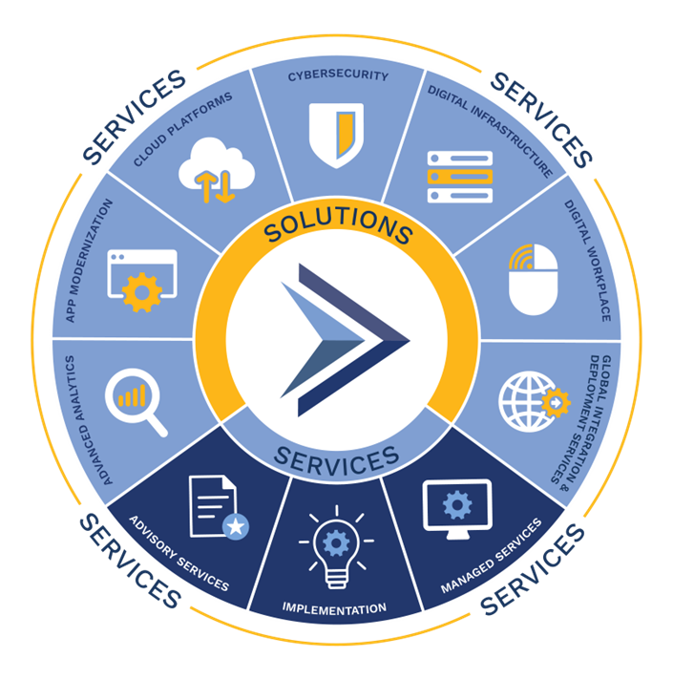
Company Overview
Converge is a services-led, software-enabled, IT & Cloud Solutions provider focused on delivering industry-leading solutions.
Converge supports these solutions with advisory, implementation, and managed services expertise across all major IT vendors in the marketplace
Notes:
Converge Technology Solutions Corp. is a services-led, software-enabled, IT & Cloud Solutions provider focused on delivering industry-leading solutions. Converge’s global approach delivers advanced analytics, application modernization, cloud platforms, cybersecurity, digital infrastructure, and digital workplace offerings to clients across various industries.
Converge supports these solutions with advisory, implementation, and managed services expertise across all major IT vendors in the marketplace. This multi-faceted approach enables Converge to address the unique business and technology requirements for all clients in the public and private sectors.

Slide 3
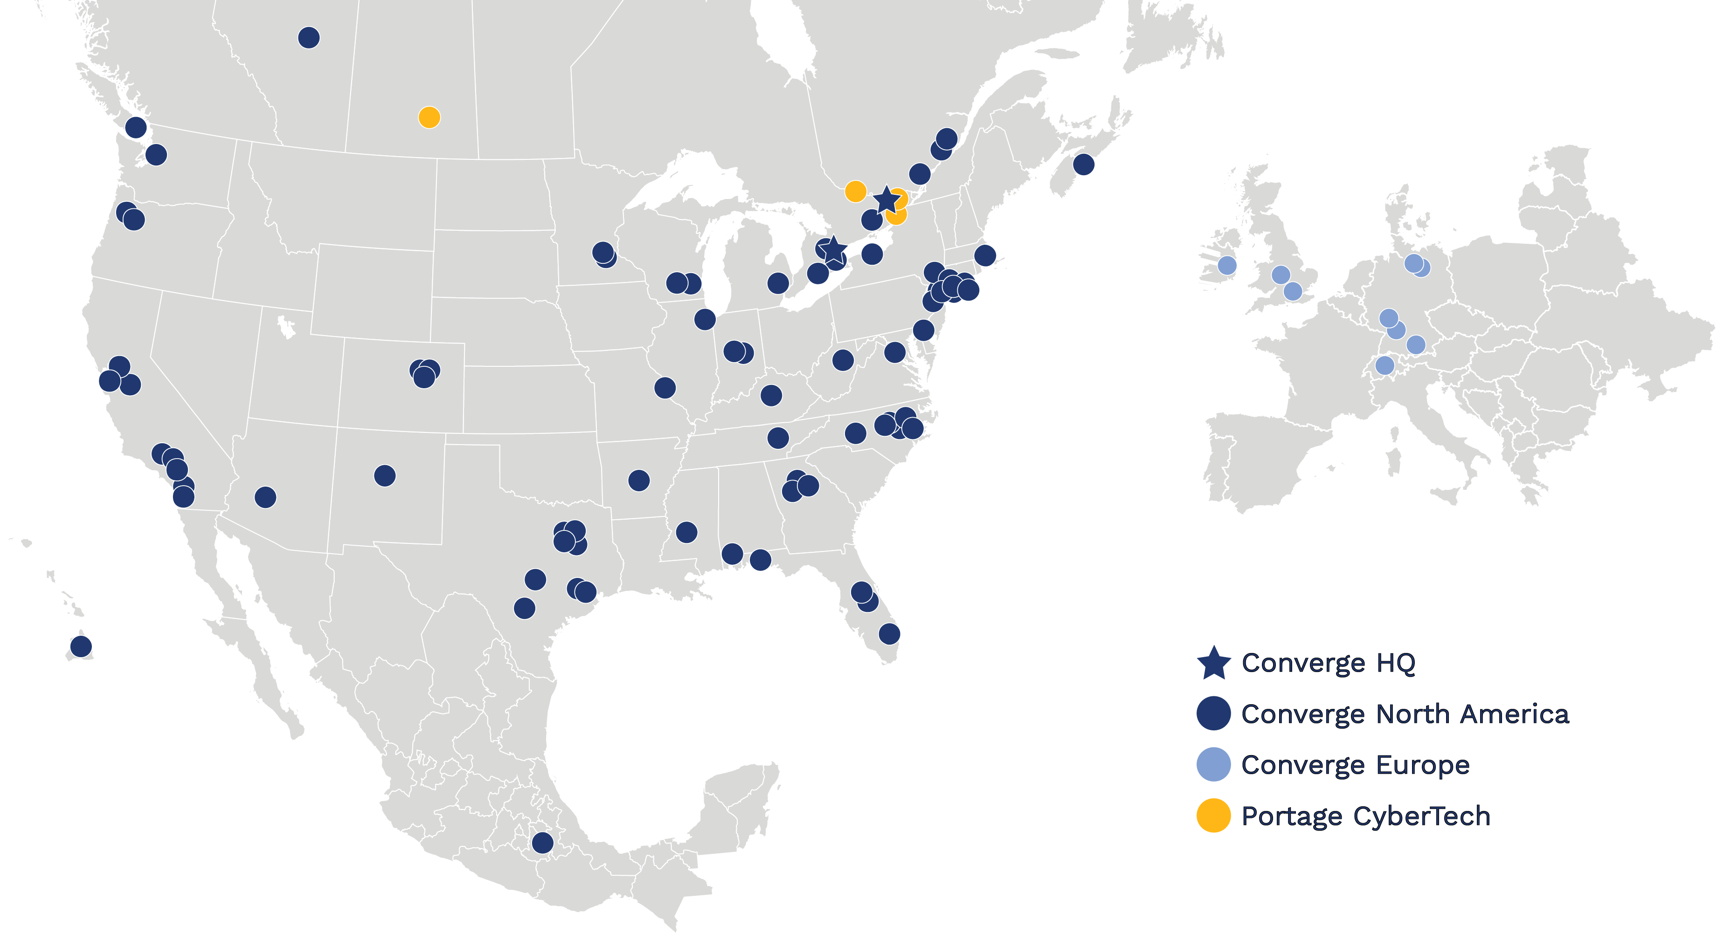
Converge Platform
Scaled Footprint with Strong Partner Relationships and Capabilities
60+
Office
Locations
400+
NA Sales Personnel
1,200+
NA Technical Resources
Canada
400+
UK Personnel
300+
Germany Personnel
350+
EU Technical Resources
Central
Northeast
West
Europe
with
Southeast
1,000+
Certifications
4,000+
Customers
Mexico
10
Key Partner Relationships
1,000+
Total Partner Relationships

Slide 4
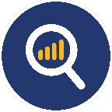










Fully Integrated Set of Solutions & Services
A Full Suite of Solutions…
Advanced Analytics
AI/ML
Business Analytics
Data Visualization
Data Platforming & Integration
Financial & Operational Mgmt.
Robotic Process Automation
Application Modernization
Application Development & Migrations
DevOps
Containers Services & Kubernetes
Automation & Orchestration
Observability & Intelligent Ops
Integration & Middleware
Cloud
Platforms
Cloud Foundations & Landing Zones
Cloud Migrations
IBM Power on Cloud
VMware on Cloud
Infrastructure as Code & Automation
Cloud Governance & Operations
FinOps & Cost Optimization
Cybersecurity
Advanced Testing
Governance, Risk & Compliance
Incident Response
Architecture & Integration
Strategic Staffing
Managed Security
Digital Infrastructure
Datacenter & Compute
Intelligent Networking
Customer Experience
Multi-site Deployment
Configuration Centers
Infrastructure Security
Digital
Workplace
Voice & Unified Communications
Workplace Productivity Solutions
Endpoint Management Solutions
Virtual Desktop Solution
End User Compute
GIDS
Planning/Acquisition
Configuration
Deployment
Support
Management
Retirement/Disposal
…Delivered Through End-to-End Service Offerings
Advise
Architecture Planning & Insights
Roadmap Design & Prioritization
Software Asset Management
Strategic Transformation Workshops & Assessments
Implement
Agile Methodology & DevSecOps
Build & Design
Integration & Support
Program & Project Management
Talent Services
Manage
Service Desk & Managed ITSM
Managed Applications (AMS)
Security Operations Center (SOC)
Infrastructure Operations Center (IOC)
Notes:
Strength and uniqueness in the market
Focus on AIM – delivery anywhere
Technical and Sales Talent we have in the organization
And our vendors are taking notice – awards, recognition, etc.

Slide 5

We Want to get you “Here”

Slide 6

Converge Technology Solutions
Data Modernization:
You Are Here and We Can Help

Slide 7

Legacy “Data Estate” Symptoms
Employees who need data have no idea what data is available.
Finding the right data is often trial & error – calling multiple people and hoping they know where the right data is.
Nobody has the overview of what data is where, what the quality of that data is, and how to access it.
Data is replicated many times, each time in a unique form.
“Lets look for sales units and $ for last quarter for balls by region”
Big Data ➔ Bigger Confusion

Slide 8
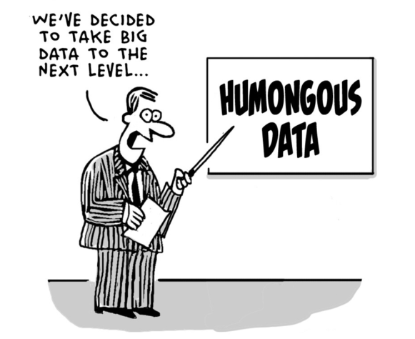
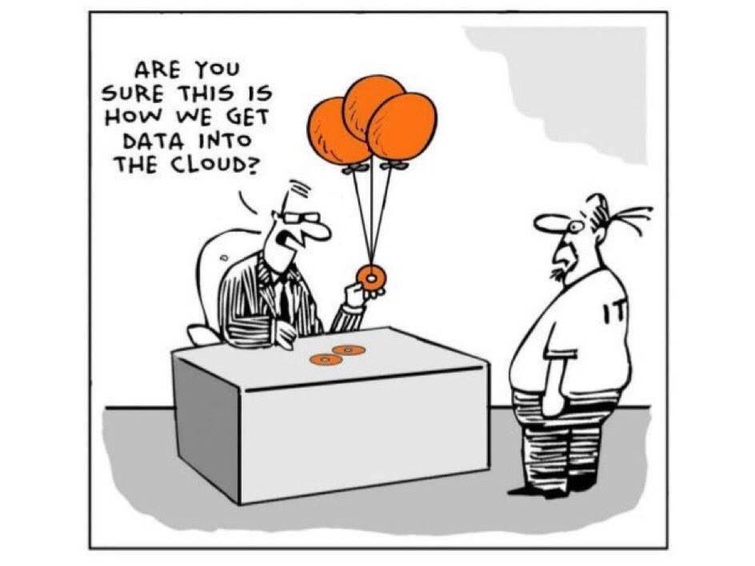
4 Common Themes of a Customer’s “Data Estate”
None or multiple BI/Budgeting tools or their implementation is poor or uses legacy mindsets
Embarking on or invested in a Data Lake or Warehouse
Data is everywhere and rapidly growing and are moving to the cloud
Increased needs for advanced analytics such as AI & Machine Learning

Slide 9

Build for the Library even if it is only one Shelf
Small Wins help propagate continued success
Stake in the Ground vs Boil the Ocean
Agile Sprint Methodology
Scalability, Repeatability, Agility
Monetizing and Productizing Data quickly
Increase Data Literacy, Trust, and Adoption
Reduce the Cost of Ownership
Perfect is the enemy of Complete

Slide 10







DATA GOVERNANCE ROADMAP
WHAT DOES IT CONTAIN?
Create a Strategy
Define the Data Governance Strategy ​
Connected to your business goals​
We recommend taking the first natural steps as outlined in this roadmap.
Governance Charter Creation
Council Assignments
Define Goals
Define Measurements
Create Policy and Procedures
Define Tools
Complete Assessments
Define and Rollout
Operating model – Charter
RASCI assignments
Define and Measure
Baseline measurable improvements
Track progress and look for success
Deploy Framework
Data acquisition, creation, management, dissemination, usage and destruction
Select Tools & Resources
Baseline measurable improvements
Track progress and look for success
Assess & Improve
Quarterly and annual reassessment to improve based on our metrics
Refine
Based on quarterly review (or as business goals change) – adjust strategy
Notes:
This is a high level of our methodology on building a data governance roadmap for our clients. This is designed to be executed in smaller projects that’s relegated to certain data stacks and lines of business. Once accomplished, we can move onto the next project- very much in the vein of a sprint methodology.

Slide 11


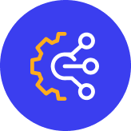

Our Capabilities
AI & Machine Learning
Business Analytics
& Data Visualization
Data Platforming
& Integration
Financial & Operational Analytics
Generative AI
Application Development
Deep Search
Virtual Agents
Visual Insights
Predictive Analytics
Data Science
(RPA) Robotic Process Automation
Self Service & Dashboarding
Metadata Modeling
Analytics Governance
Enterprisee Reporting
Data Visualization
Modernization of Current BI Tool
Data Architecture
Data Modeling
Data Integration
ELT/ETL
Data Governance
Planning
Budgeting
Forecasting
Financial Reporting & Analysis
HR Planning
Predictive Forecasting
30+
Our practice boasts a 30+ year heritage to accelerate business outcomes through emerging technologies. Our portfolio includes thousands of projects spanning all industries.
100+
Our team of 100+ dedicated experts support clients with strategy, design, development, deployment, managed services and support of critical work loads, application modernization and green field solutions across North America.
10x
Our success drives 10x business outcomes through our strategic, transformative thought leadership coupled with our innovative, multi-partner, technology solutions.

Slide 12
We Want to get you “Here”

Slide 13


THANK YOU!

