Slide 1
2024 Corporate Overview
Ben Faraone
CTO/CISO
April 25, 2024

Slide 2
WHO WE ARE
WE WERE THE CUSTOMERS.
WE'VE WALKED THE MILE IN YOUR SHOES.
THAT IS WHAT MAKES US YOUR TRUSTED PARTNER.
FOUNDED: 2008
HEADQUARTERS: ELLICOTT CITY, MD
WHAT WE DO
WE LIVE BY A "CUSTOMER FIRST" MENTALITY.
WE STRIVE TO DELIVER NOTHING SHORT OF IT EXCELLENCE.
OUR GOAL: YOUR VISION, DELIVERED.

Slide 3
Our Focus
Delivering Solutions for Complex IT Challenges
Infrastructure Solutions
Infrastructure Services
Advanced Services
Managed Services
Data Center Modernization
All Flash Architectures
Traditional & Hyper-Converged
Scale-Out Architectures
Software Defined
Cloud Enabled
Ransomware Recovery Solutions
Disaster Recovery & Business Continuity Solutions
Data Protection Solutions
HPC Architectures
Operations Automation
Installation & Implementation
Advanced Infrastructure Integration​
Complex Data Migrations
Infrastructure Optimization Contracts
Complex DR & BC Implementations
Data Center Moves
Infrastructure Assessments
Residency/ Operational Support
Virtualization
VMware, Nutanix
Citrix, Microsoft
Microsoft Practice
Azure ECR Assessment
M365 Consulting
MS SharePoint, AD, Entra, Exchange Consulting
License/Cost Optimization
Cloud Practice
Cloud Migrations/Consulting
Hybrid Cloud Enablement
Security Practice
Full-service Consulting
Product/Solution Sales
CxO As-A-Service
Virtual/Fractional/ Interim
IPDS IOS Service
3rd Party Infrastructure Assessment & Review
On-going Health Checks
IPDS Managed Data Protection
24x7x365 Management & Monitoring
Built-In Airgap Ransomware Protection
On-Prem & Cloud Capable
Professional Support Desk
Consumption Based Pricing Models
AWS/GCP/MS Azure Support

Slide 4
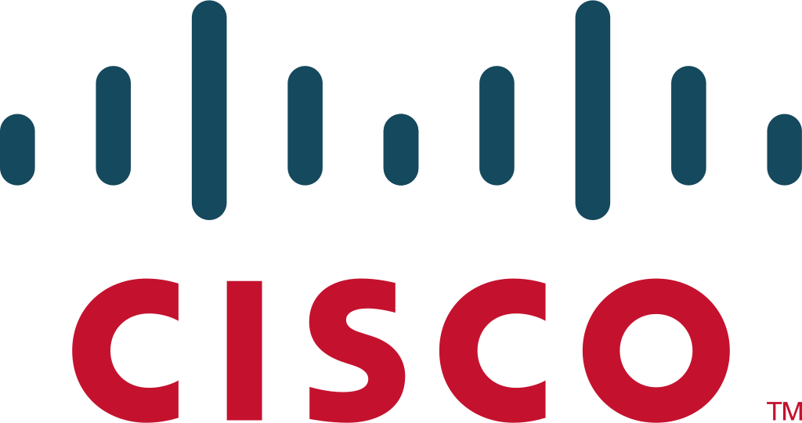
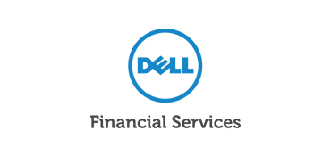
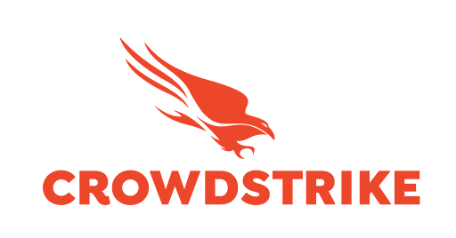
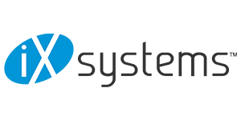
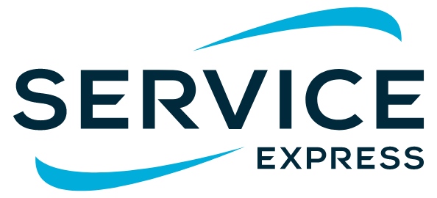
Strategic OEM Relationships
Best in Class Technology & Services Partners

Slide 5
IPDS Infrastructure Optimization Service (IOS)
IOS AT A GLANCE:
A proactive annual support contract that targets the health and optimization of infrastructure within your virtual data center environment.
WHAT WE DO:
Compute Environments
Block/File Storage Array(s)
Hyperconverged Infrastructure
Virtualization – VMware, etc.
Data Protection/Backup Environments
SAN Fabric

Slide 6
WHAT IS INCLUDED?
ONBOARDING
MONTHLY
QUARTERLY
ANNUAL
Inventory assets included in IOS support contract
Quarterly meetings scheduled by PMO
Enable IPDS remote access
Remotely collect data
Proactively analyze and identify anomalies and issues that require immediate follow-up
Formal meeting to review:
Asset details
System health, capacity and performance metrics
Log/License review *
Review of local/remote replication *
Findings summary
IPDS recommended "best practices"
Next steps
Includes everything in quarterly report, PLUS:
Detailed health assessment
Code/Firmware level recommendations
Vendor technical/security advisories
Vendor support status (EOL, EOSL, etc.)
High-level refresh plan
ONGOING
Configuration and usage questions
Assistance with vendor and product related problem escalation
Ongoing knowledge transfer
IPDS remediation services are available to correct any identified issues
* Where applicable

Slide 7
IPDS Managed Data Protection (MDP)
MDP AT A GLANCE:
A managed services contract that essentially outsources the day-to-day management of your entire backup environment to IPDS.
WHAT WE DO:
Implement Backup Solutions
Manage Backup Environment
Provide 24/7/365 Support
Provide Hybrid Cloud Support
Support For Multiple Backup Solutions
Protection From Security Threats

Slide 8
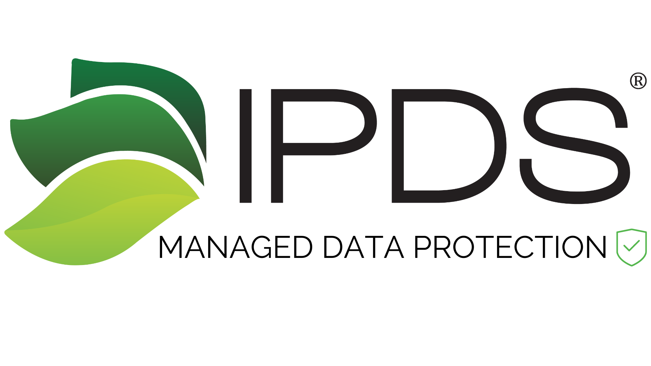
Detect:
24x7x365 monitoring by our team leverages proven technology to monitor uptime and scan your data for patterns or anomalies indicating a cybersecurity event is happening.
RECOVER
Identify:
IDENTIFY
Understand which workloads and data assets need to be protected.
Pinpoint challenges and vulnerabilities currently creating risk.
Create & continually update a data protection strategy to address those risks while meeting all organizational standards and compliance requirements.
Respond:
Because we are on call 24x7x365, we will be there when you need us most - when something goes wrong.
We pride ourselves on our response time by meeting or exceeding defined SLAs.
IPDS
MDP
RESPOND
PROTECT
Recover:
We continuously verify the integrity of your backup data and ensure we have the resources required to restore that data as quickly and efficiently as possible.
Throughout the process, we will maintain open lines of communication with your team to minimize the impact on your environment.
Protect:
DETECT
Develop and implement our customized solution securing your environment from data loss due to ransomware, malicious attack, corruption, or accidental deletion.

Slide 9
