Slide 1
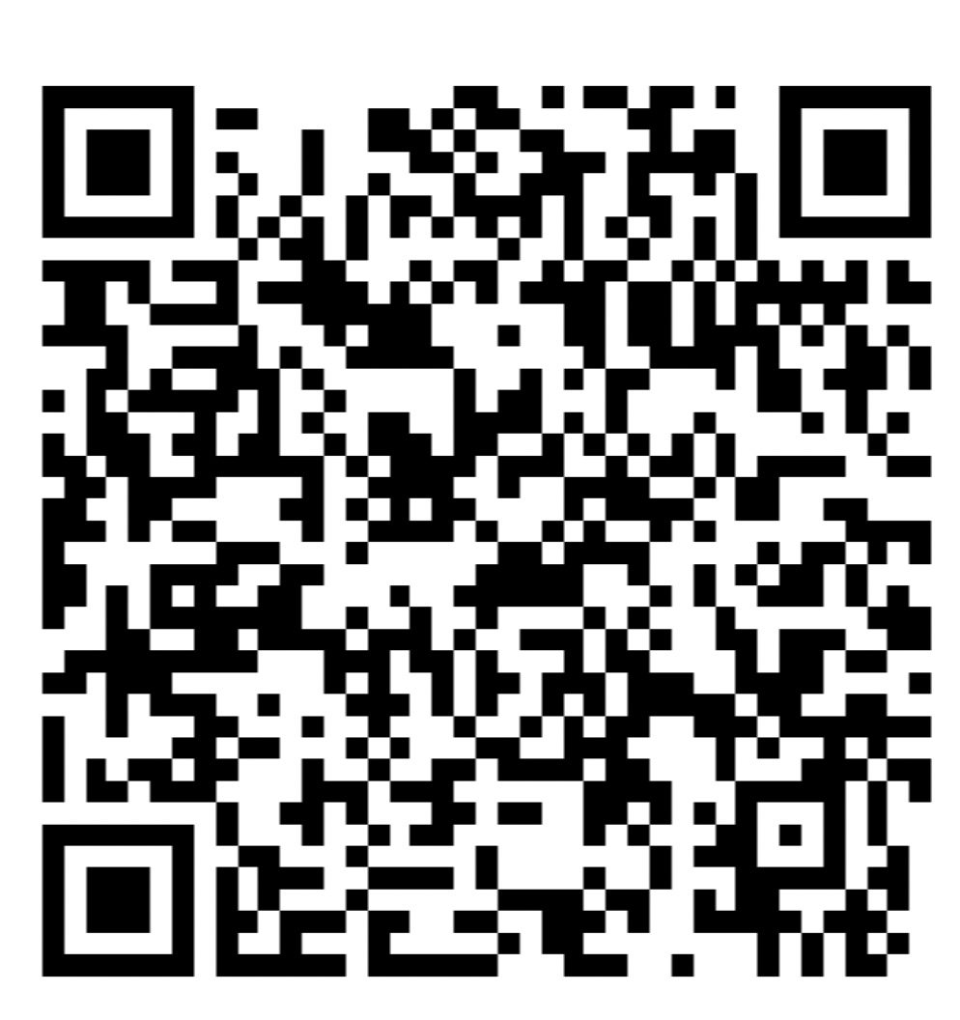
Scott Hornung TEKsystems Global Services
Governance in an AI World
Solutions and Practice Teams

Slide 3
AI: Revolution vs. Evolution
Cloud computing market
$587B (2023)
$676B (2024 projected)
$2.3T (2032 projected)
Source: Fortune Intelligence

Slide 4
Enterprises are realizing significant value
Top Generative AI powered use cases
Public Website Navigation
Effectively find information from a website via multi- modal inputs and conversational queries
Product / Content Catalog Discovery
Effectively find the most relevant Products / Content listings from a inventory catalog
Intra-Knowledge Q&A
Conversationally query questions for answers from internal knowledge sources
Business Process Automation
Automating the information retrieval and recommendation step of a recurring business process
Regulatory Compliance
Interpret regulatory policy / documents to identify potential violations relative to operating procedures
Documentation Generation
Write new documentation based on summarization of other documents & software code
Customer Service Automation
Effectively service customers requests for information and service provisioning
Product / Content Recommendation
Recommend personalized Product / Content / Next Best Action from a catalog
Document Search & Synthesis
Effectively find the most relevant documents and summarize their contents
Creative Assistance
Empower creative teams to create bespoke images and creative content for campaigns and editorial content
Research Acceleration
Find complex subject domain information across many disparate sources and synthesis the findings
Developer Efficiency
Complete and augment code to make your engineering team more efficient and effective
Complex data, intuitively accessible
Online interactions made conversational
Content generation at the click of a button

Slide 5
Top Concerns
Going from ”a lot of ideas” to delivering real business value
Data Posture
Managing AI risk and compliance
Ensuring responsible AI
Transparency and accountability
Organizational skill
Change Management
Sustainability

Slide 6
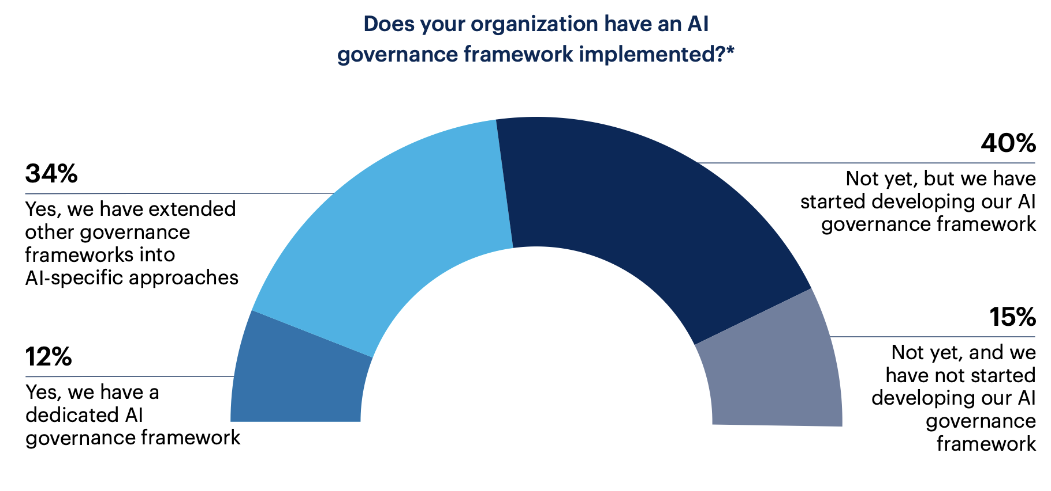
AI governance adoption
Gartner, 2023

Slide 7
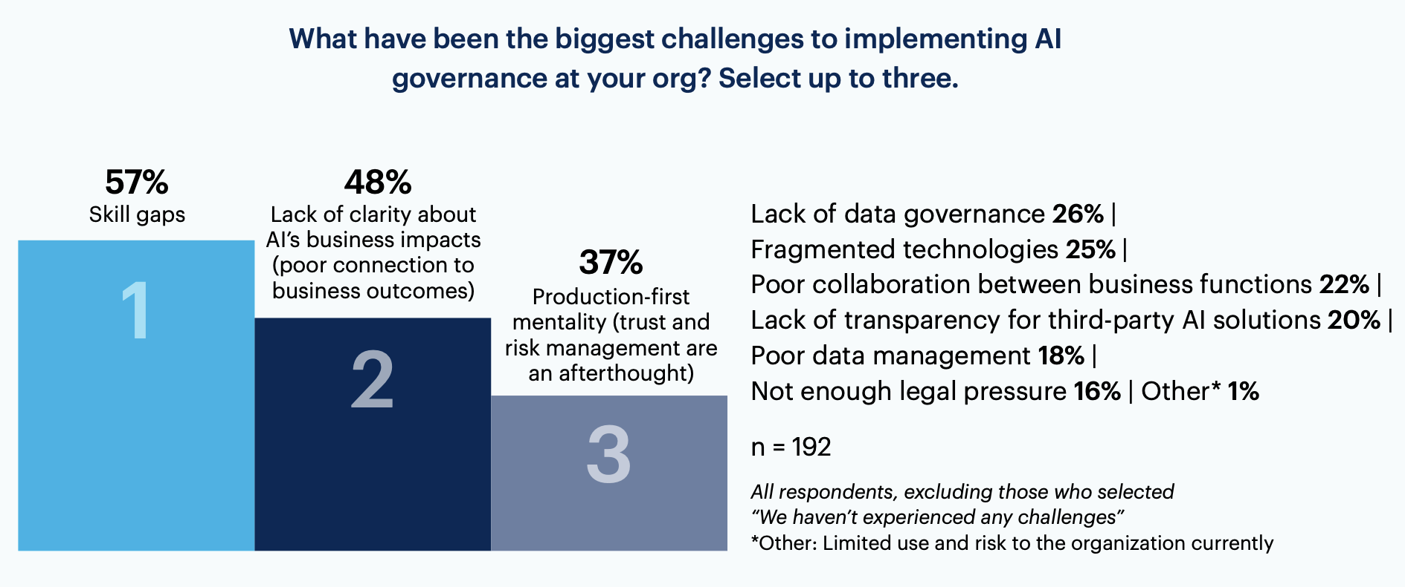
AI governance adoption challenges
Gartner, 2023

Slide 8
AI Governance best practices (so far)
Establish an AI Council
Involve the appropriate functions (legal, infosec, risk management, technology, etc)
Understand the differences between your internal AI efforts and external/GTM efforts and govern each appropriately
Balance process rigor with learning; expect things to change
Implement the right processes
Common use case definition that includes: description, intended use(s), unintended use(s), personas, technology stack, dependencies, budget/ROI, build vs buy, Metrics that Matter
Common use case intake and life cycle process that is well understood and transparent
Measure and manage
Evaluate and implement appropriate supporting technologies (e.g. Holistic AI, Fairly AI, PureML, etc)
Metrics based on ROI, business value delivered, risk, etc.
Support
Publish policies and guidance

Slide 9
AI Governance best practices (so far)
Focus on economic viability at scale when making core technology choices
Building and running generative AI applications can become very expensive
Look ahead to solve the day-two operational equation
No technology can scale unless you solve day-two operational challenges
Invest early in closing talent gaps
Invest in up-skilling your current workforce and hiring to close the talent gap
Role/Persona based training, training frameworks
Assess feasibility and impact before investing for scale, and be clear about “Buy vs Build”
Gen AI is rife with hype

Slide 10
Assessing use cases
Description of use case including Gen AI capability
Trustworthy Assessment of exceptional risks required?
Ethical (e.g., dealing with gender or diversity bias)?
Regulatory risks (e.g., pending regulatory changes)?
Cyber-security risks (e.g., in fully automated processes)
Human-in-the-Loop requirement (e.g., black-swan resilience)
Value
1
How does this use case support business strategy?
2
3
What strategic advantages does it bring?
Select multiple if needed
What is estimated business value? Please state your assumptions and attach estimated costs, ROI
New customer experience
Sales Growth
Increased Speed
Reduce Complexity
Improved resource efficiency
Ease of Implementation
Foe the following statements please insert a value between 5 (fully agree) and 0 (not agree at all). If you can’t judge the statements, please count 0 points.
Data
Solution
Processes/Systems
Know-How
1. We have access to the required data
1. We have resources to solve problem
1. No/few process need to be changed
1. Required tech know-how available
2. We have the required amounts of data
2. Similar problem already solved by others
2. No/few systems need to be adjusted
2. Required domain know-how available
3. We have the required quality of data
3. Know techniques that could work for this
3. No/few org changes need to be made
3. Required trainings can be done quickly
Data Score
Solution Score
Process/Systems Score
Know-How Score
How long will the development of this use case take (until a verified PoC)?
Overall Score
Ease of Implementation
Max 65 points
< 3 months
+ 5 points
4 - 6 months
+ 4 points
7 - 9 months
+ 3 points
10 - 12 months
+ 2 points
> 12 months
+ 1 point
Time Score

Slide 11
From POC to Operation
POC/POV
MVP
PI Planning / Execution
Operate
Solution Components
POC/POV
Identify desired outcomes, personas, "Metric That Matters"
Data definition, data validation
Establish target architecture, technology environment
Establish AI governance/ governance link
Develop POC/POV
MVP
Build on POC/POV exploration, learning
Define Executive Dashboard MVP groomed/prioritized backlog
Project schedule, team formation, Quality/Validation plan
Technology architecture
Governance
Develop MVP
Program Increments
Additional data sets
Additional personas
Evaluate use case expansion
Additional metrics
Interpretations/suggestions
Model refinement, training
Steady State
Support & Maintenance
Outcomes
Cloud Foundations
POC/POV feature set implemented – Data/Model, prompts, UI, validation criteria
Measurement metrics identified
Working production software
Test plan and test cases, security plan
Support deployed features
User personas engaged, feedback mechanisms established for continuous learning
"Metric(s) That Matter" evaluation
Refined models
New metrics, business insights
Increased interactivity, prompt intelligence/chaining
Metrics tracking
Model refinement
Fix defects
Value
Exploration, learning
Improved business data quality
Improved decision-making ability
Increase value to business based on realization or expansion of metrics that matter
Process optimization, competitive advantage, productivity gains

Slide 12
The terms matter…
Term | Definition
POC | Delivers a conceptual primitive that validates an idea or the feasibility of a concept. No production data or usage, and generally delivered in a short number of weeks.
POV | A Proof of Value delivers a learning/exploration element that also ties to proving that an idea is going to contribute business value. Typically delivered in weeks and carries one or more “Metrics that Matter” which are tied to the desired business value/outcome expectation. A POV does not typically use production data and is not used in production.
MVP | An MVP, or Minimum Viable Product, is an initial set of capabilities delivered for a given product, based on a well-defined backlog of prioritized features. An MVP does use production data and and is used in a live environment, though usage may be constrained as a means to contain initial risk and cost.

Slide 13
Thank You

