Slide 1
Continuous Improvements for this Strange New World
September 19, 2024
Erin Moran, Executive Director
emoran@towson.edu

Slide 2
The Broader Context

Slide 3
Intensifying Natural Disasters

Slide 4
Impactful Societal Movements

Slide 5
Global Health Crises

Slide 6
Speed of Communication

Slide 7
5 Generations in the Workforce

Slide 8
Speed of Technological Advancements

Slide 9
“The Fourth Industrial Revolution represents a fundamental change in the way we live, work and relate to one another. These advances are merging the physical, digital and biological worlds in ways that create both huge promise and potential peril.”
- World Economic Forum

Slide 10
The world is changing with accelerating speed, increasing the Volatility, Uncertainty, Complexity and Ambiguity for leaders.

Slide 12
Compared to September of 2023:
7 time increase in executives believing it is urgent to integrate AI across their business operations
Proportion of executives aiming to incorporate the new tech within the next 18 months rose from 5% to 35%
Source: Slack Research Study

Slide 13
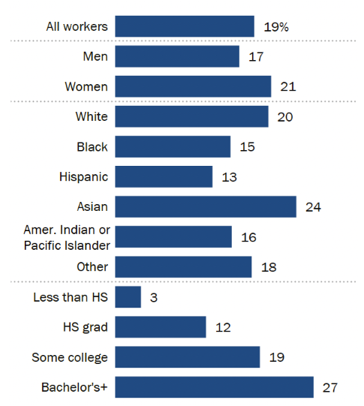
In Comparison: Employee Utilization
Source: Pew Research Center

Slide 14
In Comparison: How Employees Feel
77% of employees using AI say it has added to their workload
47% of employees using AI say they don’t know how to achieve the expected productivity gains their employers expect
40% feel their company is asking too much of them when it comes to AI
Source: The Upwork Research Institute

Slide 15
Concerns & Obstacles
Lack of skill
Fear of being monitored
Mistrust of quality and accuracy
Spreading misinformation
Ethical concerns
Potential to be replaced
Lack of trust in leadership

Slide 16
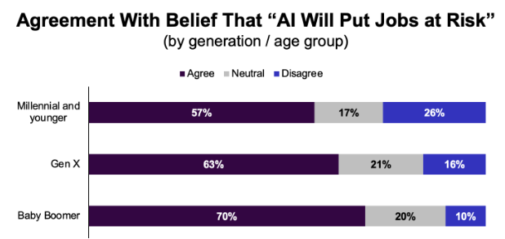
Source: Aberdeen Strategy Research

Slide 17
Enthusiasm Varies By Generation
49% of Gen Z are excited to use AI tools to enhance their work and organization
43% of Millennials are excited to use AI tools to enhance their work and organization
26% of Baby Boomers and Gen X combined are excited to use AI tools to enhance their work and organization
Source: Great Place to Work Study

Slide 18
Best Practices AI:
Solicit employee input
Solicited input from employees around Firefly, its generative AI tool, prior to beta launch
Held a voluntary company meeting addressing the ethical considerations, which attracted thousands of attendees
Cofounded the Content Authenticity Initiative—essentially a “nutrition label” for digital content
Established AI Ethics Principles and AI Ethics Committee and Review Board made up of employees from diverse professional backgrounds and life experiences for accountability
Notes:
Frame the reference that these are large, well funded companies, and it is not to suggest that this is a plug and play, but to offer ideas that spark some inspiration about wht might work within your organization

Slide 19
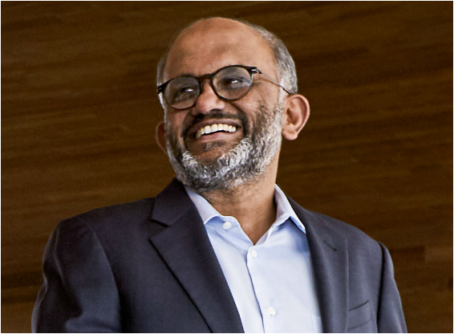
“Our highly differentiated approach to AI and innovative product delivery are attracting an expanding universe of customers and providing more value to existing users”
CEO Shantanu Narayen said in a June 13 press release

Slide 20
Best Practices AI:
Create AI learning modules
PwC developed a live trivia game, “PowerUp,” that quizzes employees on firm strategy and content from its AI curriculum, with players earning prizes
Intuit created GenStudio, a custom, internal-only development platform where employees could use gen AI through various large language models to experiment and refine their experience

Slide 21
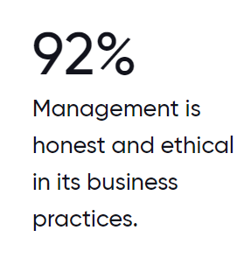
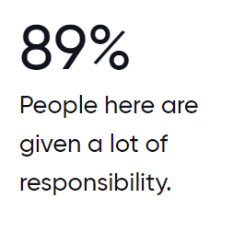

Slide 22
Best Practices AI:
Offer AI-assisted learning and development
Hilton has invested in “MentorcliQ,” an employee mentoring platform that uses an algorithm to help pair employees with mentors and mentees within the organization to promote development and networking opportunities

Slide 23
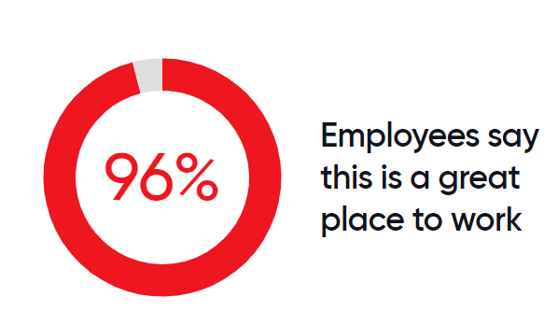

Slide 24
Best Practices AI:
Bring in outside experts to help your workforce with AI projects
48% of global C-suite leaders are using freelancers to jumpstart a delayed AI project
39% said using freelancers has doubled their innovation outcomes
48% of freelancers report being "somewhat" or "highly" skilled at using AI
Source: The Upwork Research Institute

Slide 25
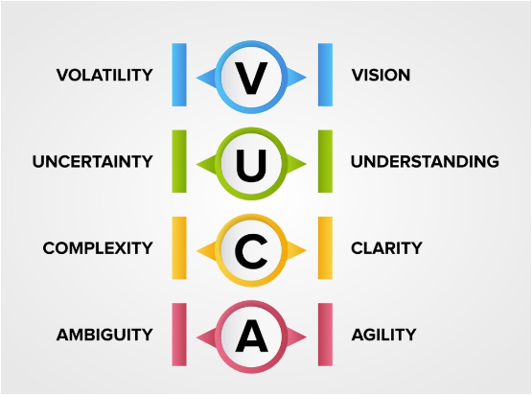

Slide 26
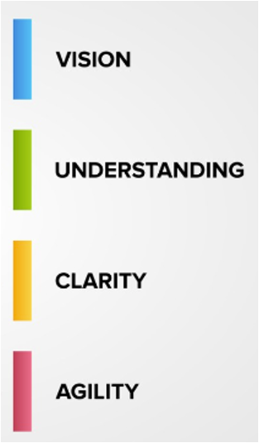
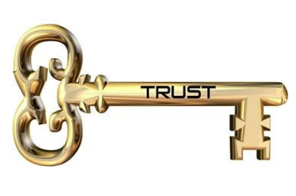
Articulate the big “why” behind the “what”
Communicate, Communicate, Communicate
Ensure active forums of listening are available & respond
Empathize with the fear
Define, communicate and reinforce the “WIIFM?” to all stakeholders
Anticipate and be prepared for the bumps

Slide 27
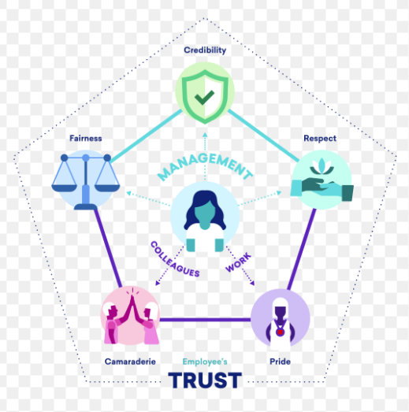
The Power of Trust:
The Trust Index©

Slide 28
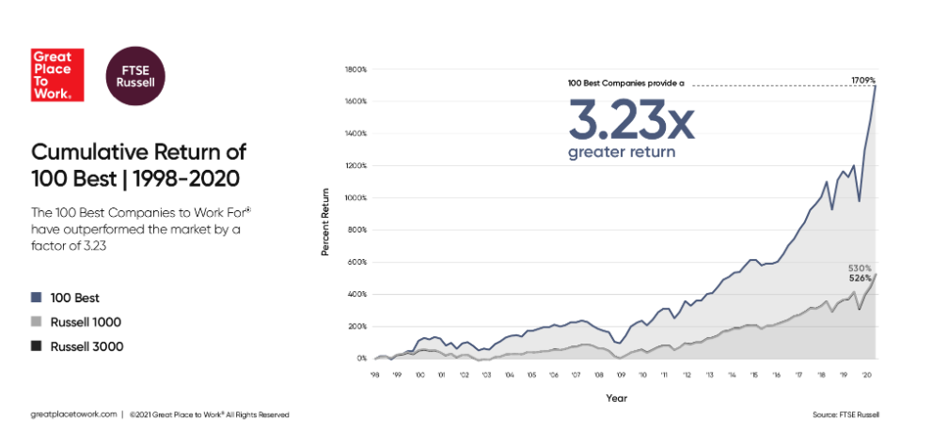
Trust Fuels Performance

Slide 29
Cultivating Trust
Invite feedback from direct reports
Recognize that there is no such thing as a “trust neutral interaction”
When you make a mistake, own up to it
You’ve got to give trust to get trust
Reflect on potential mix-messages and align your behaviors to your words

Slide 30
Thank You & Questions
Erin Moran, Executive Director
emoran@towson.edu

