Slide 1
Unlocking the future of AI
A Strategic Roadmap for CIOs
David McCarty
Director, AI and High-Performance Data Platforms

Slide 2
Agenda
AI as a Workforce Game-Changer How treating AI as an integral “employee” is revolutionizing productivity.
1
The Rise of AI-as-a-Service (AIaaS) How AI-as-a-Service can reduce infrastructure costs and make cutting-edge AI capabilities accessible and scalable on demand
2
Navigating the AI Regulatory Landscape Exploring the latest regulatory developments and offering guidance on how to ensure compliance while maximizing the benefits of AI within your organization.
3
Closing / Questions
4

Slide 3
AI as a Workforce Game-Changer

Slide 4
AI as a Workforce Game-Changer
Why AI is more than just a tool
AI’s evolution from a technology tool to an integral "workforce member."
Defining AI as an “Employee”
AI systems with assigned roles, responsibilities, and key performance indicators.
24/7 availability
Rapid data processing
Reduced error rates
Streamlined processes
Faster decision-making
Enhanced accuracy and consistency

Slide 5
AI as a Workforce Game-Changer
Role Assignments for AI in the Workplace
Data Analyst, Customer Support Assistant, Quality Inspector, etc.
Each of these roles leverages AI’s strengths in processing vast amounts of data, identifying patterns, and performing repetitive tasks, helping organizations streamline operations, reduce costs, and improve service quality.
Notes:
AI can be designed to excel in various roles, each tailored to support specific business needs and drive efficiency. Here are some examples:
Data Analyst AI can automate data gathering, cleansing, and preliminary analysis, identifying trends and patterns that might otherwise go unnoticed. By applying machine learning models to historical data, AI can generate insights to predict outcomes, optimize strategies, and assist human analysts in making data-driven decisions faster.
Customer Support Assistant AI-powered virtual assistants or chatbots can handle customer queries, offer real-time assistance, and provide 24/7 support. These assistants can respond to frequently asked questions, guide users through troubleshooting steps, and escalate complex issues to human representatives when needed, enhancing customer satisfaction and reducing response times.
Quality Inspector Using computer vision and machine learning, AI can inspect products for defects, assess quality during manufacturing, and ensure products meet set standards. These systems can detect minute inconsistencies or issues that may be difficult for human inspectors to notice, contributing to higher product quality and minimizing waste.
Predictive Maintenance Specialist AI systems can monitor equipment data to identify signs of wear or impending failure, allowing companies to schedule maintenance proactively. This helps in reducing unplanned downtime, extending equipment lifespan, and cutting maintenance costs by addressing issues before they escalate.
Marketing Analyst AI can analyze customer behaviors, segment audiences, and predict which marketing campaigns are likely to be successful with specific groups. By understanding user preferences and behaviors, AI helps create targeted marketing strategies, optimizing ad spend and improving customer engagement.
Supply Chain Optimizer AI can enhance supply chain management by forecasting demand, optimizing inventory levels, and improving logistics planning. It considers various factors like seasonal demand shifts, delivery times, and shipping costs to streamline processes and enhance efficiency in the supply chain.
Sales Assistant AI can support sales teams by automating lead scoring, suggesting upsell or cross-sell opportunities, and analyzing customer interactions to personalize pitches. It can help sales representatives prioritize their efforts on high-potential leads and suggest next-best actions.
Fraud Detector AI can analyze transaction data in real time to detect fraudulent activities by identifying unusual patterns and flagging them for investigation. With machine learning, it continuously improves its detection capabilities, safeguarding financial and sensitive data against malicious attacks.
Human Resources Assistant In HR, AI can streamline recruitment by scanning resumes, ranking candidates, and scheduling interviews. It can also assist in employee engagement by analyzing feedback data, predicting employee turnover, and identifying potential areas for improvement in workplace satisfaction.
Energy Management System AI can analyze energy consumption patterns to recommend ways to reduce waste and optimize energy use in buildings and manufacturing facilities. By forecasting demand and automatically adjusting systems like lighting, heating, and cooling, AI helps to reduce costs and environmental impact.

Slide 6
AI as a Workforce Game-Changer
Case Study:
Air Canada’s AI Chatbot Misrepresentation Case
Context: Passenger relied on Air Canada’s AI chatbot, which misinformed them about bereavement fare policy, resulting in an $812 award to the passenger after a small claims court case.
Incident: The chatbot inaccurately suggested retroactive fare refunds were available, contradicting Air Canada’s official policy. The passenger, based on this, pursued the refund.
Court’s Decision:
Found Air Canada liable for “negligent misrepresentation.”
Asserted the airline's responsibility for the chatbot’s information as part of its website.
https://www.forbes.com/sites/marisagarcia/2024/02/19/what-air-canada-lost-in-remarkable-lying-ai-chatbot-case/
Notes:
https://www.forbes.com/sites/marisagarcia/2024/02/19/what-air-canada-lost-in-remarkable-lying-ai-chatbot-case/

Slide 7
The Rise of AI-as-a-Service (AIaaS) Market

Slide 8
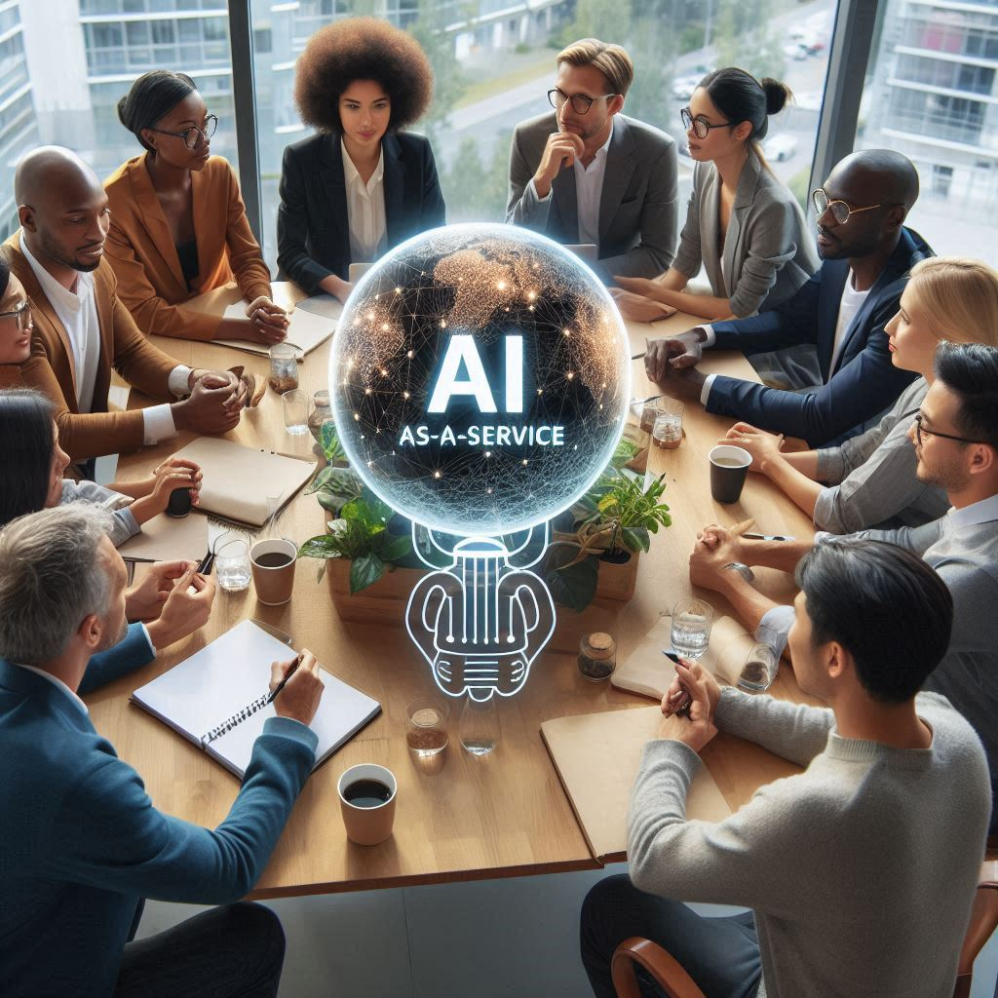
The Rise of AI-as-a-Service (AIaaS) Market
Amazon Web Services (AWS) – Machine Learning, NLP, and AI tools (e.g., Amazon SageMaker, Rekognition)
Microsoft Azure AI – Comprehensive AI tools, NLP, computer vision, and language understanding (e.g., Azure Cognitive Services)
Google Cloud AI – Machine learning and AI-driven APIs (e.g., AutoML, Dialogflow)
IBM Watson – NLP, machine learning, and data analytics (Watson AI Suite)
Alibaba Cloud – AI for business solutions, NLP, and facial recognition in the APAC region

Slide 9
The Rise of AI-as-a-Service (AIaaS) Market
Challenges and Market Barriers
Data privacy and security regulations
Dependency on third-party vendors
Need for seamless integration with existing systems
Concerns over data handling, security standards, and integration limitations

Slide 10
Navigating the AI Regulatory Landscape

Slide 11
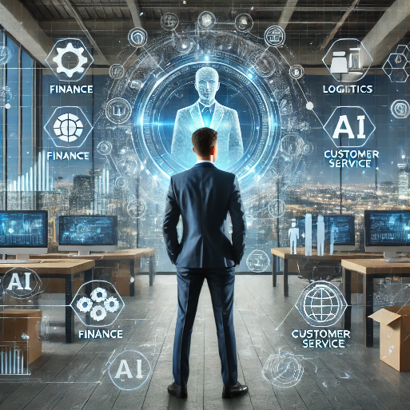
Navigating the AI Regulatory Landscape
Key Proposed AI Legislation in the U.S Senate
The SAFE Innovation Framework Act – Addresses transparency, accountability, and data security in AI systems.
The Algorithmic Accountability Act – Proposes assessments of high-risk AI systems for bias, discrimination, and data protection.
The National AI Commission Act – Focuses on creating a commission to guide AI regulation and monitor impacts.
Notes:
Title: Understanding the SAFE Innovation Framework Act
Content: Break down the main goals of the SAFE Innovation Framework:
Prioritizing transparency in AI systems
Ensuring data protection
Setting clear accountability standards for AI use in high-risk applications
Title: Ensuring Algorithmic Accountability in AI
Content: Explain the requirements of the Algorithmic Accountability Act:
Mandatory impact assessments for high-risk AI systems
Focus on identifying and mitigating biases and risks in AI algorithms
Regular audits for compliance and fairness
Title: Role of the National AI Commission in Shaping AI Policy
Content: Describe the proposed National AI Commission, its goals, and the potential influence it could have on AI governance:
Monitoring AI’s social and economic impact
Establishing best practices for AI usage
Guiding future legislative efforts based on emerging AI trends

Slide 12
Navigating the AI Regulatory Landscape
Accountability Requirements for IT Professionals
Increased responsibility for data security and privacy compliance
Need to regularly audit and assess AI systems for fairness and transparency
Role in documenting AI system decisions and ensuring explainability

Slide 13
Navigating the AI Regulatory Landscape
Challenges in Meeting Regulatory Requirements
Keeping pace with new regulations
Managing resource allocation for continuous AI audits
Balancing accountability with AI innovation

Slide 14
Thank You

