Slide 1
AI and Digital Transformation in Higher Education
Emily Bailey, PhD

Slide 2
AI in Higher Education: How it’s going
The golden ticket?

Slide 3
Or that which must not be named…?

Slide 4
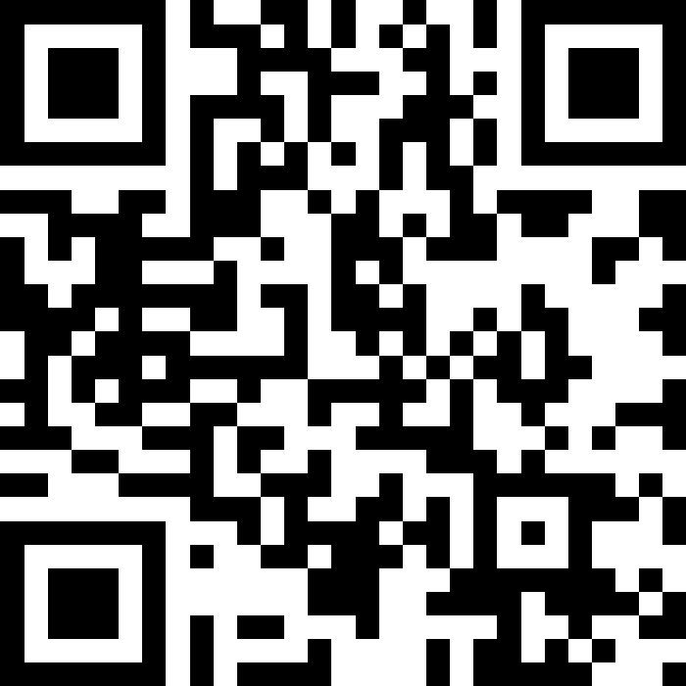
What one word best describes how AI will transform learning?

Slide 5
As we prepare students for the workforce:
What are we seeing?
What are next steps?

Slide 6
What are we seeing?
Students are using generative AI
Students often have limited AI literacy
Evaluate what it does well
Understand its limitations
Critically analyze outcomes
Decide what to do with that information
AI has created gray areas around academic integrity
Parameters for use
AI detection
Ethical use

Slide 7
AI Literacy in the Classroom: a case study
Fall 2024 section of 30 students in a 200-level asynchronous online course
Read an article about the intersections of AI and reading sacred texts
Completed a project using an AI tool to:
generate responses about textual interpretation (create a prompt)
critically analyze these responses using scholarly sources (then revise their prompt)
reflect on the implications of AI use in evaluating texts

Slide 8
AI Literacy in the Classroom: case study outcomes
“I think AI is successful when it comes to quickly gathering information and providing a baseline outline for readers to go off of. Where I believe AI falls short is its inability to dive deeper into information unless prompted, meaning the website will simply give you what is asked but fail to provide background details, sources of information, and other valuable information.”
“For the AI interpretation, I do not feel as though I was challenged by the response and the information was oversimplified. The information provided would have allowed me to “get by” on the topic, but I did not walk away from the experience feeling that I had learnt something new or grown in my academic study of sacred texts - in a way the experience was unfulfilling.”

Slide 9
Building the bridge in classrooms
What do students need to know?
When to use AI
Which AI tools to use (including discipline-specific applications)
How to interact with AI tools (prompting/re-prompting)
Parameters for responsible AI use
How to evaluate AI outcomes
Bowen & Watson, Teaching with AI (2024)

Slide 10
Final thoughts
Most classrooms/jobs are changing (or need to change) because AI exists
Higher ed is a place to foster AI literacy in preparation for the job market
It is time to reimagine learning outcomes and how we assess them
It will be necessary to expand definitions of digital and information literacies and to support faculty and students in meeting those new expectations

