Slide 1
Mid Atlantic CIO
Forum
Information Systems
1/16/2025

Slide 2

Agenda
IT Strategic Roadmap
AI Update
Operational Technology Strategy
Summary
2

Slide 3
PERDUE FARMS BY THE NUMBERS
PERDUE FOODS
PERDUE AGRIBUSINESS
20 Hatcheries
20 Feed Mills
11 Harvest Plants
7 Breeder Operations
8 Distribution Centers
5 Prepared Plants
3 Research Farms
1 Pet Treat Plant
1 Innovation Center
48 Locations
  35 Grain Storage Facilities
    34 grain elevators
    1 organic warehouse/shipping facility
  12 Manufacturing Facilities
    4 conventional soy crushing plants
    3 expeller press plants
    2 vegetable oil refineries
    3 blending facilities
  1 Deepwater Port

Slide 4


IT: Strategic Roadmap
4
Enterprise
Business Process Re-engineering (BPR)
Governance Structure
Implement Data Lake
Platform
Farms
Foods
PAB
Enterprise
Finance
Inventory,
Logistics, Transport Management, Whole Bird Profitability
Discovery
Phase
SAP S/4
Software Selection
Cybersecurity
Improvement
Data Governance
Human
Resources
Product & Process Control
Analysis
Design
Implementation
Commercial
Trade / Customer Investment
Ongoing
48 months
FY 2026 (paused)
Unified Systems
OnePerdue Framework
Legend
Completed
In process
Paused

Slide 5
Application Modernization Unified Systems
Utilizing Business Process Reengineering
Unified Systems
Utilize Foods, Agribusiness, HR, and additional business initiatives to modernize IT Systems
Leverage a Unified Systems approach to identify IT system consolidation opportunities
  Analyze BPR projects as one to identify IT system synergies
  Initial Synergies – Master Data, Procurement, Transportation, Logistic and Warehouse
  3-month analysis will begin
  Only those differentiated business capabilities remain in the BU specific systems.
Future proof systems to allow flexibility in support of OnePerdue journey
  Provide agility and flexibility for OnePerdue needs, acquisitions, or organization modifications
  Allow associates to move between roles with common systems
One master roadmap from a systems deployment perspective
Moving forward with SAP RISE approach
  S/4 Finance on-prem -> RISE
  Retire ECC to RISE (Greenfield project)
Finance BPR
Foods BPR
Unified Systems
PAB BPR

Slide 6
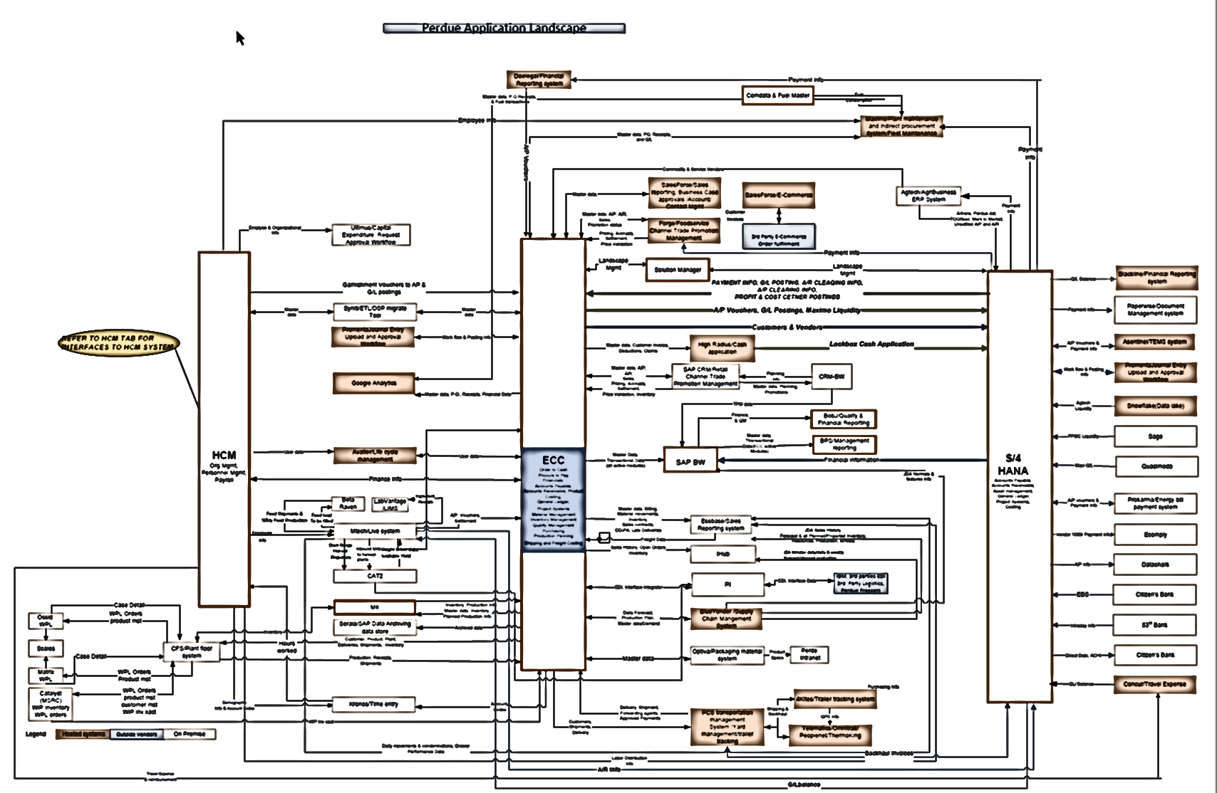
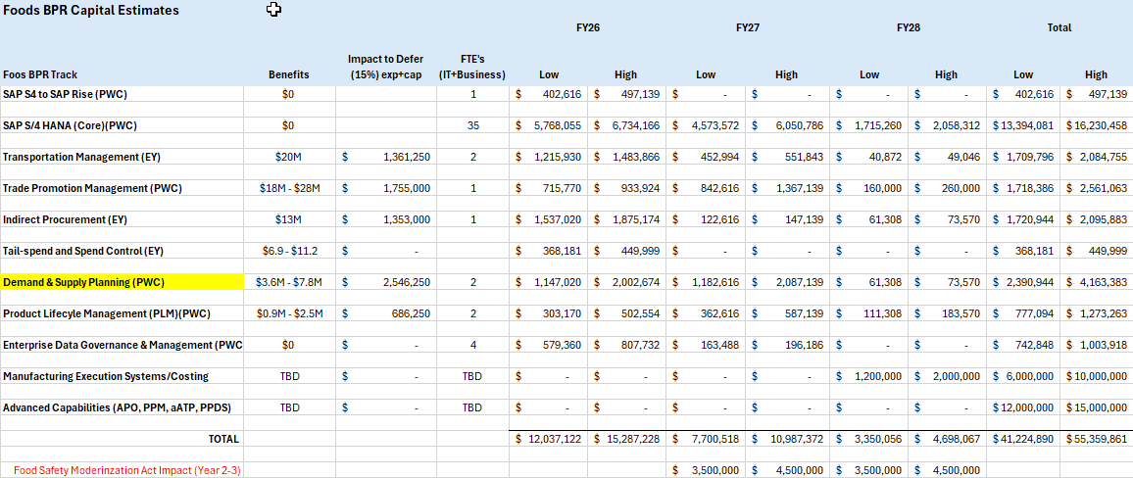
Current Applications Landscape - Foods & Corp
Indirect Procurement
Trade Promotions
“CORE”
Product Lifecyle Mgmt
CFS (WPL)
Transportation Mgmt

Slide 7
OnePerdue IT Systems Approach
Modern efficient systems
Benefits
Business Decisions
Allows for OnePerdue approach.
  Best in class processes produce accurate data
  Single system of record, no duplication of data
  Foundation for analytics, AI, advanced capabilities
Lower Total Cost of Ownership vs alternative
  Efficiencies by using systems by business capability and consolidate systems where possible
  Differentiated capabilities will be in the business units providing greater focus
  IT Technical skills sets can be applied across Perdue
    Transportation, Procurement, TBD
Improved End User Experience. Seamless and consistent experience increasing productivity.
Enhanced Security by providing a unified approach to managing and protecting data.
Analytics
Artificial Intelligence
Governed Data – Master Data / Data-Lake
Process – Business Process Reengineering
Systems of Record

Slide 8
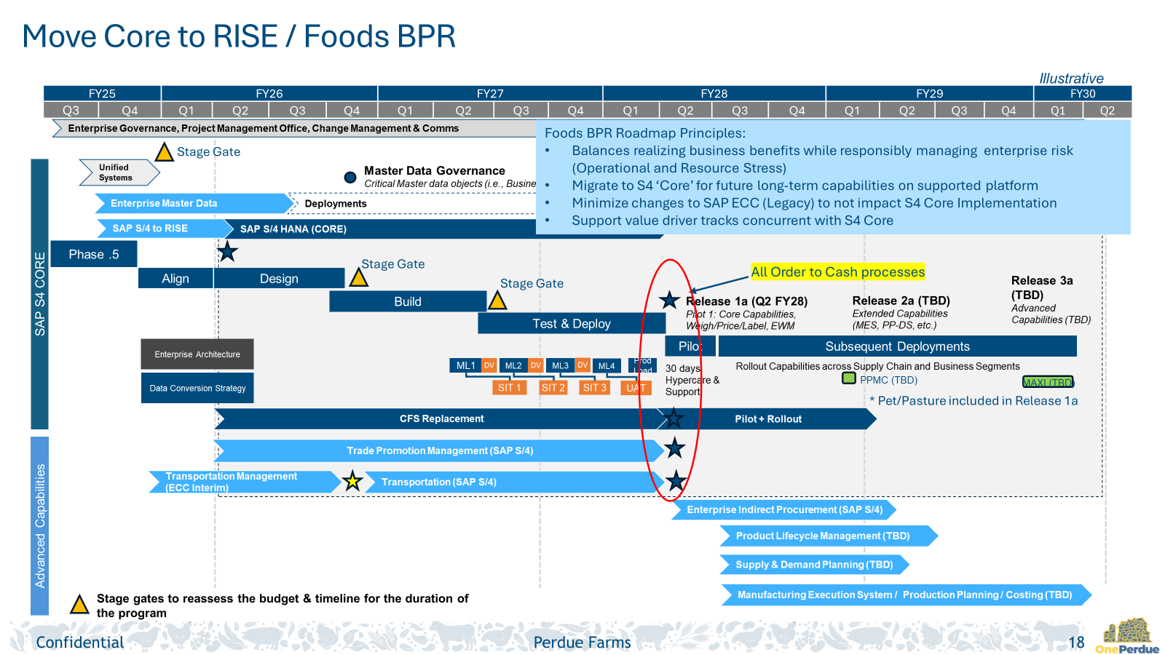
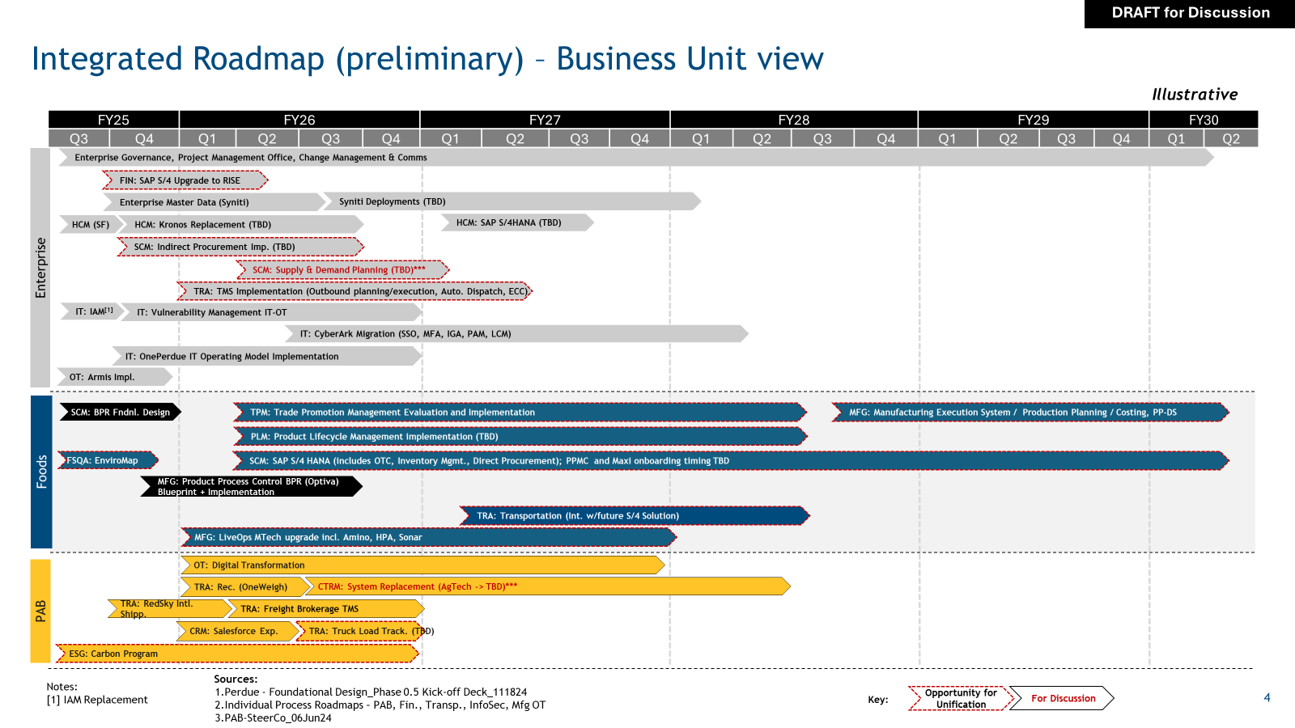
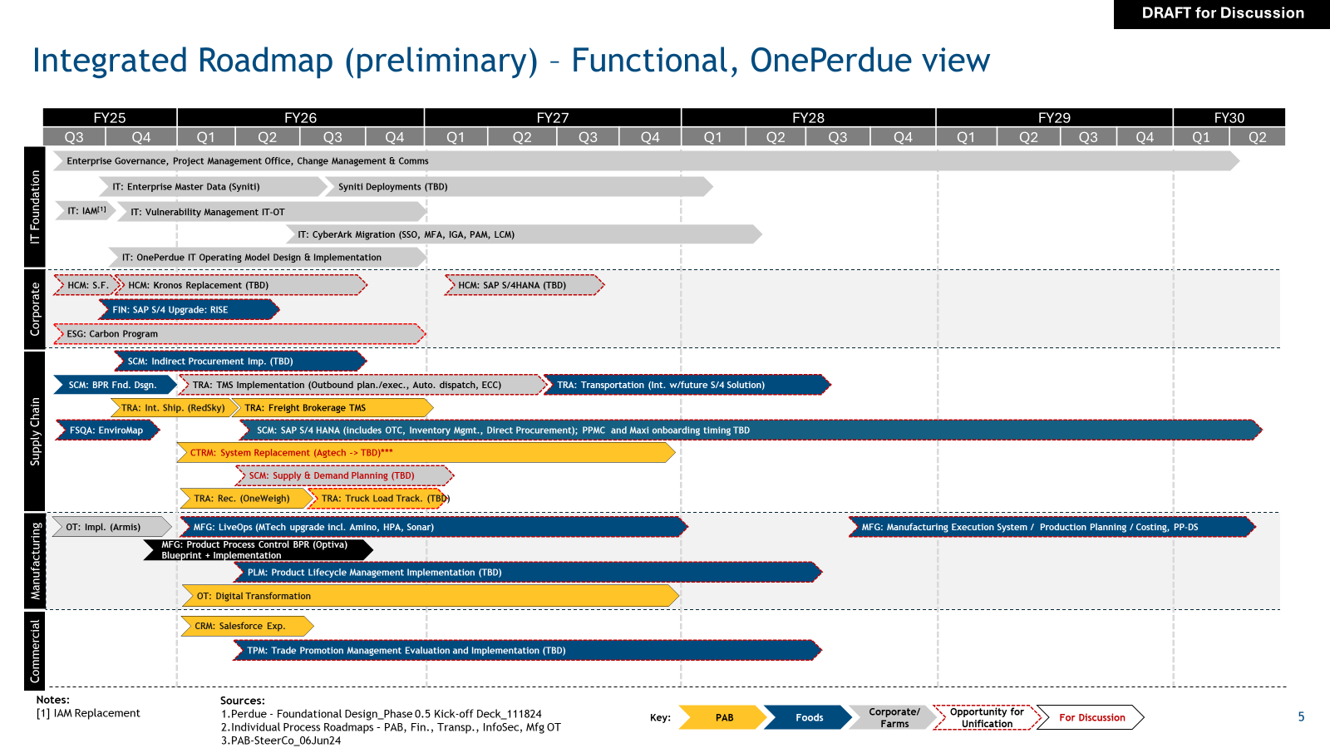
OnePerdue Unified IT Systems – Next Steps
Begin deployment of SAP RISE model.
Complete Unified Systems work – 3 months
  Leverage work already completed to determine like business capabilities
Develop the OnePerdue IT Unified Systems roadmap
  Shared business capabilities will be identified
  Differentiated capabilities (Foods / PAB) will be included
  Identify resources and needs for first stage gate funding request
  Determine PAB next steps after Unified Systems analysis.

Slide 9
AI Update
Enabling Data and Process Transformation
FY 2026
9

Slide 10



Perdue AI Journey
Roadmap to embed AI in business operations
Current
FY26 – FY27
Long Term beyond FY28
Policy and Governance
  Awareness training
Focused on associate productivity
  ChatGPT
  Microsoft Co-pilot
  Select Use Cases
Unique opportunity to leverage BPR to prepare data
  Unified Systems
  Begin Master Data
Begin data literacy and governance
Build AI staffing
  Technical and Business
Utilize Perdue Systems for AI
  SAP, OneStream, Blue Yonder
  Other BPR systems of record
Agents
Continued focus on associate productivity
Data-Lake for AI analysis
  Cross system data
  Aligned with BPR rollout
IT systems testing
Continue data literacy and governance
Transform Operations
  Key business processes complete with AI
  Utilization on Plant Floor
  AI Augmentation for additional processes
Technical Stack in place
  AI Governance
  Data Governance and availability
  AI Technical Stack
    Plant floor included
10

Slide 11
Operations Technology Strategy
Enabling Data and Process Transformation
FY 2026
11

Slide 12
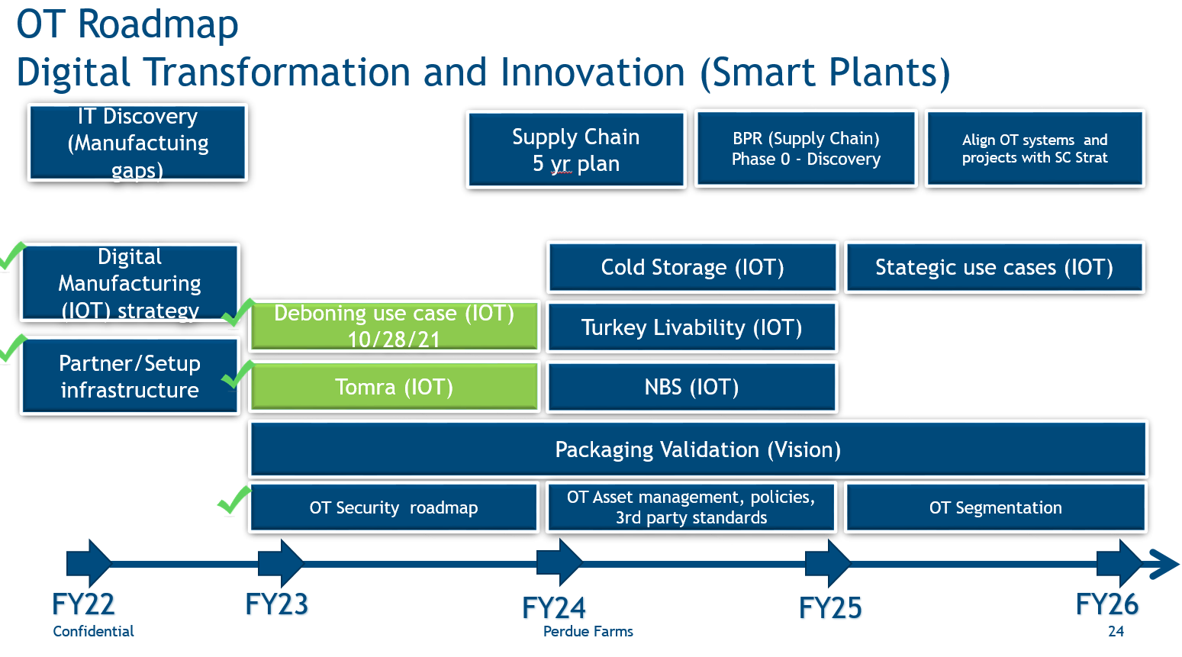
12

Slide 13
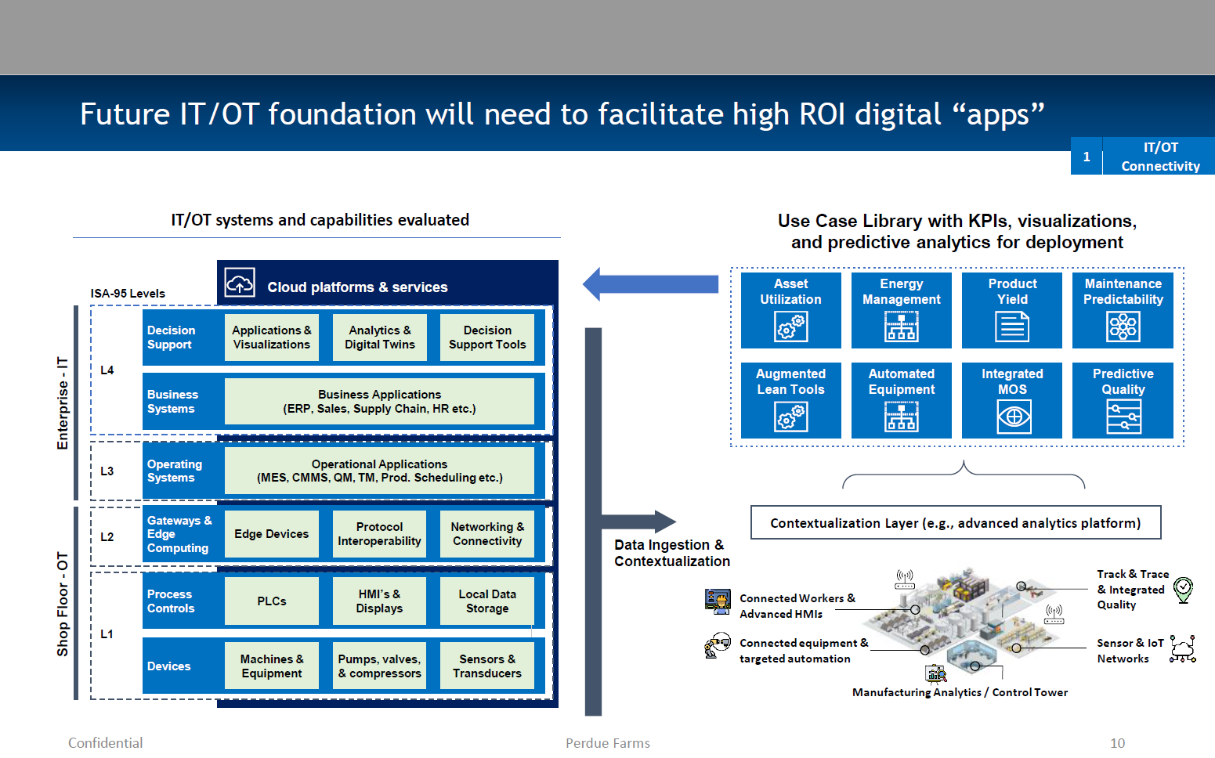
Perdue AI Journey I
IT / OT Comes Together
13

Slide 14
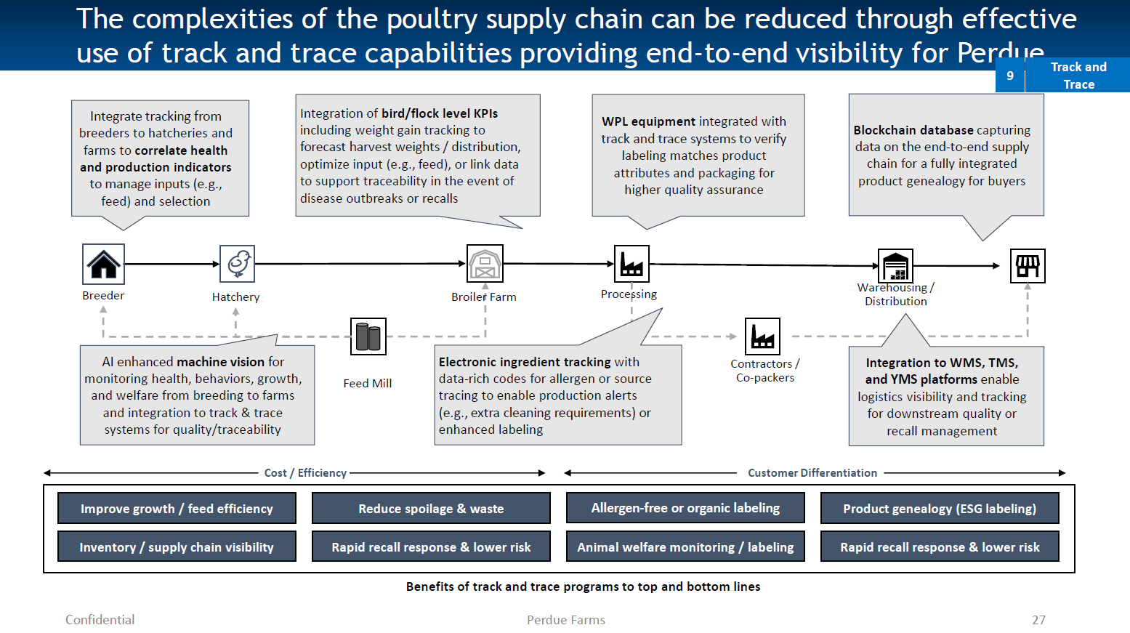
14

Slide 15
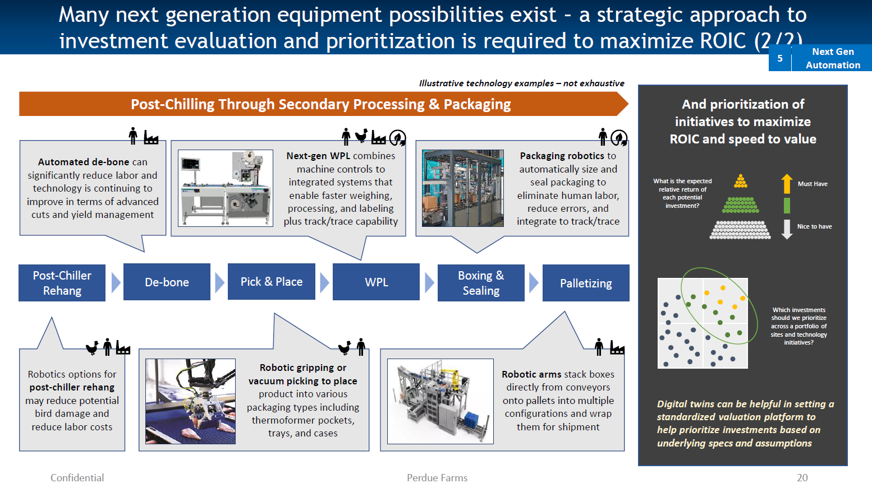
15

Slide 16
Summary
Build the Foundation – SAP RISE
Deploy Business Process Re-engineering / Unified Systems
Roll data to the data-lake
Apply AI and Analytics
Automate Plants
IT / OT Integrations
Move to an IT product-based organization
16

