Slide 1
Data within M&A and Modernization

Slide 2



















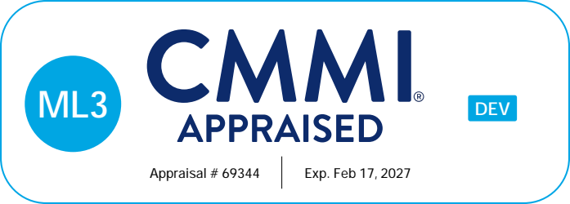
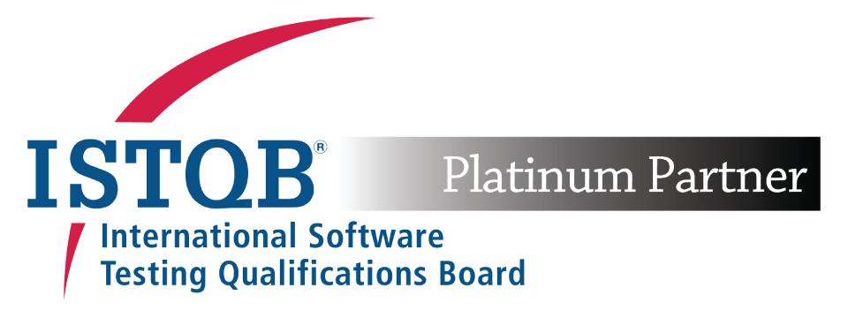
OUR BACKGROUND
FOCUS AREAS
PARTNERSHIPS
375+
15+
Employees (US/India)
Years in Business
Data Management
& Visualization
HIGHLIGHTS
150+
Certified Professionals
Custom Application
Development
CERTIFICATIONS
INDUSTRIES
Microsoft
Dynamics 365
Financial
Utilities & Energy
Insurance
Service Companies
IT Mergers, Acquisitions, Divestitures

Slide 3



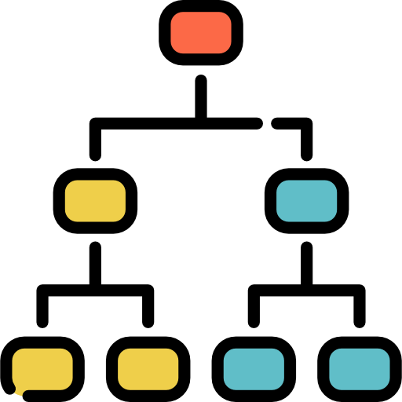









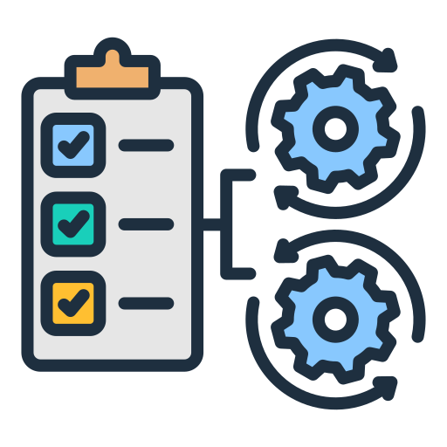









1RIVET Capabilities Summary
Strategy
Business Analysis/Requirements
Program/Project Management
UI/UX
Architecture
Assessment
User Training
Execution
Frontend – Website, Application
Mobile Applications
AI/ML
Integration
Database -
Lake, Warehousing
RPA
Data Visualization
Testing -
Automation & Manual
1Lab – Emerging Technologies
Modernization
CRM/ERP
Cloud
Migration
Operations & Maintenance
DevSecOps
Infrastructure
Production Support
Help Desk

Slide 4
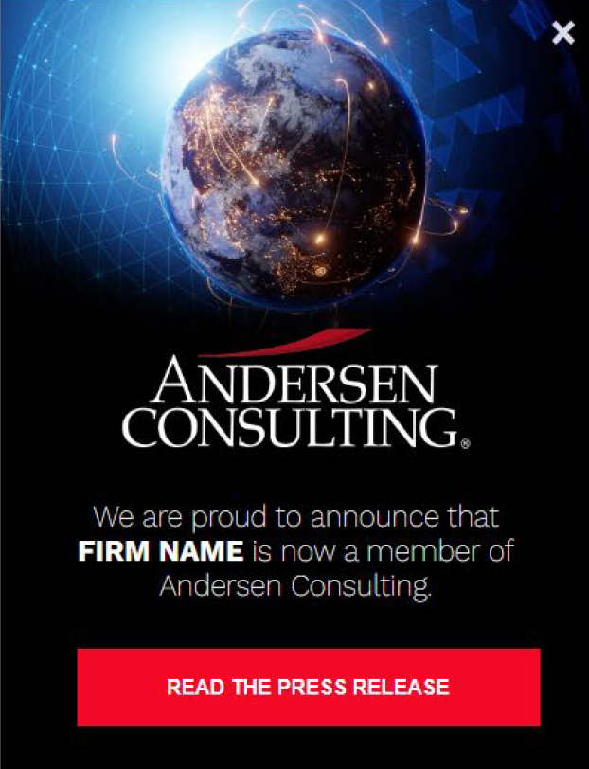

1RIVET Announcement
We are proud to announce that as of February 19, 2025, 1RIVET is now an ANDERSEN CONSULTING member firm.
BENEFITS TO OUR CLIENTS & PARTNERS
GLOBAL PLATFORM (179 COUNTRIES AND 604 LOCATIONS)
BORDERLESS, SEAMLESS, INTEGRATED SERVICE MODEL
CLIENTS (OVER 238,000)
BRAND (RECRUITING, GLOBAL VISIBILITY AND PRICING)
CORE SERVICES
  STRATEGY
  TECHNOLOGY
  BUSINESS (DIGITAL) TRANSFORMATION
  ARTIFICIAL INTELLIGENCE
  CYBER SECURITY
  SUSTAINABILITY
  HUMAN CAPITAL/CHANGE MANAGEMENT
OFFICIAL PRESS RELEASE
Notes:
1RIVET is still 1RIVET. And we are still the entrepreneurial entity we always have been, but now we have access to our worldwide partners to enhance what we can offer.

Slide 5

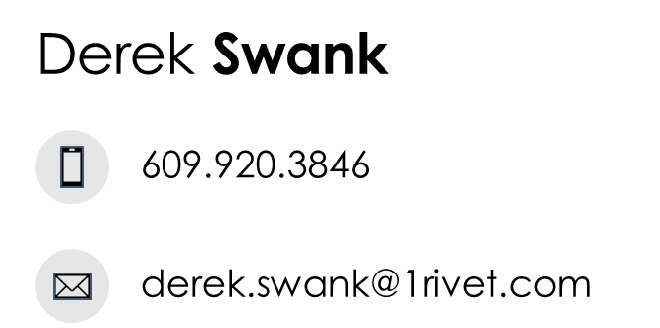
Derek Swank – Managing Partner, Chief Delivery Officer
Derek has 20+ years of M&A Implementation and Technology Modernization experience.
Derek serves as a central point of accountability across business and IT teams. He collaborates with client C-suite executives, presenting to boards, and offering them the transparency they need to make critical decisions during large-scale, transformative programs.
Derek has deep experience integrating complex IT systems during mergers, acquisitions, and divestitures, and has guided major organizations like the Canadian Pension Plan, GE Capital, Federal Home Loans Bank, and TD Bank to successful outcomes.
Derek’s downtime is typically spent on the golf course, he holds an honors, bachelor of mathematics degree from the University of Waterloo in Ontario, Canada.
FLU
15 Day IL

Slide 6

Michael Wolk – Chief Strategy Officer, Senior Delivery Consultant
Mike Wolk has over 30 years of experience in serving clients globally and across a range of industries. Mike works with 1Rivet’s team of technology specialists to identify and implement technology improvement initiatives.
Mike’s career includes 15 years with Accenture, where he was a Partner and led several enterprise IT implementations; and as part of the business strategy practice delivered IT synergy savings for client M&A transactions. At 1Rivet, Mike is Chief Strategy Officer.
Mike lives as an empty nester in Fairfax, VA with his wife, Sandra. He enjoys golf and traveling.

Slide 7

Data – What is it good for?
“Data: The only thing that makes sense in an otherwise senseless world…
Unless you’re looking at your own weight.”
Notes:
Data is all over the place and the volume of the data being gathered is only accelerating.
Data provides us with the ability to develop statistics. …and as Mark Twain made popular, there are lies, damn lies and statistics…..so we’ll be sharing some of those interesting statistics, how they relate (or don’t) and would love to know your thoughts.

Slide 8






Data Importance and Challenges in M&A
M&A
Strategy
Target Screening
Due Diligence
Transaction Execution
Integration (Day 0)
Day 1 + Support
Pre-Announcement
Announcement
Execution
Data is Crucial!​
Due Diligence​
Synergy Identification​
Integration Planning​
Risk Mitigation​
Decision Making​
Delivery / Performance Evaluation​
Data Challenges:
Data Governance
Data Quality
Data Access / Security
Data Integration Complexity
Notes:
Wolk:
The M&A lifecycle is a critical framework for managing mergers and acquisitions. It encompasses several stages: planning, due diligence, negotiation, and integration. Each phase requires careful strategic decision-making and collaboration among teams. Effective communication is vital to ensure all stakeholders are aligned. Ultimately, successful post-merger integration can significantly influence the long-term success of the merged entities.

Slide 9
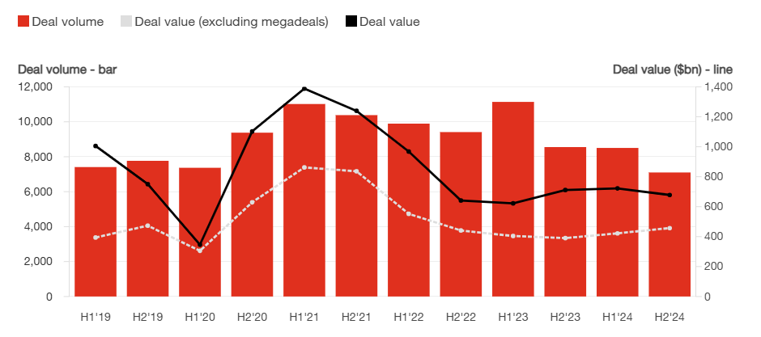
Current State of Deals
Source: PWC Deal Trends
AMER Deals
Notes:
Here’s a brief summary of the key points from the PwC 2025 Outlook for Global M&A Industry Trends and many of these trends are battling against each other.
1. **M&A Market Recovery**: There's an upward trend in dealmaking, especially for deals over $1 billion, although smaller and mid-sized deals have decreased.
2. **Economic and Geopolitical Factors**: Volatile geopolitics and changes in policy, especially due to the new Trump administration, are significant factors impacting the M&A landscape.
3. **Interest Rates**: Rising long-term interest rates and higher valuations in some countries are influencing deal strategies.
4. **Sector-Specific Impacts**: Different sectors like manufacturing, energy, healthcare, and technology are affected by various policy changes and economic conditions.
5. **AI and Transformation**: AI is a major catalyst for change, driving companies to transform their business models and invest in digital infrastructure.
6. **Private Equity Trends**: PE firms are under pressure to exit mature investments, leading to more market activity.
7. **M&A Activity by Region**: There are notable regional variations, with some countries like Japan and India seeing increased deal values, while others see declines in deal volumes.
The challenge for Dealmakers is that they need to navigate high valuations, interest rates, and geopolitical uncertainties to be successful.

Slide 10
What’s coming?
81%
of CEOs who made a significant acquisition in the past three years plan to make one or more acquisitions in the next three years.
Source: PwC’s 28th Annual Global CEO Survey, January 2025
Notes:
CEO’s who are new to their leadership roles tend to be less successful in their M&A efforts

Slide 11
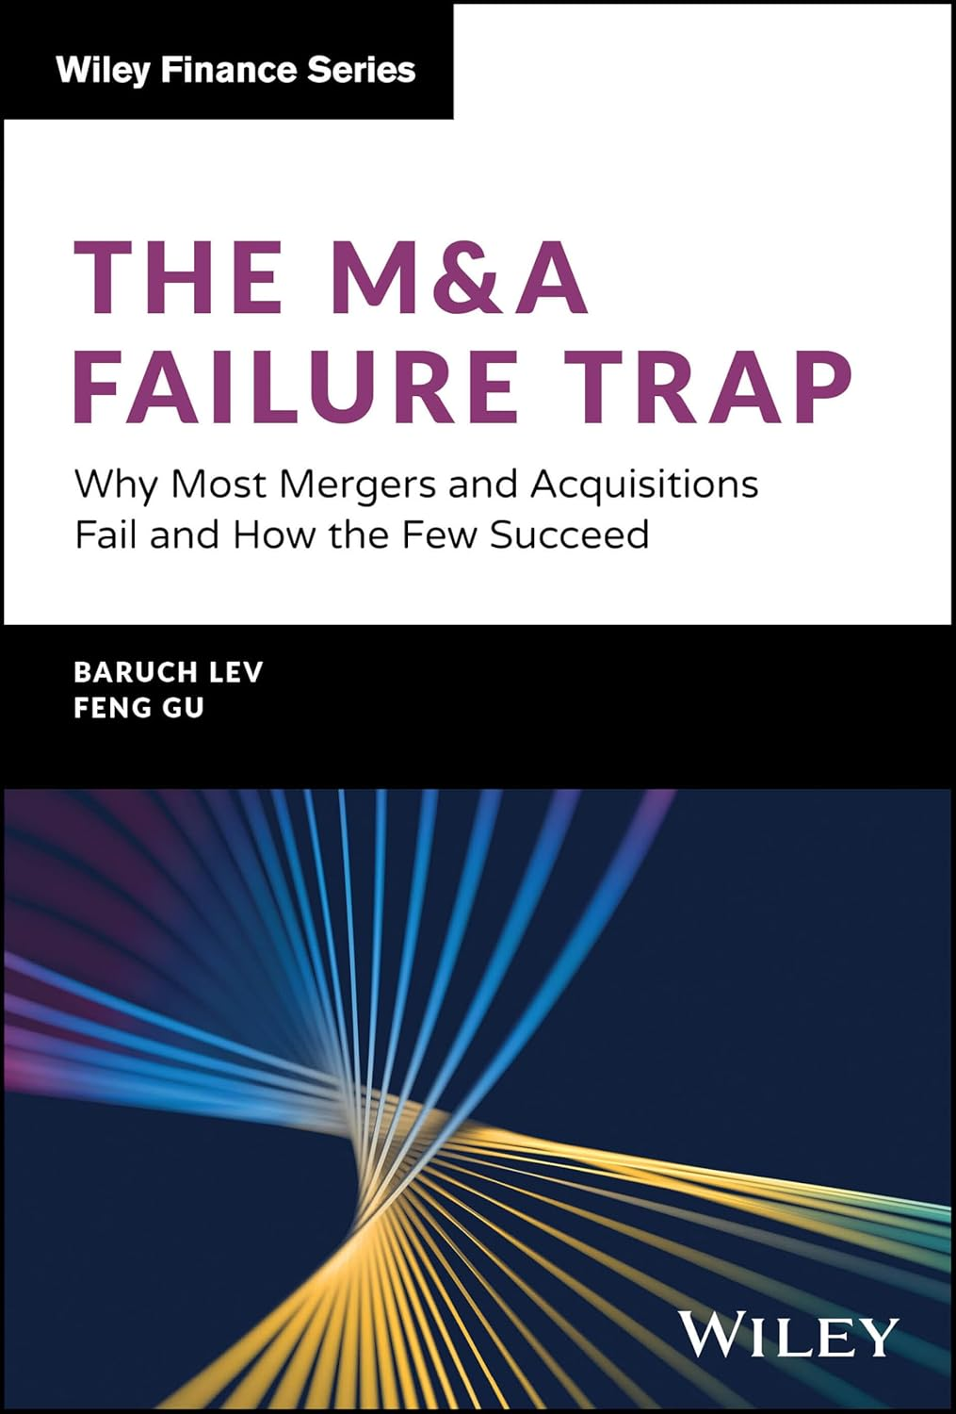
Caution!!!
40,000 deals analyzed over 40 years.
Failure rate to meet expectations?
(take a guess)
70-75%
Notes:
Baruch Lev is a distinguished academic in the field of accounting and finance. He is the Philip Bardes Professor Emeritus of Accounting and Finance at NYU's Stern School of Business. Lev has held professorial positions at several prestigious institutions, including the University of Chicago, Tel Aviv University (where he served as Dean of the business school), and the University of California, Berkeley. His research interests include corporate financial analysis, earnings measurement and management, mergers and acquisitions, and the impact of machine learning and AI on financial analysis. Lev has authored numerous books and over 100 research studies, making significant contributions to the understanding of intangible assets and corporate financial reporting.
Feng Gu is a prominent academic and professor in the field of accounting and law. He currently serves as the Chair and Professor at the School of Management at the University at Buffalo. His research interests include financial reporting, intangible assets, and the impact of information technology on business practices.

Slide 12
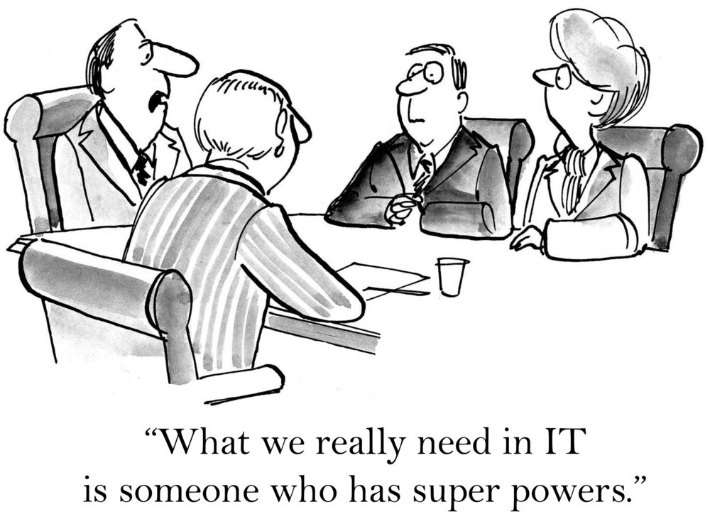
The Importance of Integration
“Integrating the target with the buyer comes at the conclusion of the acquisition process, when the major players – CEO and chief financial officer (CFO) – return to their regular work. The hard and crucial integration is often left to the staff and consultants. Consequently, target integration is where most acquisitions fail.”
The M&A Failure Trap: Why Most Mergers and Acquisitions Fail and How The Few Succeed
By Baruch Lev and Feng Gu, Nov 2024
Notes:
Baruch Lev is a distinguished academic in the field of accounting and finance. He is the Philip Bardes Professor Emeritus of Accounting and Finance at NYU's Stern School of Business and has held professorial positions at several prestigious institutions, including the University of Chicago, Tel Aviv University (where he served as Dean of the business school), and the University of California, Berkeley. His research interests include corporate financial analysis, earnings measurement and management, mergers and acquisitions, and the impact of machine learning and AI on financial analysis.
Feng Gu is a prominent academic and professor in the field of accounting and law. He currently serves as the Chair and Professor at the School of Management at the University at Buffalo. His research interests include financial reporting, intangible assets, and the impact of information technology on business practices.
Fleet Management and license plate example.

Slide 13

The Importance of IT Planning in M&A and Technology Modernization
Factoring IT consolidation into early M&A planning positions companies for quicker business gains and long-term success.
Steps for Success:
Make disciplined and strategic decisions about systems to keep and consolidate.
Create a data governance plan to manage and purge irrelevant data.
Leverage synchronization for coexistence between systems.
Govern and monitor new solutions post-merger using third-party tools.
Source: The Critical Role Of IT Consolidation In M&A Success
Notes:
IT consolidation plays a vital role in the success of mergers and acquisitions. By streamlining IT systems, companies can significantly reduce costs and enhance efficiency. Conducting thorough due diligence is essential to uncover potential risks prior to merging. Moreover, effective integration of technology ensures that all systems align with the overall business objectives, thus facilitating a smoother transition and achieving desired outcomes.
**Title: The Critical Role of IT Consolidation in M&A Success**
**Key Points:**
- **M&A Momentum Post-Pandemic**: After a slowdown during the pandemic, M&A activity surged in late 2020, with a total value of $2.3 trillion.
- **Importance of IT Integration**: Proper IT integration is crucial for realizing ROI, reducing costs, and increasing productivity. Neglecting this can lead to disjointed workflows and business risks.
- **Common Pitfalls**: Missteps in merging IT, such as lack of planning and communication, can lead to frustration and additional complications.
- **Steps for Success**:
1. Make disciplined and strategic decisions about systems to keep and consolidate.
2. Create a data governance plan to manage and purge irrelevant data.
3. Leverage synchronization for coexistence between systems.
4. Govern and monitor new solutions post-merger using third-party tools.
**Conclusion**: Factoring IT consolidation into early M&A planning positions companies for quicker business gains and long-term success.
---
I hope this helps! Let me know if you need any more details.

Slide 14
Data During Technical Due Diligence

Slide 15
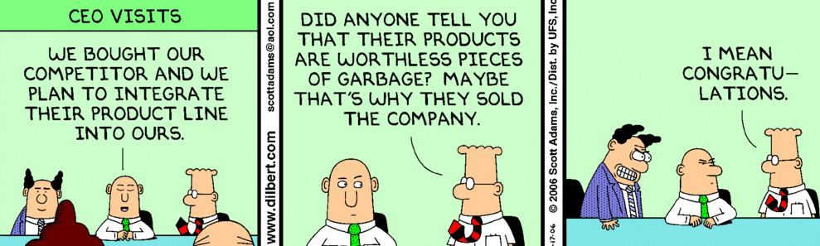
Why Technology Due Diligence is Important
Notes:
Rolfes

Slide 16



Data During Diligence: Before the Transaction
3 key deliverables which serve as critical inputs to post-close:
Risk Identification Red Flag Report and Remediations
IT Operational Maturity Assessment
Opportunities Roadmap
  Assesses IT operational maturity, risks and remediation, integration and scalability
  Defines technology costs, investments, and opportunities involved in the transaction
  Roadmap Options: Good, Better, and Best alternatives to deliver investment value
Notes:
Wolk

Slide 17
Data During Diligence: 360 Maturity Assessment
Technology Operational Maturity is an assessment of scalability and sophistication, relative to the size and maturity of the overall business.
Identifies areas of strength and those requiring investment
Preliminary broad-based risk identification
Directly ties to recommended Day 1 activities
Strong guidance for Day 2 initiatives planning
Notes:
Wolk

Slide 18
Data During Diligence: Risk Assessment
Technology Risk Assessment
High
Identifying and Mitigating IT Risks is essential to classifying potential Red Flags that may impede value delivery.
(Example: Cybersecurity Risk Assessment before and after mitigation.)
Medium Risk
High Risk
CYBERSECURITY & NETWORK
(Before Mitigation)
Likelihood of Occurrence
Low Risk
Medium Risk
CYBERSECURITY & NETWORK
(After Mitigation)
Low
Low
High
Severity of Consequences
Notes:
Wolk

Slide 19

Data During Diligence: Opportunities Roadmap
Investors/Stakeholders must understand the associated effort of integration onto selected platforms.
PE Firms/Organization Leadership, what is needed to achieve growth and scalability?
Program Timeline
Timeline
JAN
FEB
MAR
APR
MAY
JUN
JUL
OMS Config Req'ts
UAT Built
Code Freeze
GO
Milestones
Dev + Test Build /
Bootcamp Complete
Req'ts Freeze
DRESS
-
LIVE
Access
REHEARSAL
ERP Workstream
Config
Development
Create Runbook
Data Ingestion
QA Workshops
UAT 1
BF
UAT 2
BF
CRM
Workstream
Config
Development
Authoring
Create Runbook
Data Ingestion
QA Workshops
UAT 1
BF
UAT 2
BF
Customer Facing Software
Config
Refactoring
Authoring
Create Runbook
Data Ingestion
Development
QA Workshops
UAT 1
BF
UAT 2
BF
Operations / Field Services
Go
Application Connector Dev/QA
Static Data Prep
Q1 GoLive
-
Live
Authoring Updates
UAT
"Storm Period"
Data/Reporting
Config
Refactoring
Authoring
Create Runbook
Data Ingestion
Development
QA Workshops
UAT 1
BF
UAT 2
BF
User Acceptance
Built
Tested
Test Environment
Configured
Deploy
Activity Health:
Complete
Not Started
On Track
Warning
In Trouble
Notes:
Wolk

Slide 20
Post-Close Execution and Integration

Slide 21
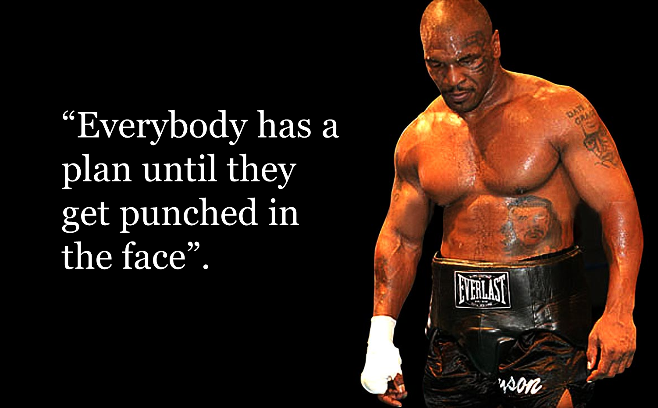
Let’s Go
Notes:
Rolfes –any punches you can relate with?

Slide 22
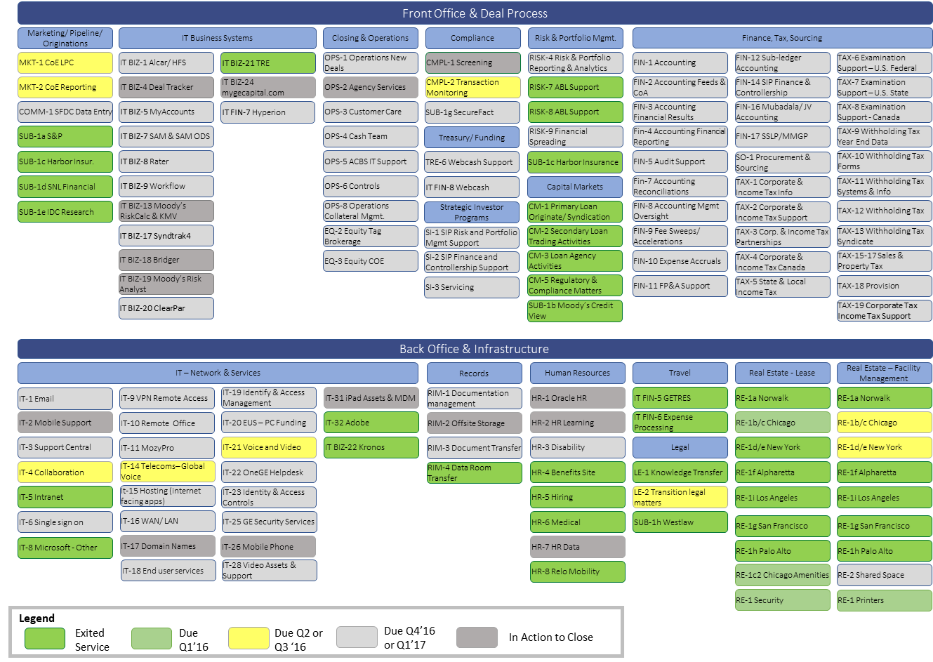
What’s the Plan & Tracking Progress

Slide 23
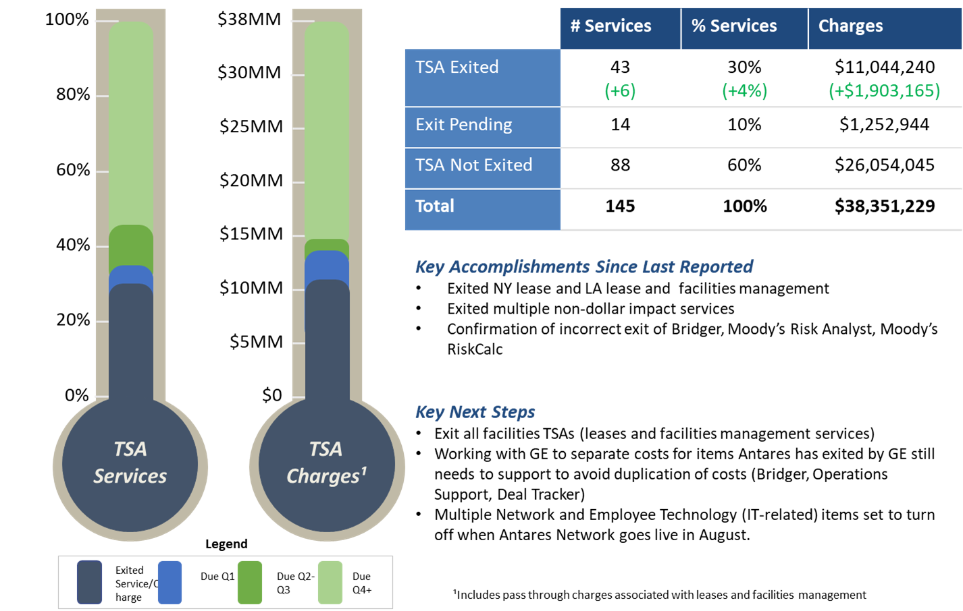
What’s the Plan & Tracking Progress
EXAMPLE TRANSITION SERVICES COST / VALUE TRACKING
Tracking 'realized value' throughout the post-close phase is imperative to ensure what was planned and budgeted, is delivered – on time.
* Detailed Examples illustrated in the Appendix

Slide 24
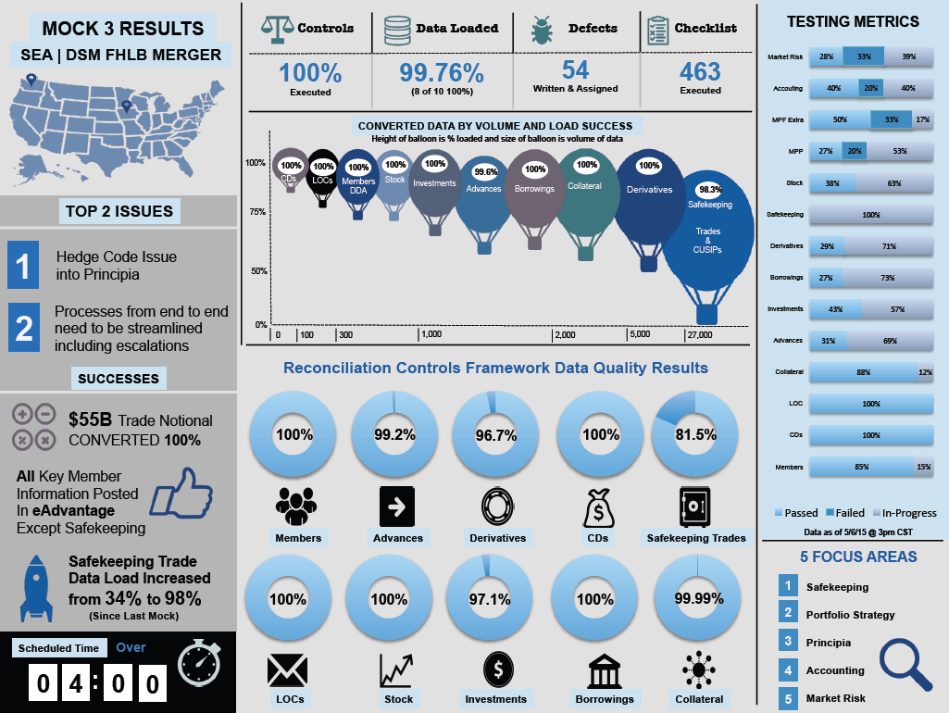
Tracking Progress…. and Measuring Success
Tracking key KPIs and metrics throughout the Integration cycle are critical to measure progress and know where you need to continue to focus additional attention.
Infographics are a great tool to memorialize historical snapshots of your “mock conversions” as you get closer and closer to Go-Live

Slide 25
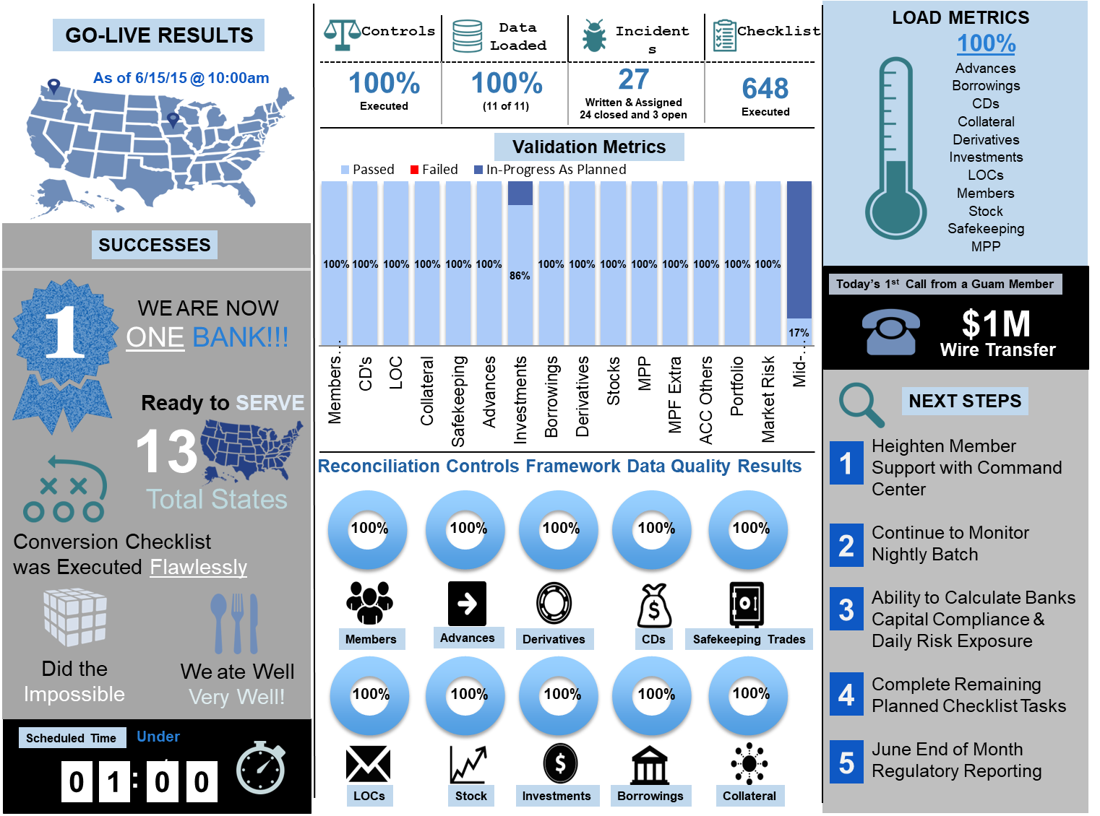
Tracking Success… and Measuring Success
These data points not only measures your success throughout the Integration cycle but also sets you up for “prove it” conversations with Audit
Infographics are also a great way to present all of the key data you are measuring to an executive audience (and the rest of the non-technical organization)

Slide 26









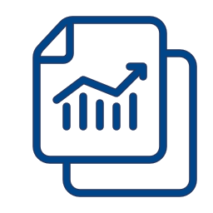





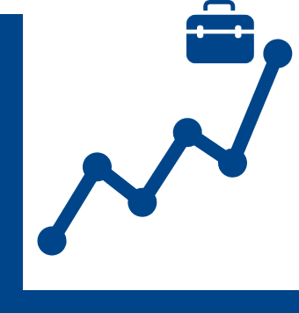









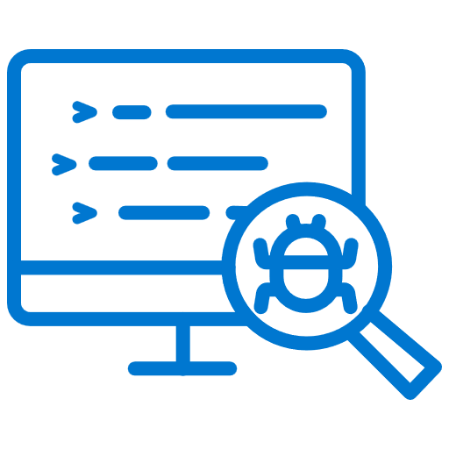



Closing Insights
Data helps in every step of the way in any major transformative initiatives, from Diligence, through Initiation, Execution, Go-Live and forming the Opportunities Roadmap for Day 2+
Technology Due Diligence
IT Operational Maturity Assessment
Risk Identification, Red Flag Report & Remediations
Cost, Investment, Opportunities Roadmap
Initiation
Execution
Go-Live
Support & Maintain
Charter/Scope
Business Case
Governance & Comms
Integrated Program Plan / RAID Logs
EPMO & Team Status Reporting
Command Center Setup
& Execution (runbooks)
Organizational Readiness
Modernization – AI/ML
Remove
Technical Debt
Solution Architecture /Blueprints
Project Kick-Off
& Alignment
Board/Executive Presentations
Financial Tracking
Data Reconciliation & Controls Balancing
Real-Time Updates / Executive Dashboard
Optimized Solution /Integration
Growth Engine Begins
Vendor/Product Integration Mapping
Business Processes & RACI
Full SDLC Template Library
Mock Conversion Strategy
Rapid Issue / Defect Management
Ongoing Production Support
Robotics / Automation Processing
Regulatory Updates
Notes:
Rolfes

Slide 27
Questions?

Slide 28
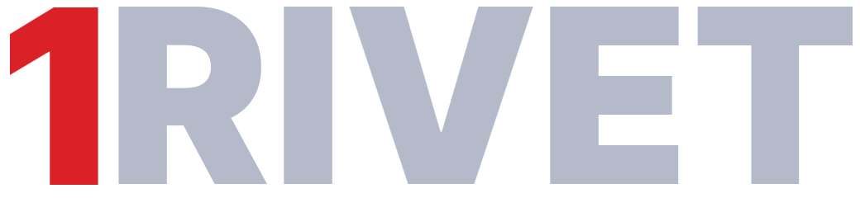

THANK YOU!
443-985-0449
703-966-6943
Mike.Rolfes@1Rivet.com
Michael.Wolk@1Rivet.com

