Slide 1
Driving Business Success with a Strong Cybersecurity Strategy
Ken St. Cyr
Principal Cybersecurity Architect

Slide 2

























































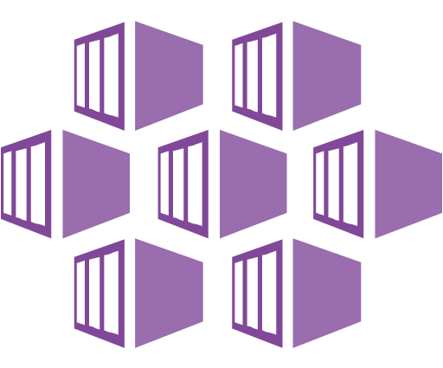








Security Operations / SOC
Software as a Service (SaaS)
Microsoft Security Experts
Managed Security Operations
Using Microsoft Security
Cybersecurity Reference Architecture
Security modernization with Zero Trust Principles
December 2023 – aka.ms/MCRA
Microsoft Defender for Cloud Apps
App Discovery & Risk Scoring (Shadow IT)
Threat Detection & Response
Policy Audit & Enforcement
Session monitoring & control
Information Protection &
Data Loss Prevention (DLP)
Defender Experts | Detection and Response Team (DART)
Microsoft Defender XDR
Unified Threat Detection and Response across IT, OT, and IoT Assets
Incident Response | Automation | Threat Hunting | Threat Intelligence
Cloud
Azure, AWS, GCP, On Prem & more
Endpoint
Workstations, Server/VM, Containers, etc.
Office 365
Email, Teams,
and more
Identity
Cloud &
On-Premises
SaaS
Cloud Apps
Data
SQL, DLP, & more
OT/IoT
devices
Microsoft Sentinel
Other
Tools, Logs,
& Data
This is interactive!
Present Slide
Hover for Description
Click for more information
Security Guidance
Security Adoption Framework
Security Documentation
Cloud Security Benchmarks
Microsoft Entra Internet Access
Microsoft Security Copilot (Preview)
Cloud Native
SIEM, SOAR,
and UEBA
This is interactive!
Present Slide
Hover for Description
Click for more information
Identity & Access
Conditional Access – Zero Trust Access Control decisions based on explicit validation of user trust and endpoint integrity
Endpoints & Devices
Hybrid Infrastructure – IaaS, PaaS, On-Premises
Information Protection
Microsoft Entra
Unified Endpoint Management (UEM)
Defender for Cloud – Cross-Platform Cloud Security Posture Management (CSPM)
Microsoft Purview
Information protection and governance across data lifecycle
Passwordless & MFA
Secure Score
Intune
Configuration Manager
Microsoft Azure
Compliance Dashboard
Hello for Business
On Premises Datacenter(s)
3rd party IaaS & PaaS
Discover
Protect
Authenticator App
Azure Marketplace
Azure Firewall
& Firewall Manager
Monitor
Classify
FIDO2 Keys
NGFW
Classification Labels
Entra ID Protection
Leaked cred protection
Behavioral Analytics
Extranet
Edge DLP
Azure WAF
File Scanner
(on-premises and cloud)
IPS/IDS/NDR
DDoS Protection
Microsoft Defender for Endpoint
Unified Endpoint Security
Microsoft Entra Private Access & App Proxy
Beyond User VPN
ID Governance
VPN & Proxy
Azure Key Vault
Endpoint Detection & Response (EDR)
Express Route
S3
Microsoft Entra PIM
Private Link
Azure Bastion
Data Governance
External Identities
Web Content Filtering
Azure Arc
Threat & Vuln Management
Intranet
Azure Lighthouse
Advanced eDiscovery
Defender for Identity
Endpoint Data Loss Protection (DLP)
Azure Stack
Azure Backup
Active Directory
Security & Other Services
Compliance Manager
Securing Privileged Access – aka.ms/SPA
Entra Permission Management – Discover and Mitigate Cloud Infrastructure Permission Creep
Privileged Access Workstations (PAWs) - Secure workstations for administrators, developers, and other sensitive users
Security Posture Management – Monitor and mitigate technical security risks using Secure Score, Compliance Score, CSPM: Defender for Cloud, Microsoft Defender External Attack Surface Management (EASM) and Vulnerability Management
Windows 11 & 10 Security
IoT and Operational Technology (OT)
Defender for Cloud – Cross-Platform, Multi-Cloud XDR
Detection and response capabilities for infrastructure and development across IaaS, PaaS, and on-premises
People Security
App control
Exploit protection
Behavior monitoring
Next-generation
protection
Network protection
Credential protection
Full Disk Encryption
Attack surface
reduction
Azure Sphere
Microsoft Defender for IoT (and OT)
Attack Simulator
Insider Risk Management
Communication Compliance
ICS, SCADA, OT
Internet of Things (IoT)
Industrial IoT (IIoT)
Asset & Vulnerability management
Threat Detection
& Response
Defender for APIs (preview)
GitHub Advanced Security & Azure DevOps Security
Secure development and software supply chain
Threat Intelligence – 65+ Trillion signals per day of security context
Service Trust Portal – How Microsoft secures cloud services
Security Development Lifecycle (SDL)

Slide 3
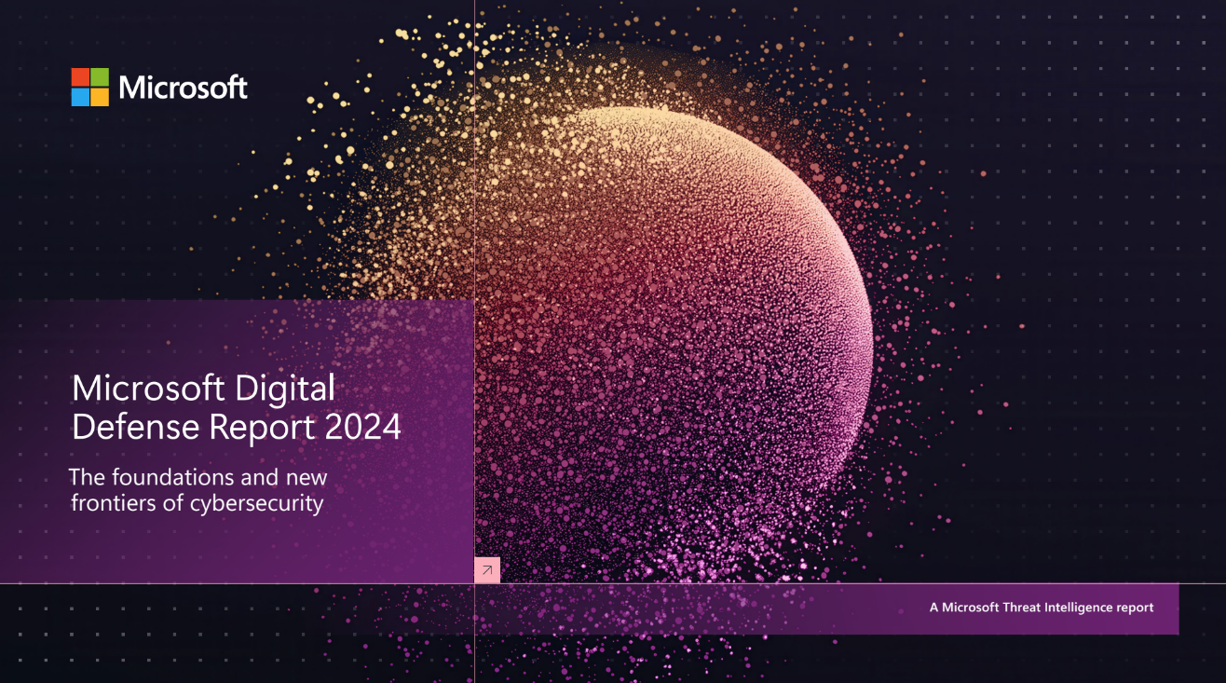
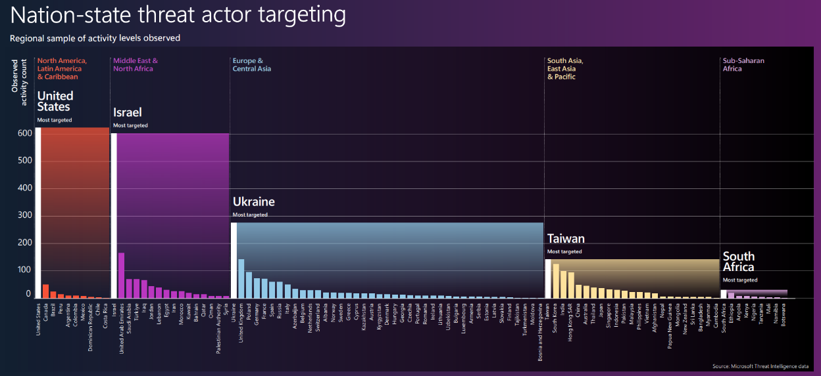
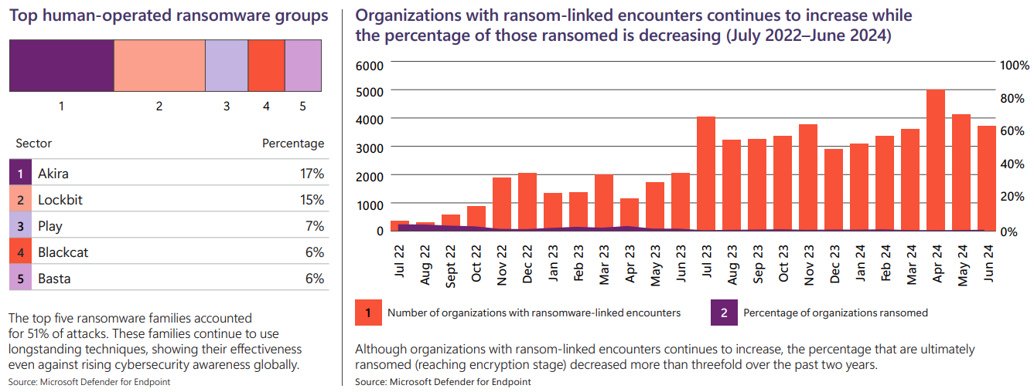
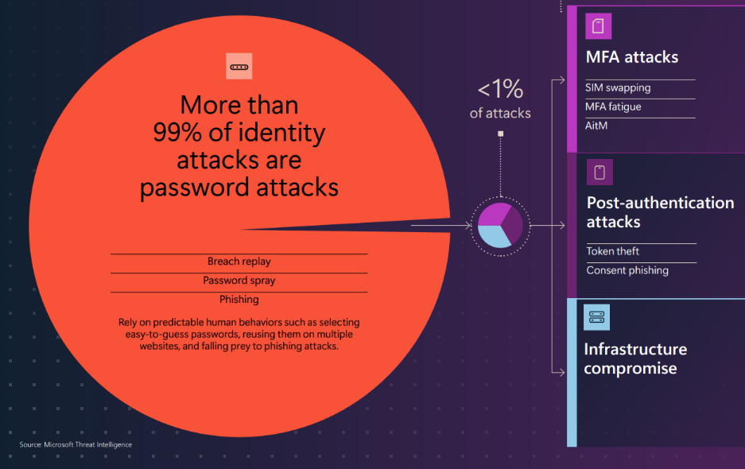
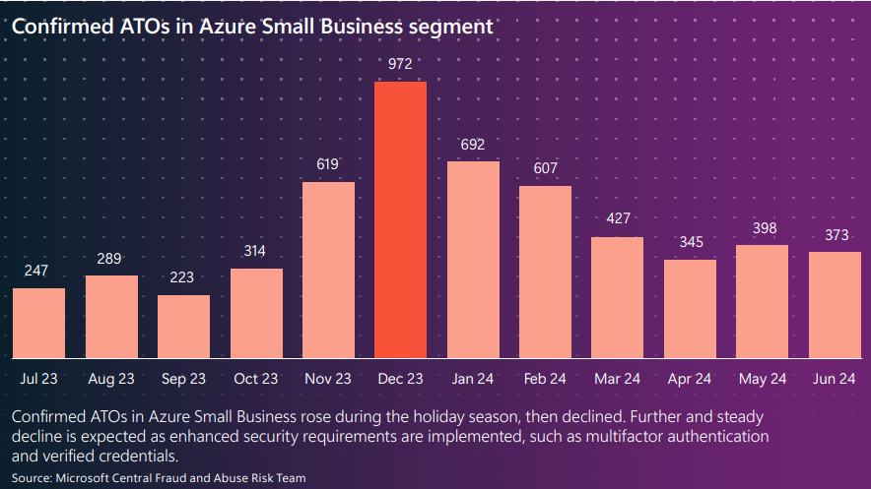
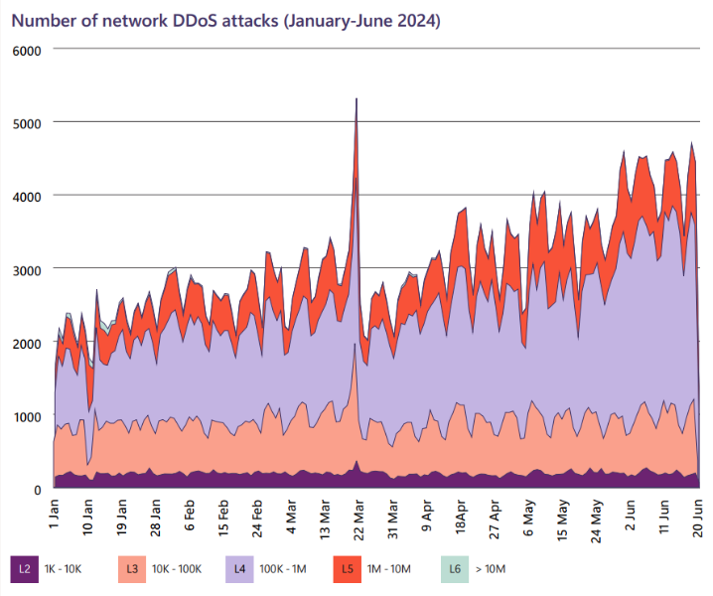



Is a Cybersecurity Strategy really necessary?
Microsoft Digital Defense Report, 2024
The malign actors of the world are becoming better resourced and better prepared, with increasingly sophisticated tactics, techniques, and tools that challenge even the world’s best cybersecurity defenders.
“If you’re faced with the tradeoff between security and another priority, your answer is clear: Do security. In some cases, this will mean prioritizing security above other things we do, such as releasing new features or providing ongoing support for legacy systems.”
Satya Nadella Microsoft CEO, May 3, 2024

Slide 4
Two Types of the Cybersecurity Strategies
Reactive
Proactive
Incident Response
Communication Plan
Disaster Recovery
Business Continuity
Employee Education
Cyber Insurance
…
Cyber investment planning
Threat Hunting
Risk Management
Security Posture Improvement
Threat Intelligence
Secure Design
…

Slide 5
Cyber Security Strategy
Architecture
Combined Goals
Strategic Objectives
Cyber Security Roadmap
Objective 1
Objective 2
Objective 3
Combined Requirements
Objective 4
Key Results
Key Results
Objective 5
Epics & Features
Transition
Objective 6
Key Results
Key Results
Combined Risks
Key results
Planning

Slide 6
5 Principles
Aligned with the Business
Grounded in a Security Framework
Prioritized Appropriately
Leads to Action
Continuously Evolves

Slide 7

Principle 1: Aligned with the Business
1
1
Business Strategy
Business Mission/Vision
Goals
Requirements
Risks
4
Cyber Security Strategy
Cyber Security
Architecture
5
Cyber Security Mission/Vision
Cyber Security Capabilities
Epics & Features
2
IT Strategy
Cyber Security Objective
Goals
Cyber Security Objective
IT Mission/Vision
Cyber Security Objective
Goals
Requirements
Risks
Key Results
Requirements
Key Results
Key Results
3
OT Strategy
Risks
OT Mission/Vision
Goals
Requirements
Risks

Slide 8
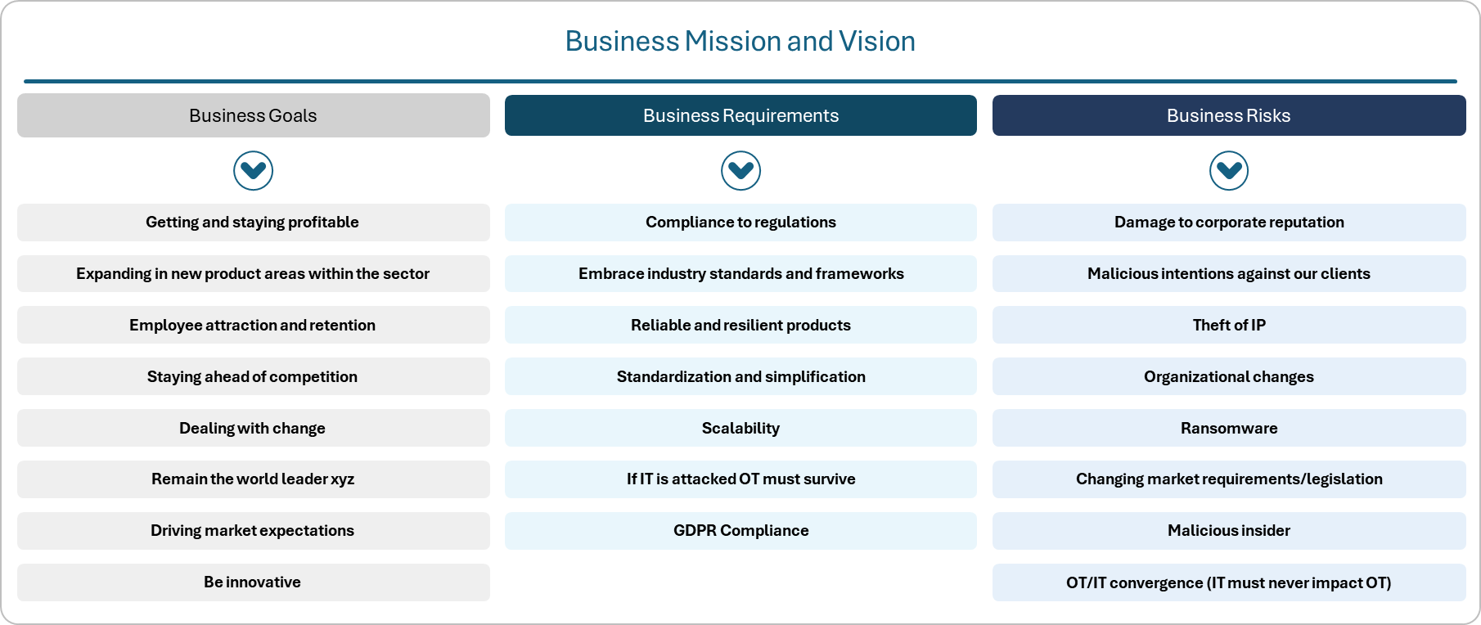
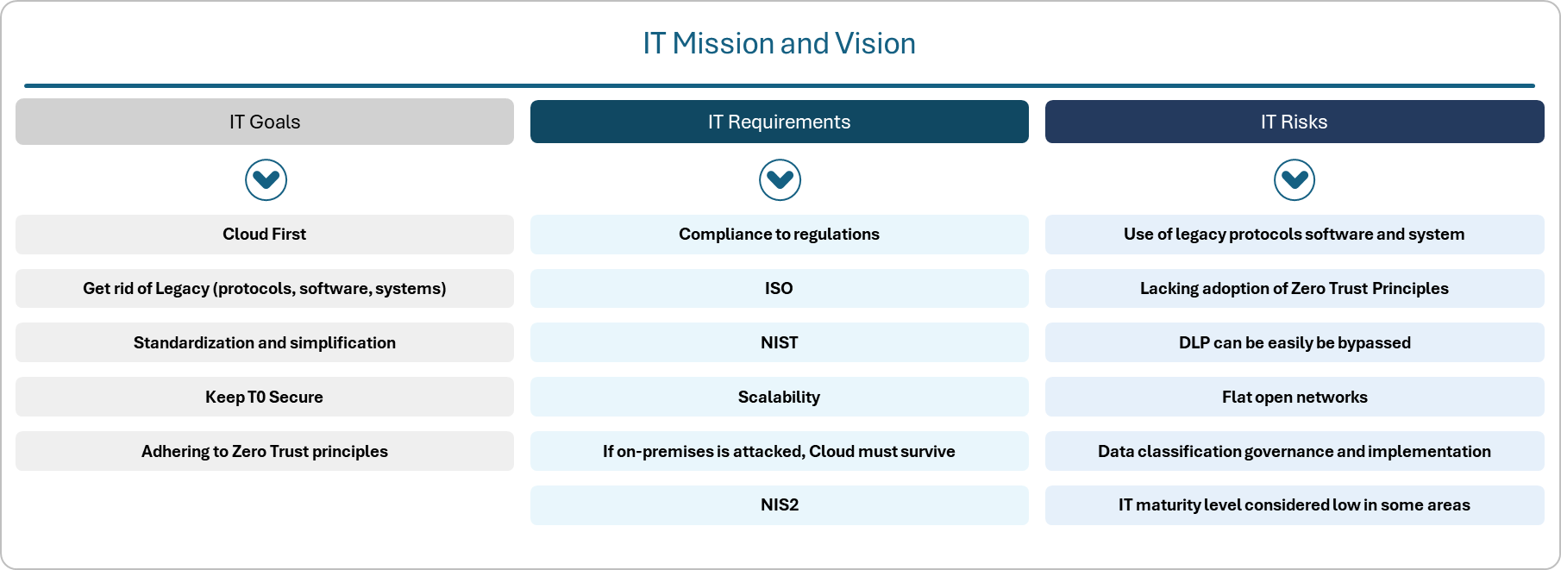
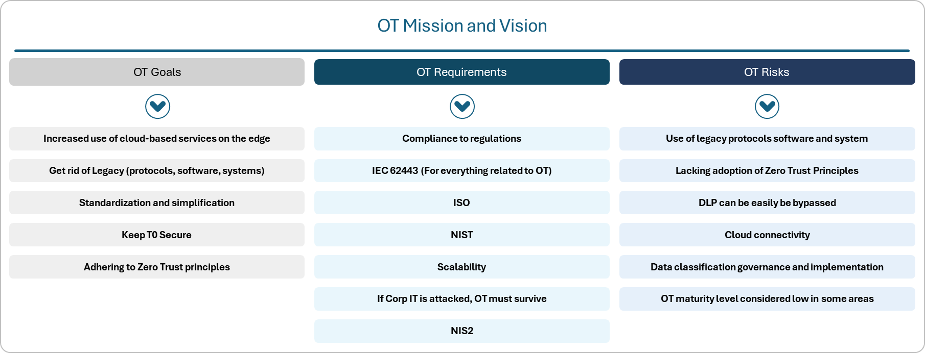
Goals, Requirements, and Risks
1

Slide 9
Goal Mapping
1
Aspiration presentation
Based on workshops and shared information
Getting and Staying Profitable
Cybersecurity Goals
Delivering 10x current energy production by 2030
Be a trusted partner
Business Goals
Expanding in new product areas within the sector
Be reliable, resilient, and secure
Employee Attraction and retention
Be attractive for cyber talent
Staying Ahead of Competition
Dealing with Change
Being sustainable in usage of data
Remain the world leader in XYZ energy product
Managing the threat landscape
Driving market expectations
Commercialize Cyber Security
Be innovative
Meeting market expectations related to Cyber Security
Cloud First
Maintaining Cyber Security Governance
Get rid of Legacy (protocols, software, systems)
IT/OT Goals
Standardization and simplification
Reach SL2 ML3
Keep Tier 0 Secure On-premises
Disrupt attacker return on investment
Adhering to Zero Trust principles
NOTE:
Goals are not listed in prioritized order

Slide 10
Example: Cyber Security Strategic Objectives
1
Enables you to achieve the goals, meet requirements, and mitigate the risks
STROBJ1
Master the Identity Control Plane
STROBJ4
Resilience to ransomware attacks
STROBJ2
Automated enterprise and industrial asset discovery
STROBJ5
Champion Zero Trust principles across the estate
STROBJ3
Discover, govern and protect data
STROBJ6
Form a Unified SOC combining
IT & OT

Slide 11
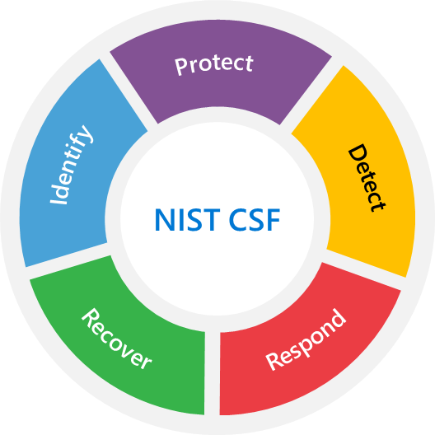



Principle 2: Grounded in a Security Framework
2
Best Practices
Security / Compliance Controls
Security Configurations

Slide 12
Mapping strategic Cybersecurity objectives to NIST
2
Identify
Protect
Detect
Respond
Recover
Master the Identity Control Plane
Automated enterprise IoT and OT asset discovery
Discover, govern and protect Data
Resilience to ransomware attacks
Champion Zero Trust principle across the estate
Form a Unified SOC combining IT & OT

Slide 13
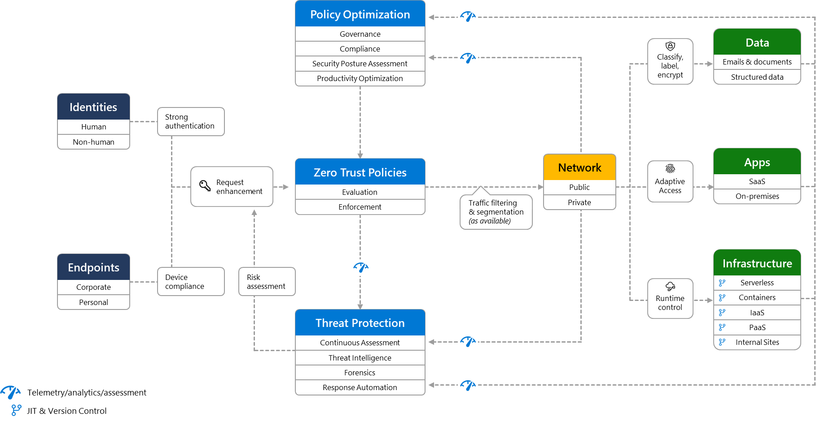

Zero Trust Architecture
2
Assume breach | Explicitly verify | Least privileged

Slide 14
Assess Yourself Against the Framework
2
Use Multiple Techniques
Risk Assessment
Threat Modeling
Penetration Testing
Red Teaming
Standards Benchmarking
SOC Trend Analysis

Slide 15






Principle 3: Prioritized Appropriately
3
Potential Limitation: Focusing solely on risk may overlook other important factors such as business impact or customer requirements.
Lack of Customization: Risk-based approaches may not consider the specific needs and priorities of the organization, leading to suboptimal prioritization.
Turning security into a business enabler and opportunity for grown is not easy with a risk-only approach.
Only-Risk-Based Approach
Incident
Response and Threat Intelligence
Reactive Approach: Relying solely on incident response and threat intelligence may result in a reactive approach to prioritization, rather than proactive risk management.
Limited Scope: This approach may focus primarily on addressing known threats and vulnerabilities, potentially overlooking emerging risks or long-term strategic goals.
Narrow Focus: Solely prioritizing based on compliance may not address emerging or unique cybersecurity risks that are not covered by specific regulations.
Potential Misalignment: Compliance requirements may not always align with the actual priorities and goals of the organization, leading to a lack of focus on critical areas.
Compliance and Regulatory Requirements
Lack of Technical Consideration: Solely prioritizing based on business impact may not adequately address technical complexities or security requirements, leading to potential vulnerabilities.
Difficulty in Quantifying Impact: Assessing the true impact on business operations and assets can be challenging and subjective, affecting the accuracy of prioritization.
Business
Impact Analysis

Slide 16


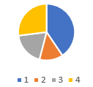
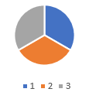


Modified VC Prioritization Model
3
Priority = $revComplexity∗Value+Bonus$
1
2
Weights, and inputs
3
Estimations
Prioritized key results
Input
+Bonus
Output
Value
Complexity
Done by subject matter experts following the defined inputs.
Based on:
Company priorities
Inputs from subject matter experts
Availability of resources
= Priority
Chosen based on a thorough understanding of the company’s
strategy and priorities.

Slide 17
The Danger of Prioritizing with Heat Maps
3
Scenario A
Likelihood is 20%
Impact is $100 Million
Scenario B
Likelihood is 2%
Impact is $10 Million
.2 x $100,000,000 = $20,000,000
.02 x $10,000,000 = $200,000
From an actuarial viewpoint, Scenario B represents
100th the risk of Scenario A, yet they occupy the same cell in the risk matrix!

Slide 18
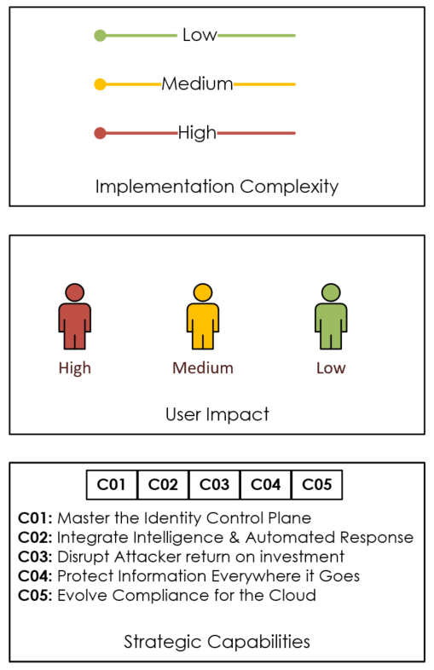
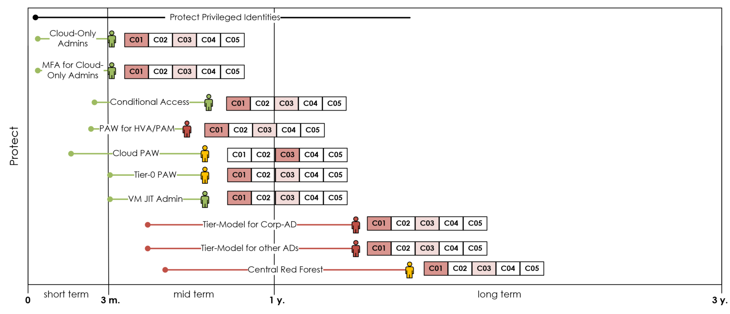
Principle 4: Leads to Action
4
Protect Privileged Identities
Integrate and leverage capabilities for protecting the identity boundary.

Slide 19
Objectives and Key Results (OKR) – Transition to Architecture
4
Strategy
Architecture & Roadmap
Enablement
Feature 1
Feature 1
Objective
Epic
Feature 2
User stories
Feature …
Tasks
Tasks
Tasks
Feature 6
Key Result #1
Epic
Feature 7
Feature …
Feature 11
Feature 11
Epic
Feature 12
User stories
Feature …
Tasks
Tasks
Tasks
Key Result #2
Feature 17
Epic
Feature 18
Feature …
Feature …
Work is organized into Epics and Features that align with the Strategic Objectives and Key Results established during the Strategic Phase.

Slide 20
High Level Roadmap (3m-1y-3y)
4

Slide 21
Principle 5: Continuously Evolves
Strategy & Governance
Driving Continuous Improvement
Intelligence
Posture Management
Access Control
Zero Trust
Innovation Security
DevSecOps
Asset
Protection
Architecture
Security Operations
Policies and Standards

Slide 22


THANK YOU

