Slide 1
Joe Marshall – Sr. Security Strategist
Notes:
The mission of Talos is protecting our customers and the internet at-large. In this landscape you don’t just need a vendor you need a partner, someone who is going to put your defense first.
Our job is your defense: Customized speaker intro

Slide 2
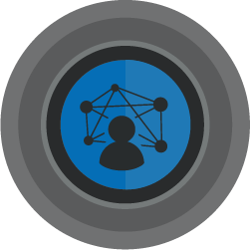



Who am I?
Senior Security Strategist and threat researcher
Hacking, IoT, and keeping the internet safe.
Baltimore, MD
Joe Marshall
@immortanjo3
josmarsh@cisco.com
Notes:
Please copy and paste your photo bubble and enlarge it to the size above.

Slide 3
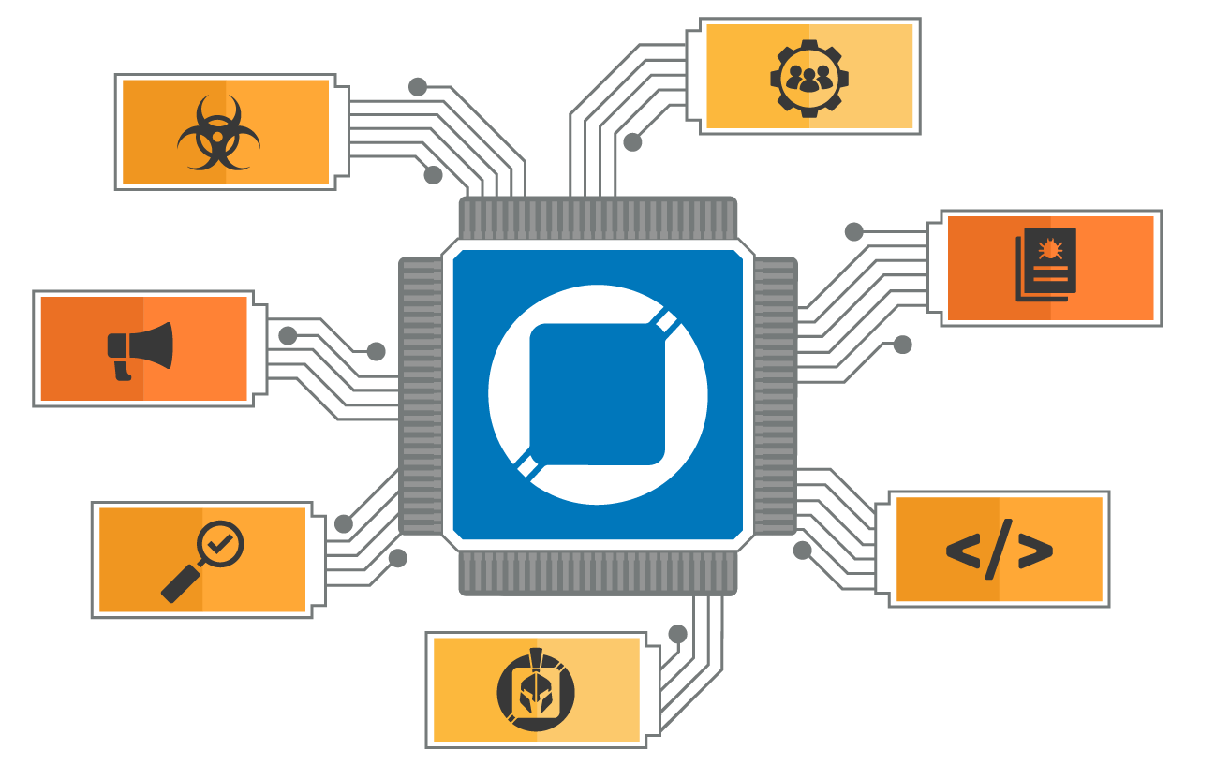
Our job is protecting your network
Talos is the threat intelligence group at Cisco. We are here to fight the good fight —
we work to keep our customers, and users at large, safe from malicious actors.
Community
Detection Research
Vulnerability
Research
& Discovery
Strategic Communications
Threat Intelligence
& Interdiction
Engineering
& Development
Incident Response
Notes:
Providing this protection requires a broad talent set. To achieve this, we leverage a wide range of skills, from threat researchers, vulnerability analysts, developers, and even a few rocket scientists. We then build this organization into six key areas:
1. Threat Intelligence & Interdiction: Is focused on "getting in the way" of active threat, by surveilling active threat campaigns for intelligence and working with incident response groups.
2. Detection Research focuses on constantly improving the methods for identifying new threat detection methods.
3. Engineering and Development is about creating more powerful tools that find their way back into Cisco Security Solution or the Open Source Community.
4. Vulnerability Research & Discovery is on the lookout for weaknesses in the software, hardware, and systems that drive our world.
5. The best security research is not done in a vacuum. Our community efforts help us build partnerships with other threat researchers, our customers, and security organizations that are working to protect us all.
6. Global Outreach team. We understand that effective security requires education and awareness. This team makes sure that our Cisco Professionals, our customers, and the world at large have the knowledge they need to be successful.
7. The newest addition to Talos is Talos Incident Response – Talos IR is the proactive and reactive response team for our customers. Before, during, and after an incident they are available on a moment’s notice - helping customers prepare for an incident or mitigate, respond, and recover with minimal disruption.

Slide 4

Unmatched visibility across the threat landscape
550B security events/day
~9M emails blocked/hour
~2,000 new samples/minute
~2,000 domains blocked/second
Notes:
We have the visibility into the breadth of data to ensure you are completely covered across the threat landscape.
We see 550 billion security events every single day. We block 9 million malicious emails per hour. We see 2000 new malware samples every minute. And block 2000 malicious domains every single second.
Updated numbers as of November 2023

Slide 5
Threat Landscape:
APTs and Commodity

Slide 6
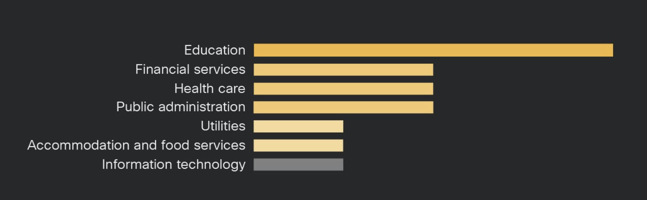
Education/FINSRV – pushing to the front!

Slide 7
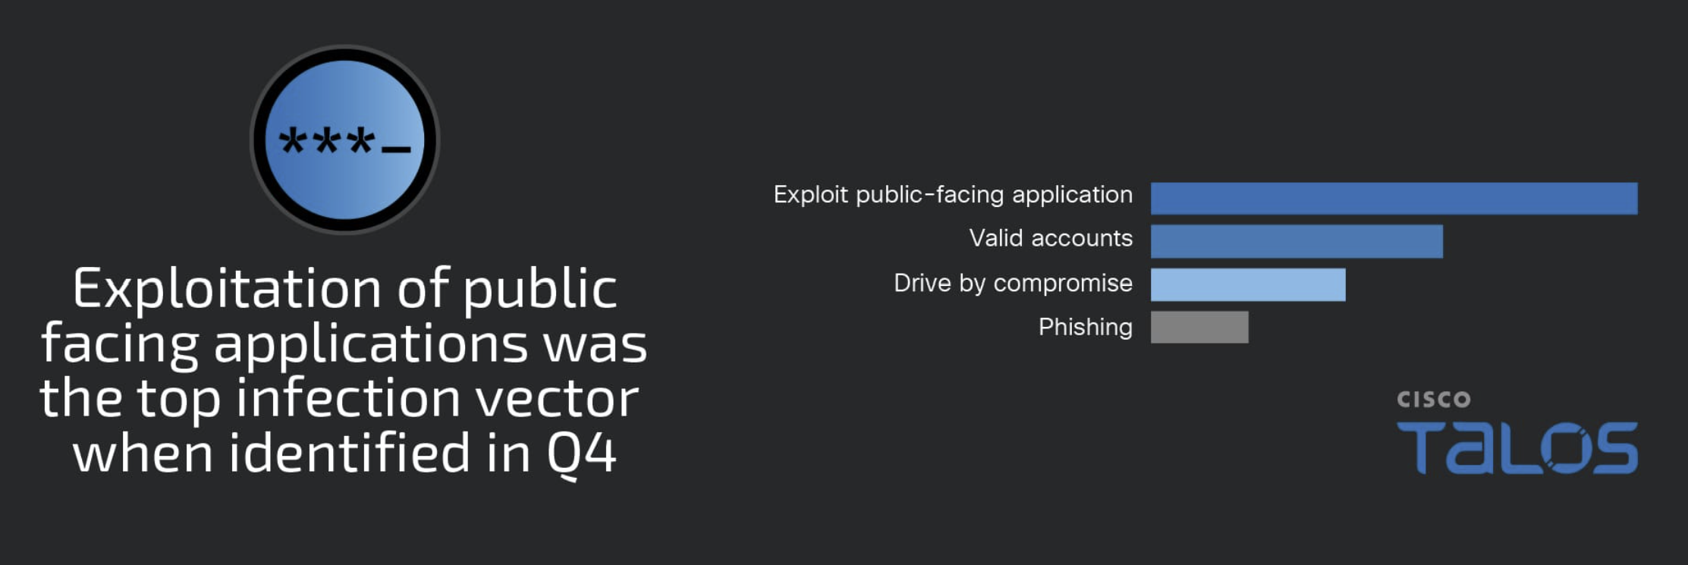
Valid accounts dethroned?!

Slide 8
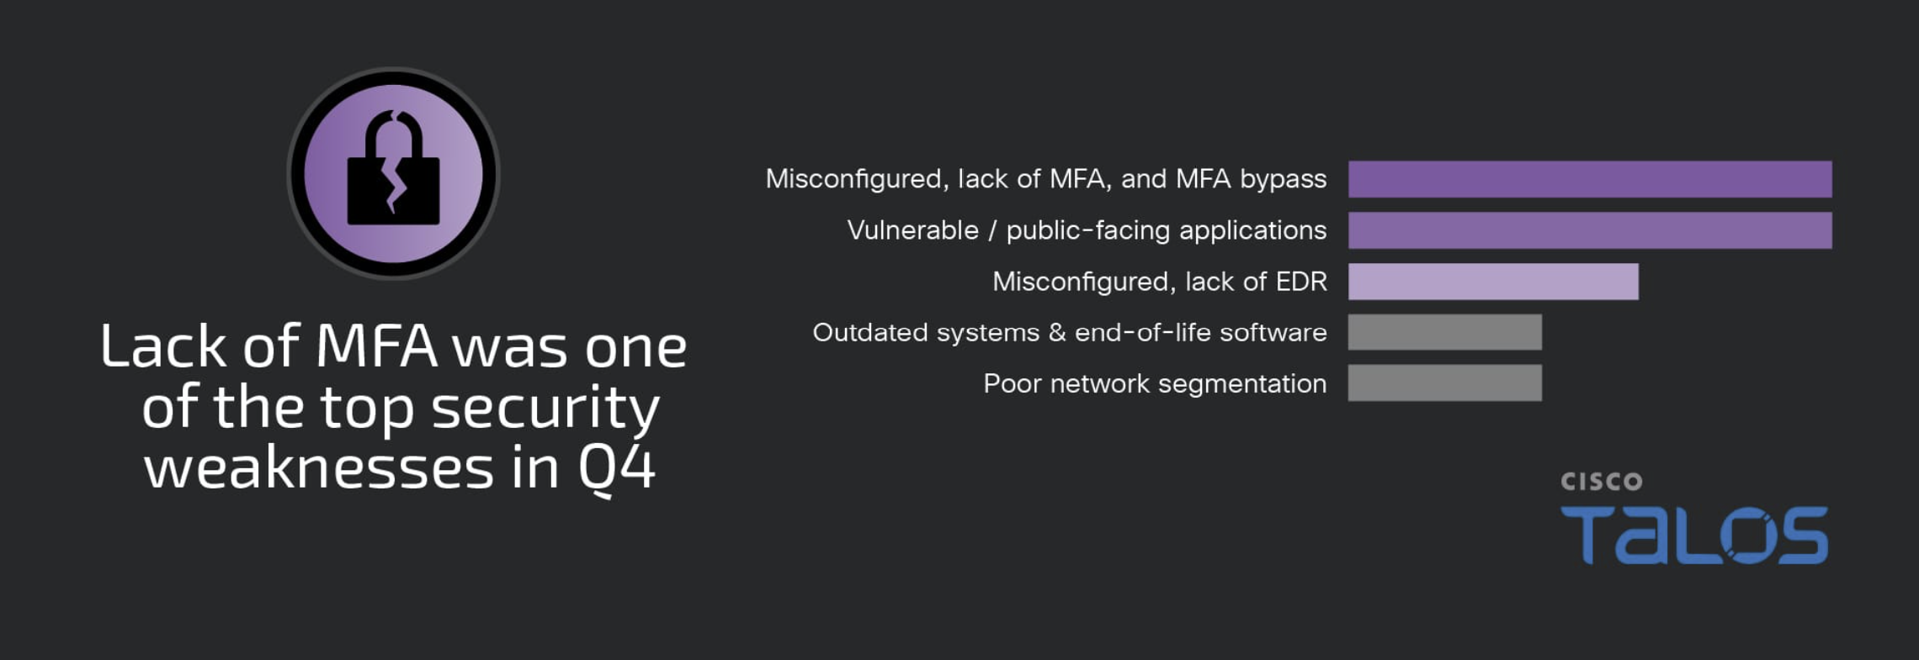
MFA still is a problem (sigh)

Slide 9
Drumroll – the top 10!
Mimikatz
• Cobalt Strike
• PSExec
• Impacket
• Bloodhound/Sharphound - AD reconnaissance tools that are examples (like ADFind, ADExplorer) that TAs use to interact with and gather info from AD.
• SOCKS proxies (Chisel, socks5, etc)
• robocopy / xcopy - good examples of common utilities we see used to aid in exfil
• PowerShell - good example as an intro to LoLBin usage
• AnyDesk/SplashTop/Atera - Examples of commercial remote desktop software that are used to help facilitate lateral movement to and pivot to other systems in an environment.
• Netscan - SoftPerfect Network Scanner, aka NetScan, a network scanning tool (similar in functionality to the commonly seen Advanced IP Scanner tool) that detects devices and open ports on a network

Slide 10
MITRE ATT&CK
Key findings from the MITRE ATT&CK framework include:
The use of remote access tooling, such as Splashtop or AteraAgent, was leveraged in nearly 40 percent of engagements, compared to 5 percent in the previous quarter.
Remote access tooling was leveraged in 100 percent of the ransomware incidents observed in Q4, a significant shift compared to that of the previous quarter.
This is the first quarter in well over a year in which the use of valid accounts was not the top initial access technique. Instead, exploitation of public-facing applications, largely contributed by the high number of web shell incidents, was the top means of gaining access this quarter.

Slide 11
Lateral Shenanigans
*RDP
*SMB
EventCode=4624 (Detect SMB)
index=main EventCode=4624 Account_Name="ANONYMOUS LOGON" host="HOSTNAMEGOESHERE" Logon_Type=3 Logon_Process="NtLmSsp" Workstation_Name="-"
| eval Account_Name2=mvindex(Account_Name, 1)
| table _time, host, Source_Network_Address, Account_Name2
| sort -_time

Slide 12
Lateral Tricks (non RDP)
EventCode=4624 (Detecting Lateral Movement)
index=main EventCode=4624 Logon_Type=3, NOT (Source_Network_Address IN ("-", "::1", "fe80::502e:32c6:96e2:84c8"))
| eval Account_Name2=mvindex(Account_Name, 1)
| stats dc(host) AS "Unique Hosts" by Source_Network_Address
| search "Unique Hosts" > 2
| sort -"Unique Hosts"

Slide 13
Lateral Tricks (with RDP-TCP hijack)
EventCode=4688 (RDP Hijack) (regex searching, sorry)
index=main EventCode=4688
| regex Process_Command_Line="(?i).*(\/dest\:rdp\-tcp\#.*).*$"24
| eval Account_Name2=mvindex(Account_Name, 1)
| table _time, host, Account_Name2, New_Process_Name, Creator_Process_Name, Process_Command_Line
| sort-_time

Slide 14
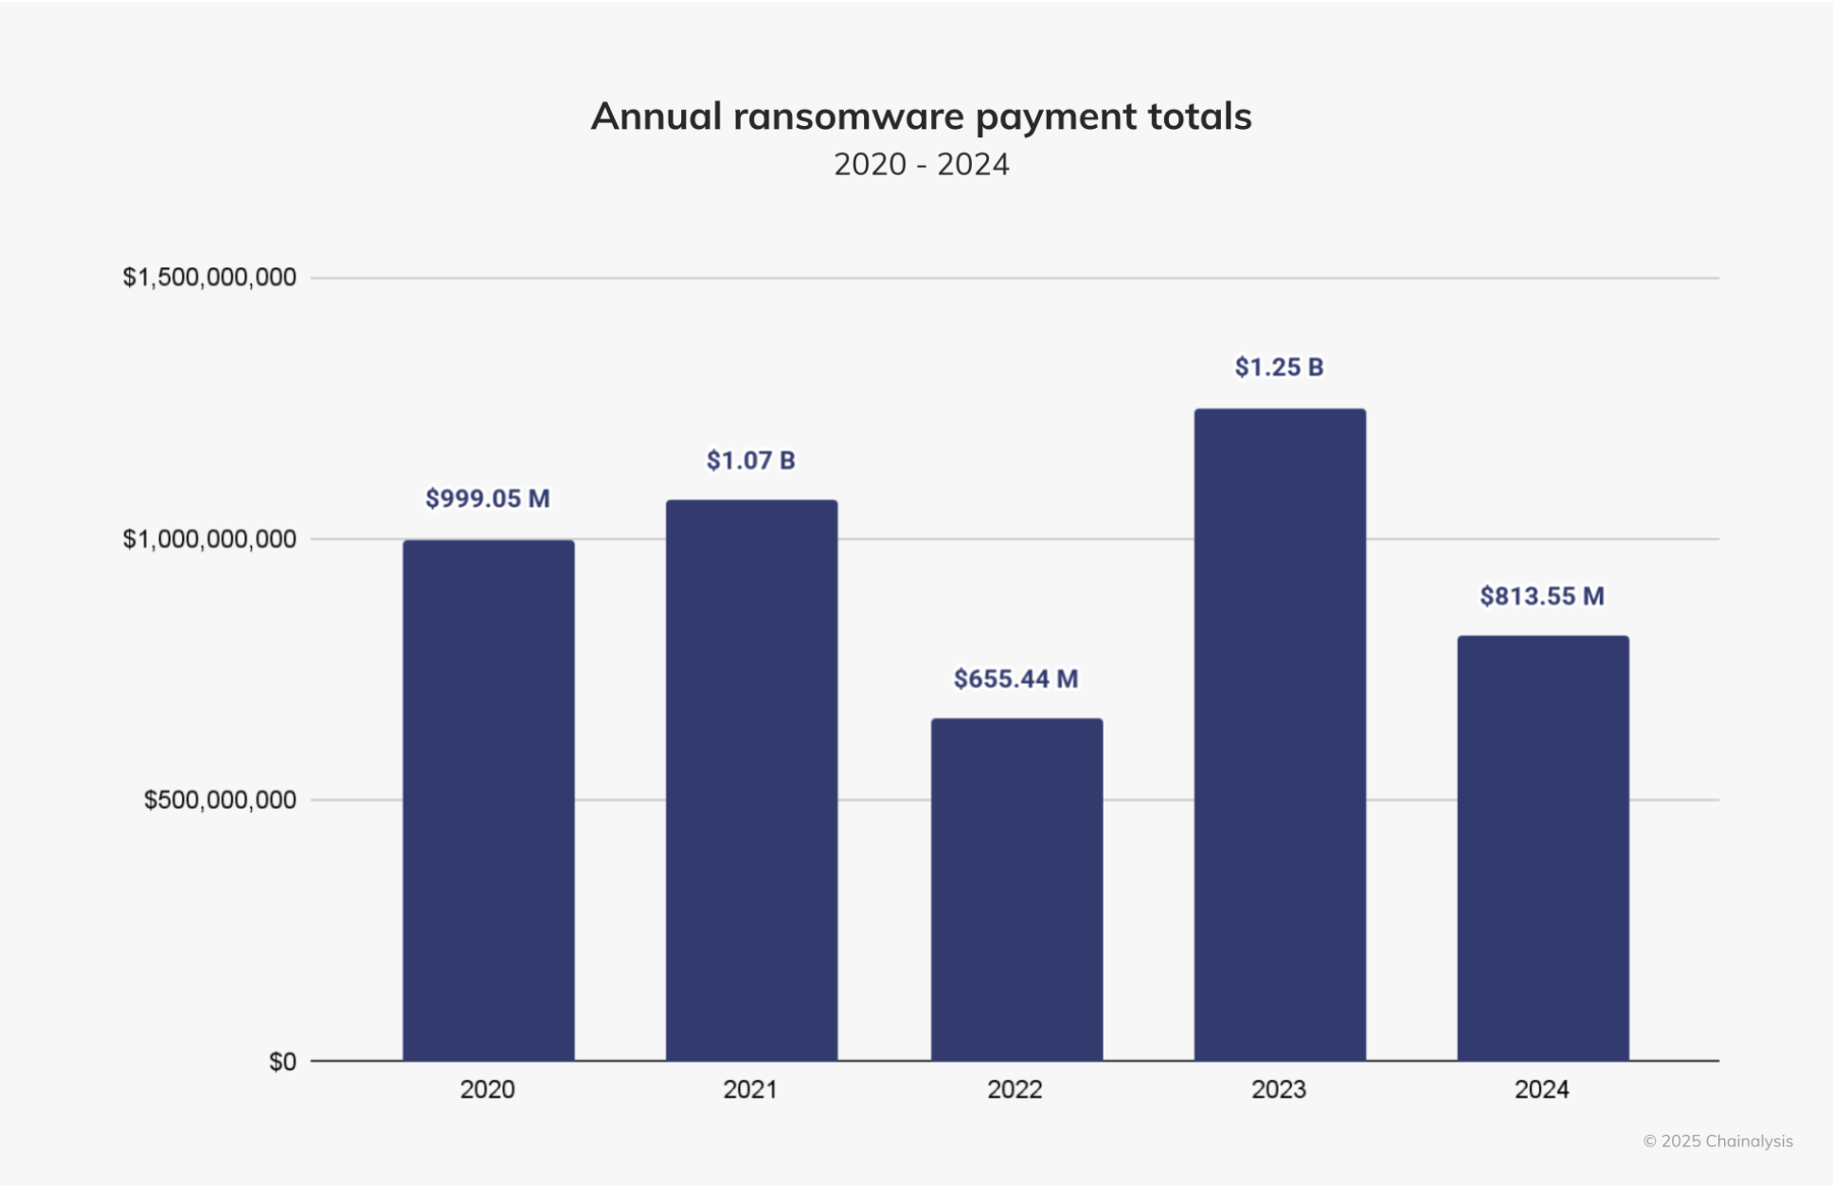
So, how bad was 2024?

Slide 15
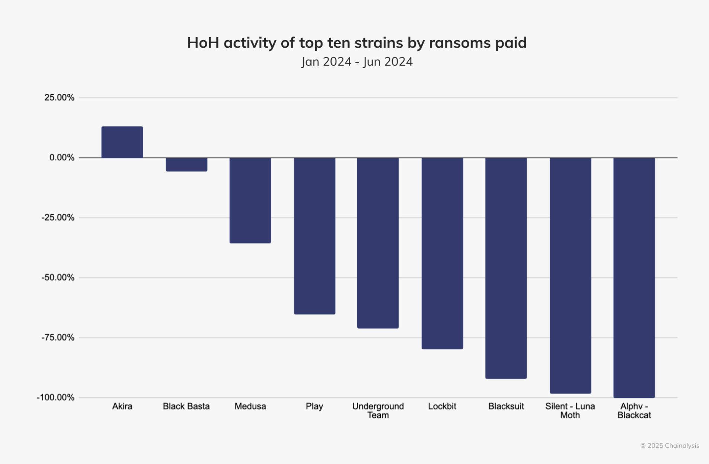
Law enforcement works?!

Slide 16
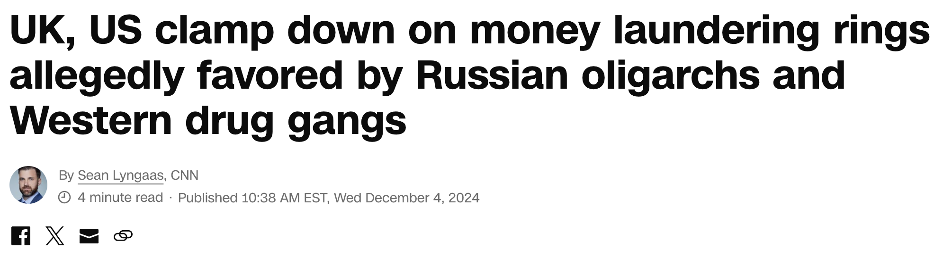

It actually does!

Slide 17
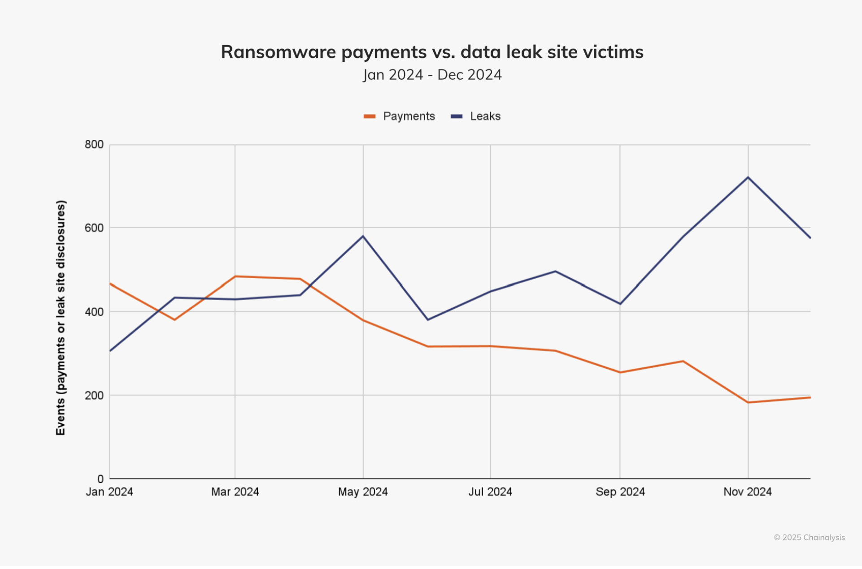
Interesting data point

Slide 18
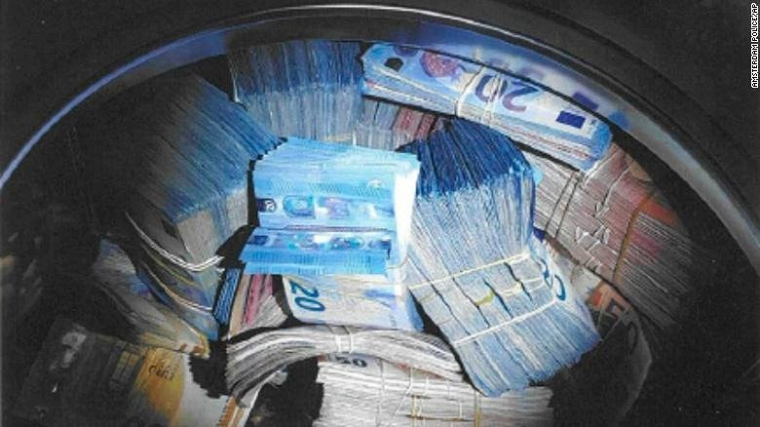
Let’s talk about laundering…

Slide 19
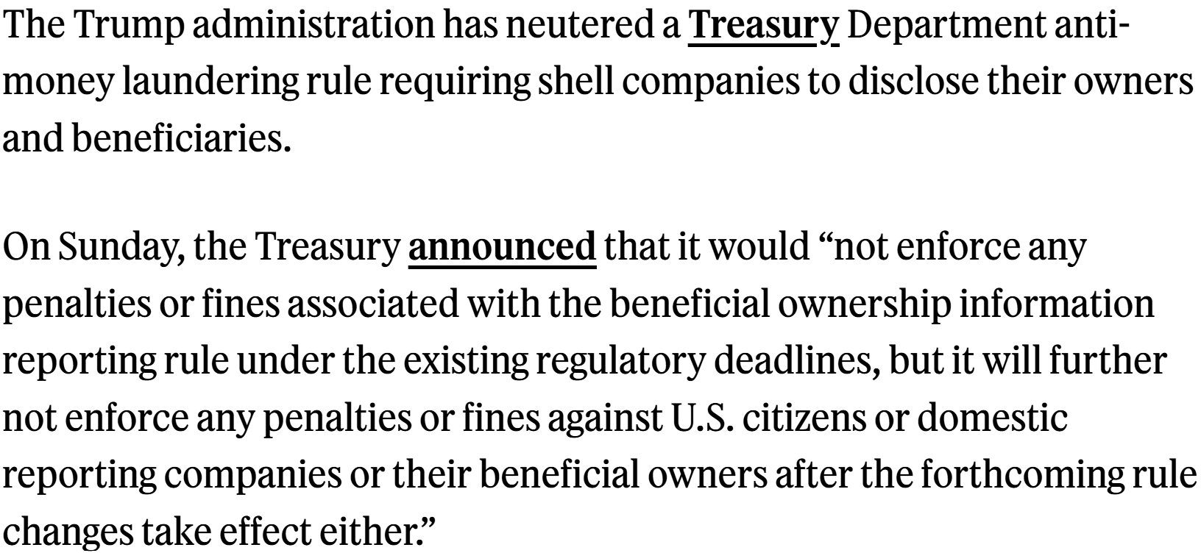


Welp.

Slide 20
Predictions? Observations?
Ukraine gives us a hint

Slide 21
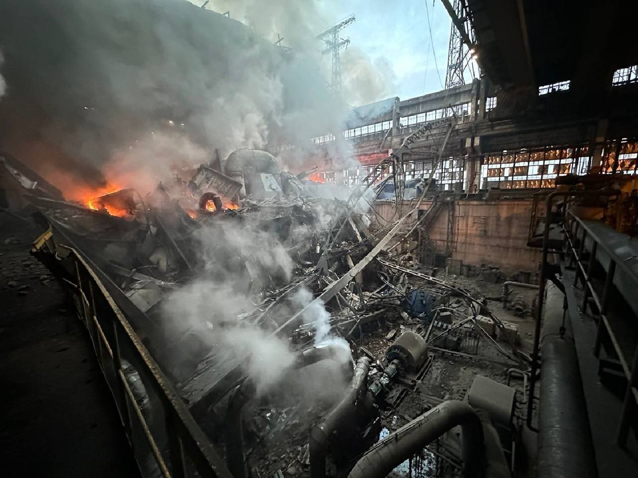
At some point, you must focus on what you can and cannot control

Slide 22
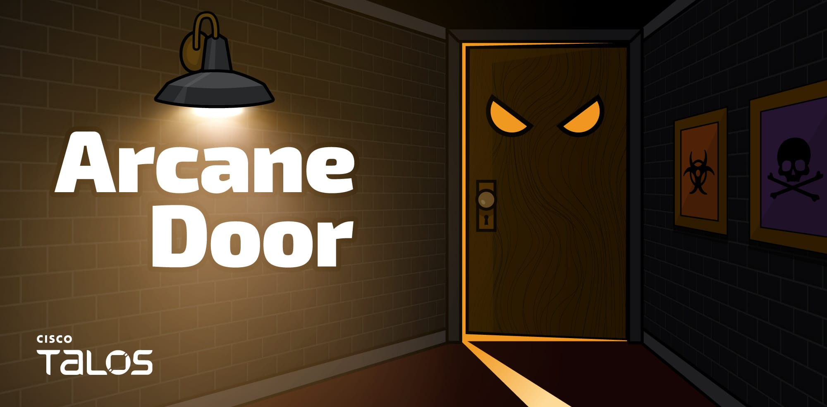
This is our world…for now

Slide 23
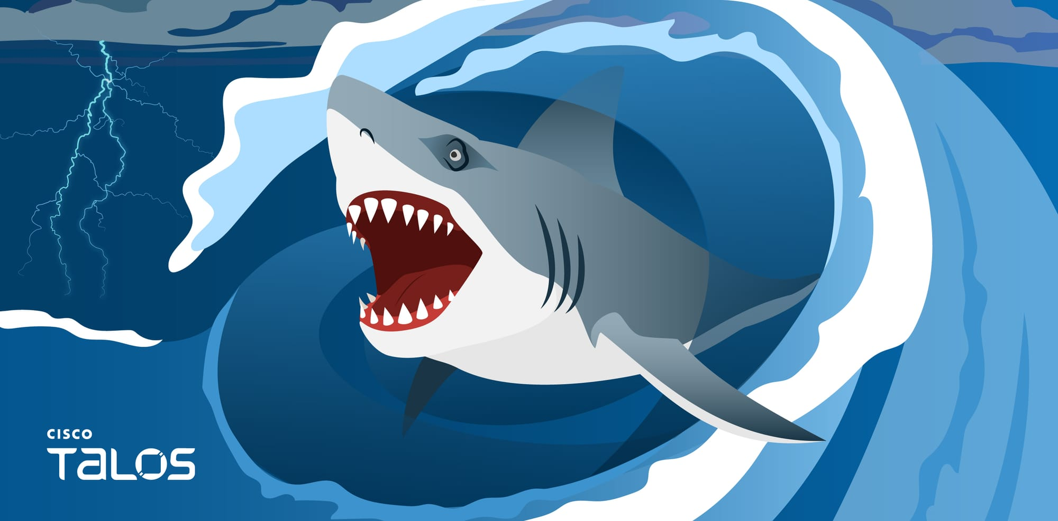
Salt Typhoon
https://blog.talosintelligence.com/salt-typhoon-analysis/

Slide 24
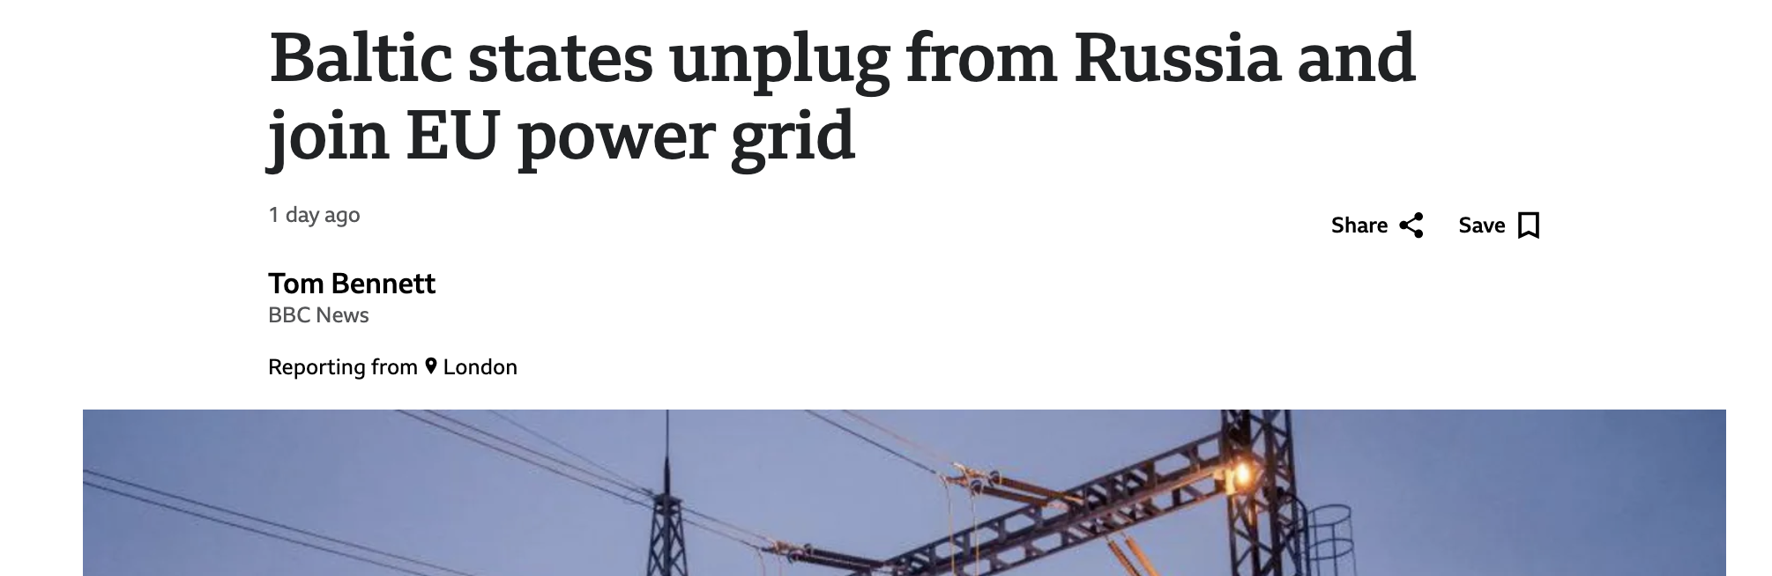
Larger Geopolitics at play

Slide 25
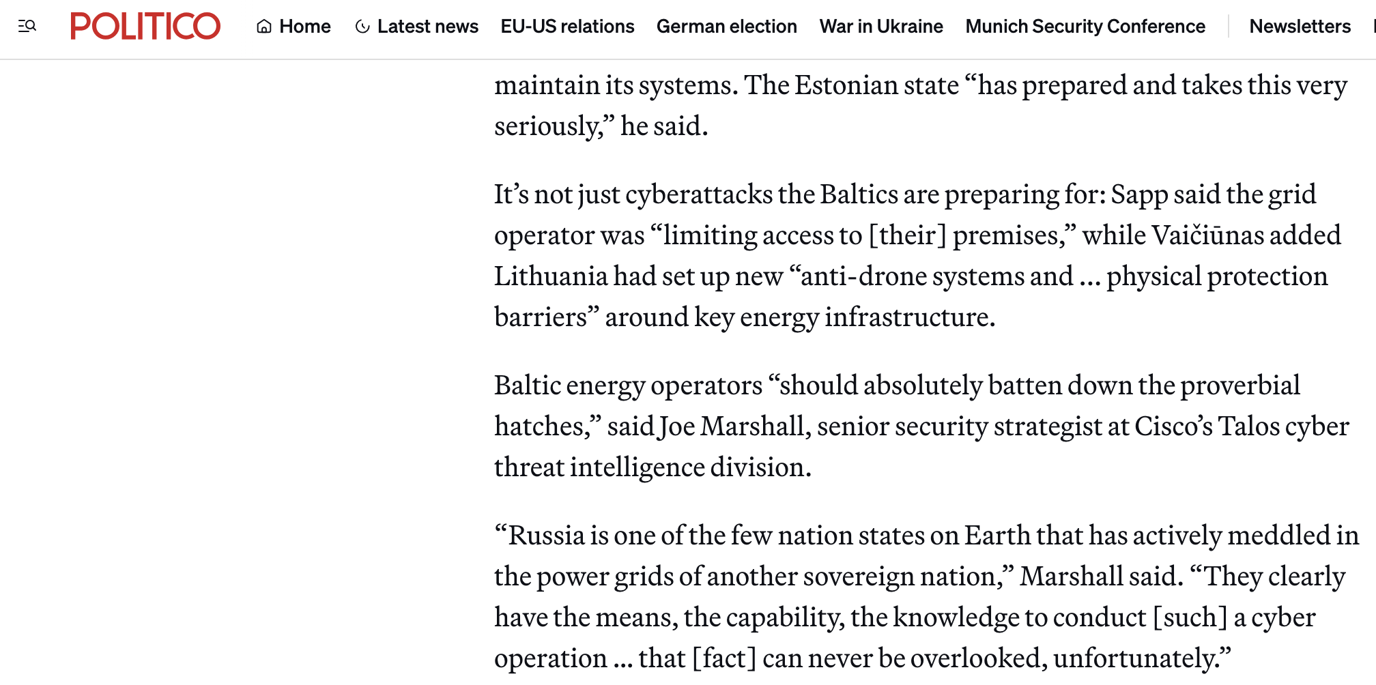



Some ’expert’ even said so

Slide 26

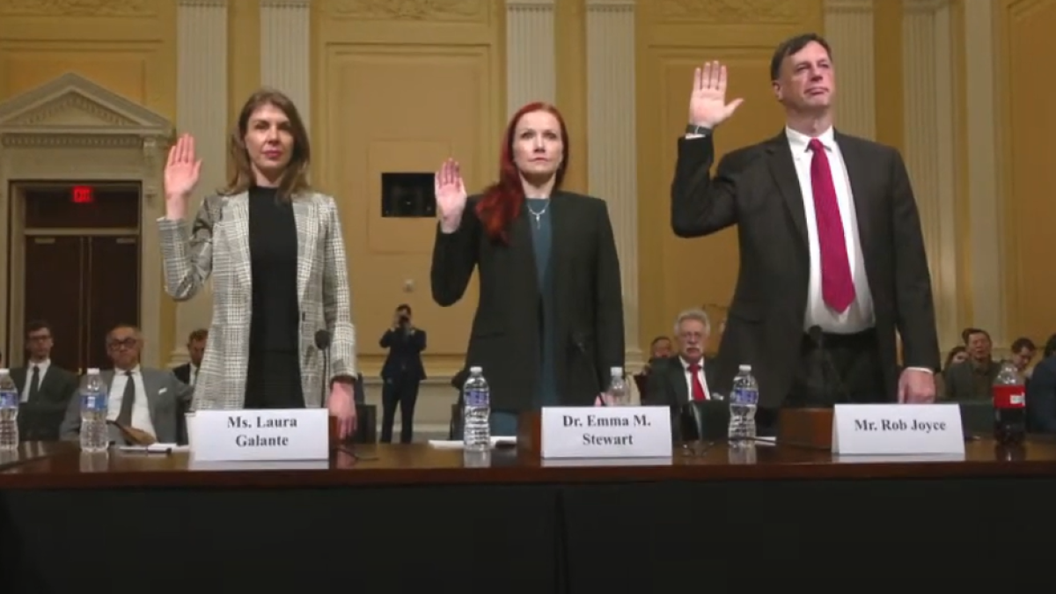
https://www.youtube.com/watch?v=FPHtzkDMPho
Seriously, go watch it

Slide 27
Saving lives in Ukraine

Slide 28
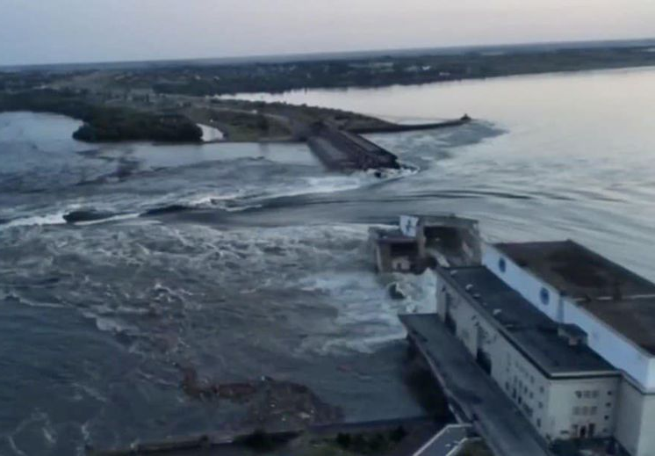
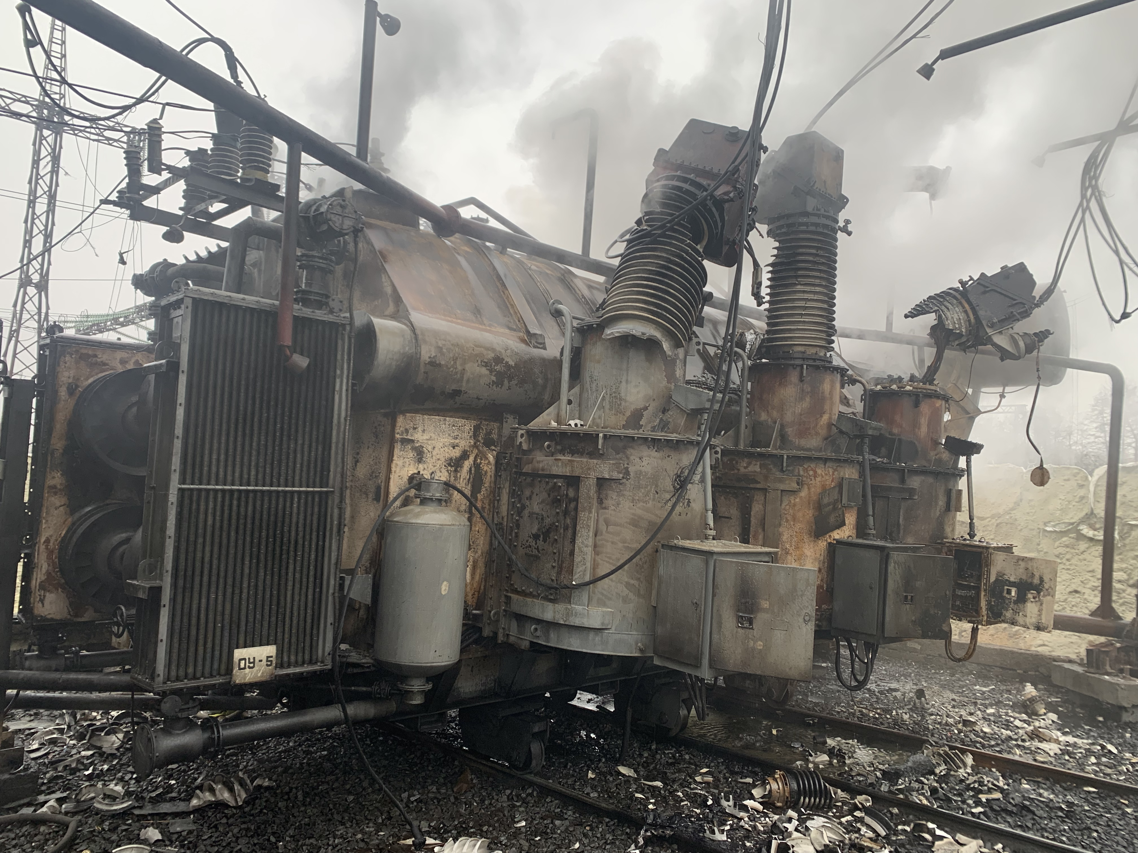
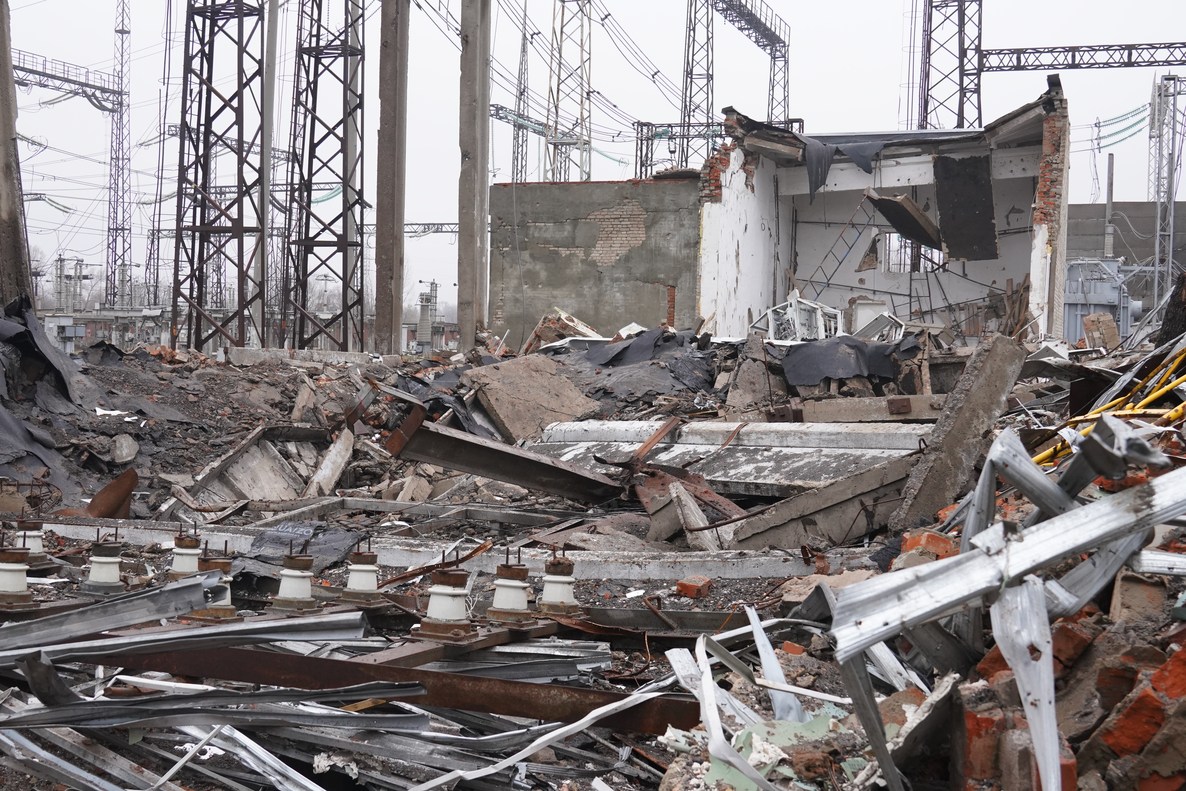
Talos is present in unique ways

Slide 29
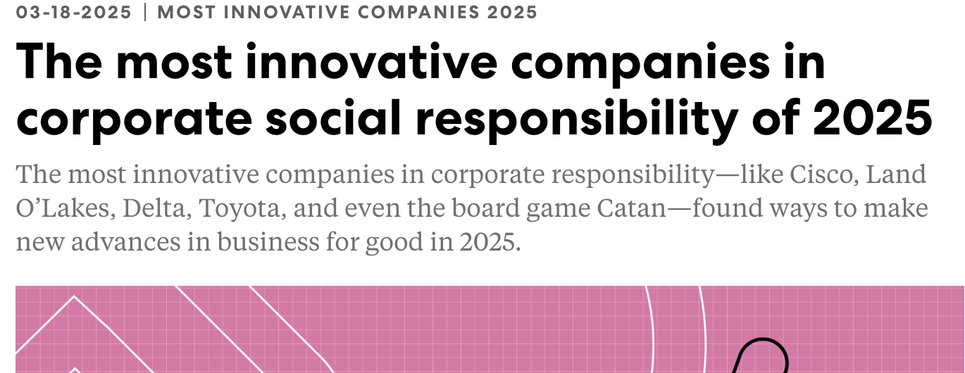
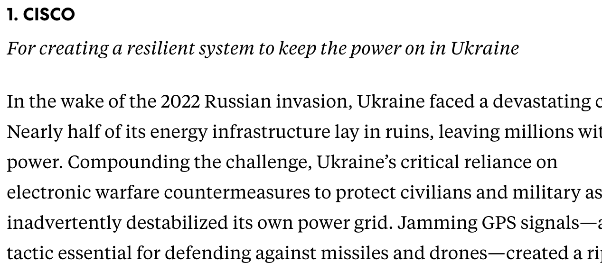
Well, this is neat

Slide 30
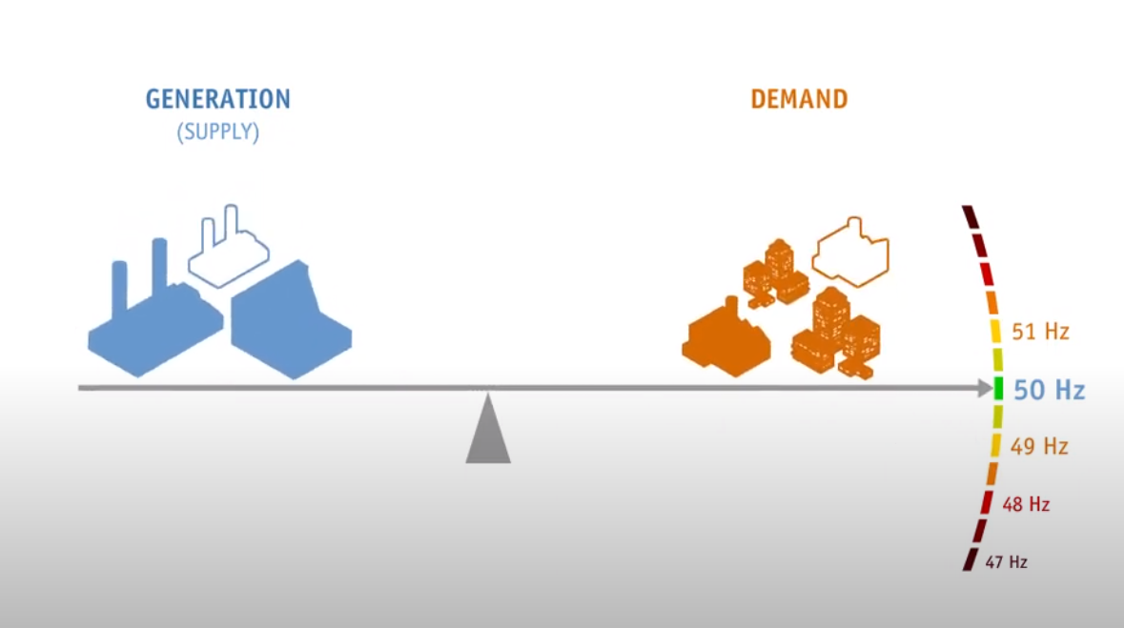
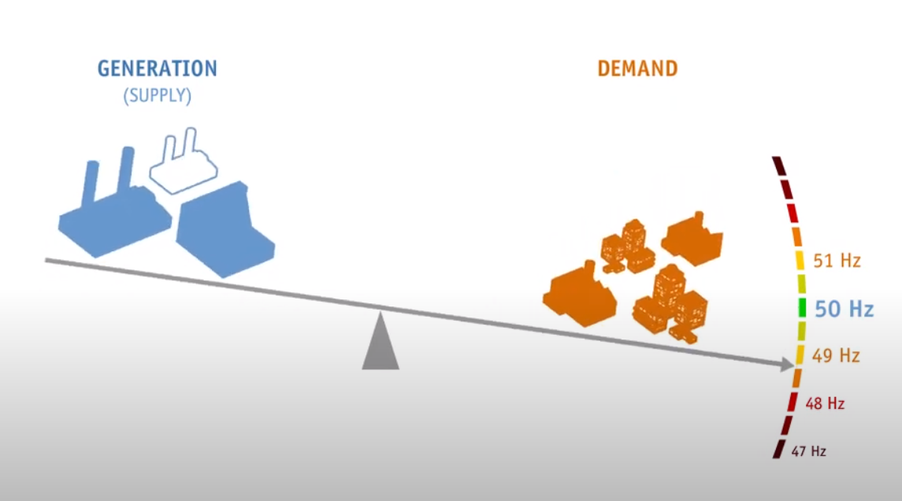
Balancing the grid
Good! ☺
Bad ☹
How do we know the balance? GPS!

Slide 31

Yep, totally. We all use GPS
GPS is also referred to generically as PNT. Precision Navigation and Time.
Without a synchronized GPS disciplined clock, managing grid balance is incredibly difficult!
Imagine electrons are in a marching band….

Slide 32

Let’s put a team together

Slide 33
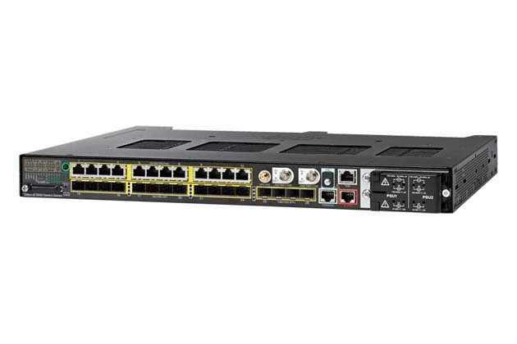

The humble IE5K
Has a robust *good enough* internal clock?
Can be rapidly obtained?
Full business BU by in?
Let’s get it done!

Slide 34
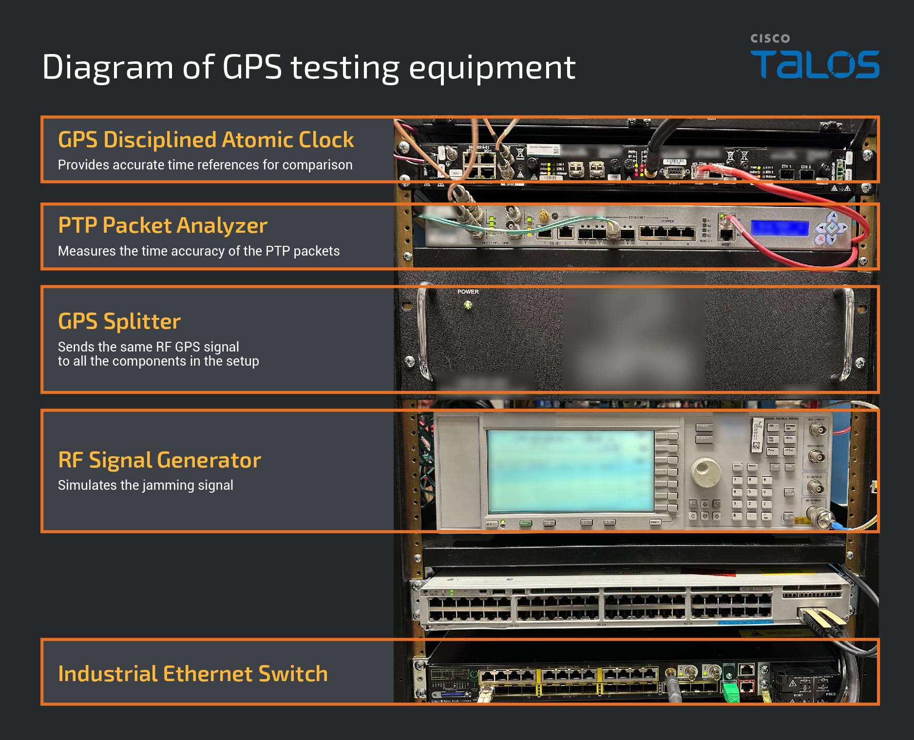
Home grown jamming test rig!
Notes:
The PMU clockClass was the trick – within PTP standards, reserved spacing for specific messaging is vital. It took a lot of trial/error to get there.

Slide 35
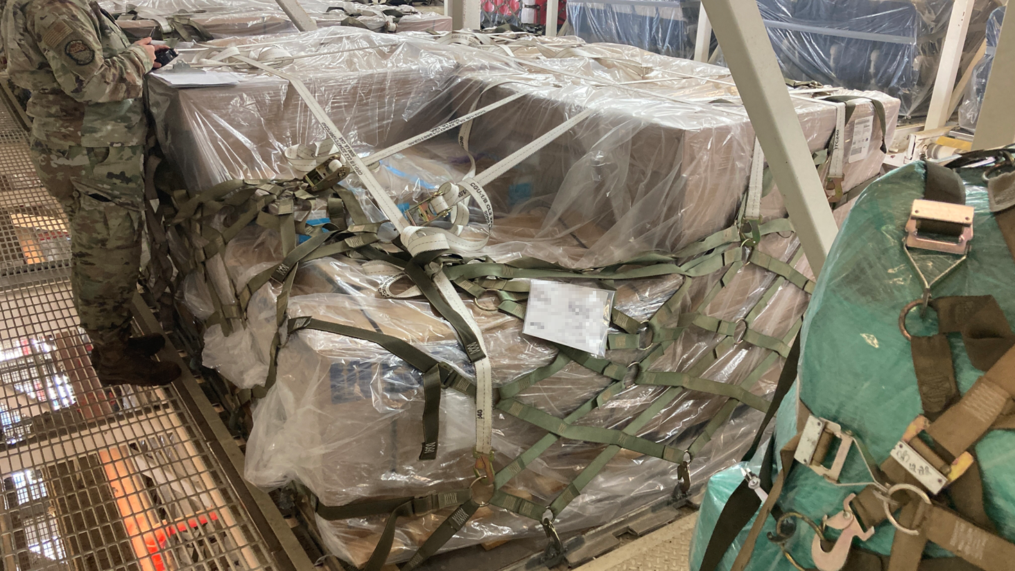
Mailing to a warzone

