Slide 1
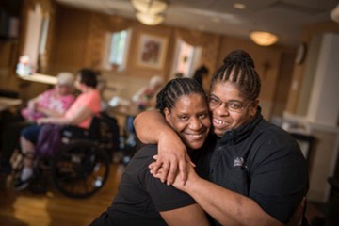
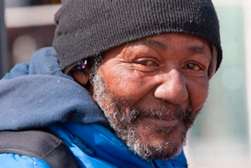
Seeing the Whole Picture: Empowering Programs with Integrated Data
DIGNITY | COMPASSION | HUMILITY | COLLABORATION | EXCELLENCE | INTEGRITY

Slide 2
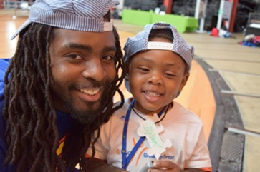
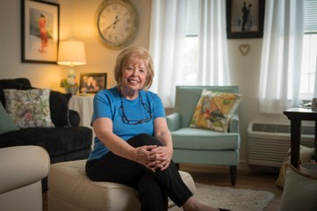
Our Challenges
Disparate Systems, Disconnected Services
80+ programs, 200 locations, multiple data systems
Leadership lack a full view of client services (behavioral health, workforce, housing, healthcare, etc.)
Data silos that create:
Inefficient and inaccurate reporting
Lack of Data Governance
Inconsistent processes
Poor documentation practices
Gaps in compliance, quality assurance, and accountability
Over 30 Systems/Applications hold client data
Duplicate Services
Missed Referrals
Operational inefficiencies
Notes:
Catholic Charities operates over 80 programs across 200 locations, delivering vital services in behavioral health, workforce development, housing, and healthcare. However, with over 30 different systems managing client data, fragmentation is a major challenge.
Front-line staff often can't see the full picture of the services a client is receiving, leading to missed connections and care gaps. Data silos create duplicate services, missed referrals, and inefficiencies that hurt both client outcomes and operational performance.
Inefficient reporting and weak data governance further limit our ability to showcase impact and meet high standards for compliance and quality. Strengthening our systems and breaking down silos is essential to fully support every client and continue building stronger communities.

Slide 3
What’s at Stake
Program-Level Impact of Disconnected Data
Wasted Resources
Gaps in Client Care
Lack of Data Governance
Funding at Risk
Inability to demonstrate impact with reliable data
Challenges meeting grant and contract reporting requirements
Inaccurate and Inefficient Reporting
Notes:
The disconnect between our systems isn’t just a back-office issue — it’s a real barrier to impact. Without a full view of services, case managers are flying blind, affecting both care and our ability to measure success.
Wasted Resources: Duplicated services and lost staff time across 80+ programs and 30+ disconnected systems.
Gaps in Client Care: Missed referrals and delayed services because we can’t see the full picture of a client's needs.
Inaccurate Reporting: Fragmented data makes it hard to track true outcomes, not just outputs.
Lack of Data Governance: Inconsistent processes, weak documentation, and limited compliance oversight.
Funding at Risk: Reliable data is critical for demonstrating impact. Without it, we risk losing grants, contracts, and the ability to grow. To continue delivering life-changing services, we must invest in stronger systems, integrated workflows, and a culture of accountability.

Slide 4

Our Current Solutions
Performance Management
Monthly meetings with Division Leadership
Review of program data to view trends and understand benchmarks
Celebration of success
Identification of areas of improvements by division leadership and analysis of challenges
Application Rationalization Through Continuous Improvement
Too many disconnected systems
Some outdated, others rarely used
Time to assess: What supports our mission? What holds us back?
Focus on alignment, integration, utilization and impact
Notes:
We’ve reached the point where the tech is in the way. Some programs cling to legacy systems because ‘that’s how we’ve always done it,’ but it’s costing us visibility, time, and outcomes. Rationalization is about stewardship — aligning our tools with our mission. Our mission is to serve people in need with dignity and impact. That starts with equipping our staff — at the program level — with the right information at the right time. Better data integration isn’t just a tech upgrade; it’s a direct investment in client outcomes.
Building Hope – myEvolv VS Esperanza Service Point Case Management
myEvolv at IG Center – VMBH, Workforce, expansion of myEvolv across CSD programs – integrated process – leads to integrated data

Slide 5
Catholic Charities of Baltimore: Enhancing Support Services with Bells AI
Challenges Before Bells AI
Extensive paperwork slowed service delivery
Growing documentation requirements
Building Hope program expansion required multilingual support after the Key Bridge collapse
The Solution: Bells AI Integration
Integrated directly into myEvolv EHR
Real-time AI-powered speech-to-text
Multilingual support to reduce errors and improved client communication
Automated assessments via the Arizona Self-Sufficiency Matrix
Improved data accuracy for reporting and funding
Results - "Bells isn’t replacing staff — it’s replacing the tasks they don’t want to do. It allows us to focus on the work that truly matters: engaging with clients."
Faster documentation, less burnout
Improved staff satisfaction
Stronger funding and reporting outcomes
More efficient bilingual case management (Building Hope)
Notes:
As demand for these services increased, we faced a significant challenge: documentation. Staff were overwhelmed with paperwork, which impacted their ability to focus on client care.
Documentation requirements were growing, not shrinking. At the same time, we were expanding services — most notably launching the Building Hope program after the Key Bridge collapse to support affected communities. Many of the new clients spoke languages other than English, making the documentation burden even heavier.
We needed a solution that was deeply integrated into our existing systems — not just a flashy new tool. After a careful review, we chose Bells AI from Netsmart, because it connected directly into our myEvolv EHR system. Bells allows staff to dictate notes in real time, document in multiple languages, and automate assessments like the Arizona Self-Sufficiency Matrix. This dramatically improved the accuracy and speed of our documentation.
Technology alone doesn’t guarantee success — how you roll it out matters. We involved staff from the beginning, asked for their feedback, and used 'super users' to champion the tool in real-world settings. Training was gradual, to make sure people were comfortable before moving on to more advanced features.“
The impact has been transformational - Staff now complete documentation much faster. Burnout has been reduced. Building Hope case managers are documenting bilingual referrals with greater accuracy. And better data has strengthened our grant reporting and funding opportunities.

Slide 6

What Front-Line Staff Need
Simple, Real-Time Access Across Programs
A user-friendly and unified view of client engagement — across all service areas
Alerts for duplicated services or missed referrals and services
Performance dashboards aligned with program outcomes
Notes:
Imagine a case manager logging into one platform and seeing: this client is receiving rental support, is in a parenting class, and just completed intake for substance use counseling. That’s the power of connected data — not just for leadership, but for the people doing the work.

Slide 7


